Slide 1
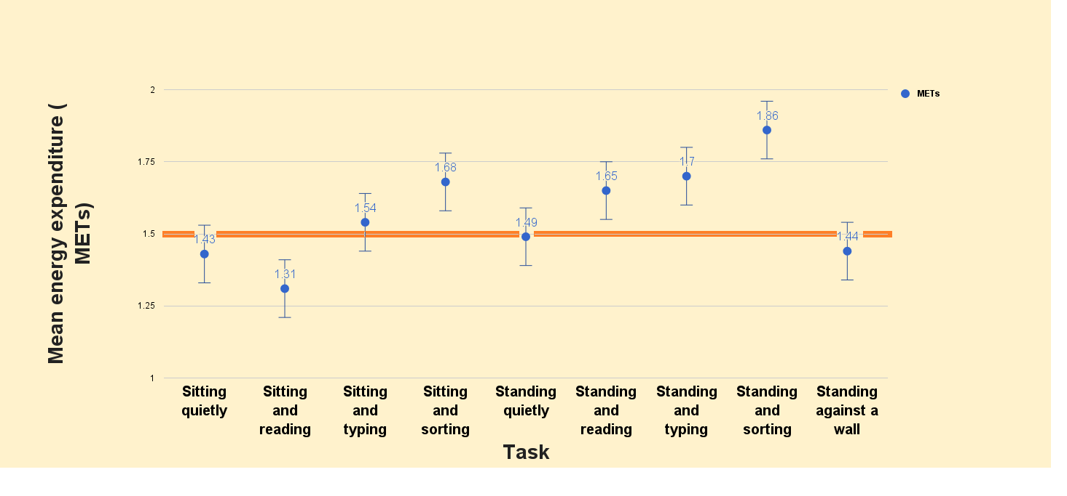
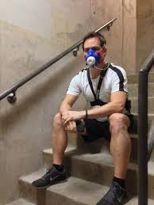
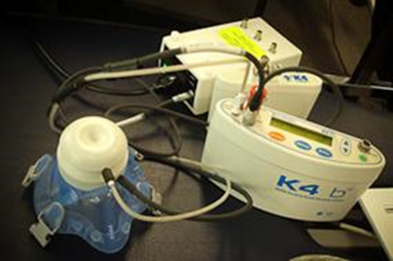



A pilot investigation among secondary school children into the energy cost of activities traditionally considered sedentary
Walsh, C. O’Sullivan, M. Purcell, S. O’Brien, C. Forde, C. Gormley, J. Dockrell, S.
Discipline of Physiotherapy, Trinity College Dublin
Introduction
The growing trend in increased sedentary behaviour (SB) and decreased physical activity (PA) levels is of concern worldwide (Gordon-Larsen et al, 2004). It is currently suggested that SB is a distinct, independent risk factor for mortality (Koster et al, 2012) and is increasingly linked with adverse health outcomes in both adults and children (Tremblay et al, 2011). SB is defined as ‘any waking behaviour characterised by an energy expenditure of ≤1.5 metabolic equivalents (METs) while in a sitting or reclining posture‘ (Sedentary Behaviour Research Network, 2012). However, the evidence supporting the accuracy of MET values for SB in the adolescent population remains sparse.
Objectives
To investigate the energy cost of common activities traditionally considered to be sedentary among secondary school children.
To classify each activity as either sedentary or active in terms of METs.
To compare the energy cost of each activity to the mean resting energy expenditure.
Figure 2: Comparison of mean energy expenditure to 1.5 METs
Figure 3: Comparison of sitting and standing activities
Figure 1: COSMED© K4b² apparatus
Discussion
The fact that some standing activities (quietly and against a wall) could be classified as sedentary in terms of METs, despite being traditionally considered as active behaviours (SBRN, 2012) warrants further investigation. Additionally, the finding that sitting behaviours involving upper limb movement could be classified as active in terms of METs is of interest. These findings may have implications for schools attempting to employ behaviours during lesson times in order to increase physical activity levels. Overall, there was no significant difference in energy cost between corresponding sitting and standing behaviours. However, the difference in the accumulation of energy expenditure for tasks carried out in different postures could be significant over time.
Method
The study was a quasi-experimental, randomised crossover trial. A convenience sample of female transition year (TY) students was used.
Inclusion criteria: TY student, informed consent and assent obtained.
Exclusion criteria: history of metabolic disease, musculoskeletal injury affecting ability to sit/stand, acute infection.
Height and weight measured with a stadiometer and weighing scales respectively. Energy expenditure was obtained using a COSMED©K4b² Gas Analysis System (Figure 1).
Participants were requested to fast for 4 hours prior to testing.
Resting energy expenditure was obtained for 15 minutes in supine. Then participants performed 9 tasks for 5 minutes, spaced 1 minute apart in random sequence (Figure 2).
A students one-sample t-test was performed comparing individual activities with ≤1.5 METs threshold. A one-way repeated measures ANOVA was conducted to compare the METs of each test condition.
Conclusions
Not all activities that were traditionally considered sedentary were in fact sedentary.
There was no significant difference between comparable sitting and standing activities in terms of energy expenditure over a 5 minute period.
This was a pilot study with a small sample size but findings suggest that further research is warranted.
Results
Ten participants (age 15±0.67 years; BMI 24.82±4.74 kg/m²) completed the study.
Results for mean energy expenditure per task measured against the ≤1.5METs threshold are displayed in Figure 2.
There was no significant difference in energy cost between comparable sitting and standing activities (Figure 3).
Standing and sorting paper was the only task which significantly expended more energy than 1.5 METs (p=0.047).
There was a significant difference in energy expended between some tasks; one-way repeated measures ANOVA (Wilk’s lambda = 0.009, F(8,2) = 26.461, p<0.05, η²=0.991). Post-hoc analysis found the energy cost of sitting and sorting, standing and typing and standing and sorting to be significantly different from sitting and reading. There were no significant differences in energy cost between any of the other tasks.
References
Gordon-Larsen, P., Adair, Linda S., Nelson, M.C., Popkin, Barry M. (2004) Five-Year Obesity Incidence in the Transition Period Between Adolescence and Adulthood: The National Longitudinal Study of Adolescent Health. Am J Clin Nutr. 80 (3), 569-575.
Koster, A., Caserotti, P., Patel, K.V., Matthews, C.E., Berrigan, D., Van Domelen, D.R., Brychta, R.J., Chen, K.Y., Harris, T.B. (2012) Association of Sedentary Time with Mortality Independent of Moderate to Vigorous Physical Activity. PLoS ONE 7(6): e37696. doi:10.1371/journal.pone.0037696.
Sedentary Behaviour Research Network (2012) Letter to the Editor: Standardized use of the terms “sedentary” and “sedentary behaviours”. Appl Physiol Nutr Metab 37:540–542.
Tremblay, M. S., Leblanc, A. G., Kho, M. E., Saunders, T. J., Larouche, R., Colley, R. C., Goldfield, G., Connor Gorber, S. 2011. Systematic review of sedentary behaviour and health indicators in school-aged children and youth. Int J Behav Nutr Phys Act, 8, 98.
walshc45@tcd.ie
@CWalshPhysio

