Slide 1

Coordination and motor skills in 22q11.2 deletion syndrome
Adam Cunningham
7th October 2017

Slide 2



Motor Problems in 22q11.2 Deletion Syndrome
Reports of children with 22q11.2 Deletion Syndrome (22q11.2 DS) having problems with:
Attaining Milestones
Balance
Predicting Motion
(Van Aken et al. 2010; Van Aken et al. 2007; Sobin et al. 2006)
Fine Motor Skills

Slide 3
Questions
How common are coordination difficulties in children with the 22q11.2 deletion?
Do children with coordination difficulties and the 22q11.2 deletion have other problems?
Do children with 22q11.2 deletion have problems in basic motor skills like tracking objects, aiming and steering?

Slide 4
Questions
How common are coordination difficulties in children with the 22q11.2 deletion?
Do children with coordination difficulties and the 22q11.2 deletion have other problems?
Do children with 22q11.2 deletion have problems in basic motor skills like tracking objects, aiming and steering?

Slide 5
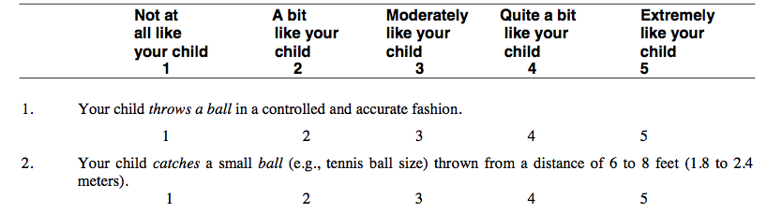
How common are coordination difficulties?
We screened for coordination difficulties using a questionnaire
Parents were asked to rate statements about their child, as compared to other children of the same age:
(Wilson et al. 2009)

Slide 6
How common are coordination difficulties?
81% of children with 22q11.2DS likely have coordination difficulties
(70 children with 22q11.2DS and
32 unaffected siblings)

Slide 7
Coordination assessment
(Movement ABC-2)
Assessed 9 children with 22q11.2 deletion syndrome who had screened positive for coordination difficulties
In collaboration with occupational therapists

Slide 8
Coordination assessment
(Movement ABC-2)
We used the Movement- ABC
Gives an overall score and scores for 3 subdomains:
  Balance
  Aiming/catching
  Manual dexterity
Notes:
http://neurobiography.info/HandLab.php?page=grasp_mabc2

Slide 9
Coordination assessment
(Movement ABC-2)
8 children had overall scores below the 5th percentile
3 below the 5th in aiming and catching
4 below 5th in manual dexterity
5 below 5th in balance

Slide 10
Questions
How common are coordination difficulties in children with the 22q11.2 deletion?
Do children with coordination difficulties and the 22q11.2 deletion have other problems?
Do children with 22q11.2 deletion have problems in basic motor skills like tracking objects, aiming and steering?

Slide 11
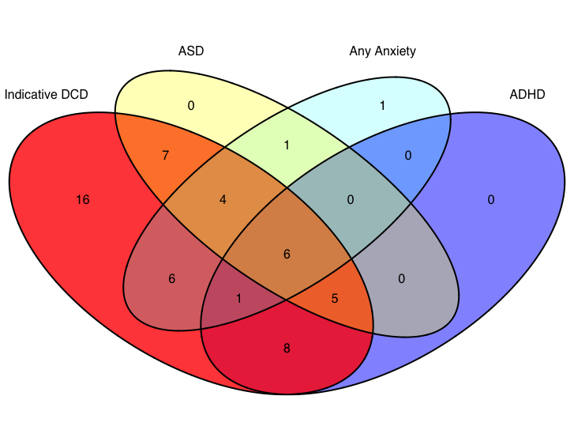
Additional Problems
Of children with 22q & coordination difficulties:
  69.8% also had at least one of ADHD, ASD or Anxiety
  30.2% had at least two
  11.3% had all three

Slide 12
Questions
How common are coordination difficulties in children with the 22q11.2 deletion?
Do children with coordination difficulties and the 22q11.2 deletion have other problems?
Do children with 22q11.2 deletion have problems in basic motor skills like tracking objects, aiming and steering?

Slide 13

Basic motor skills
Measures performance
  Accuracy, speed, jerkiness etc.
Sensorimotor data collected for:
  51 children with 22q11.2 Deletion Syndrome
  22 unaffected siblings
  (Culmer, Levesley, Mon-Williams
  & Williams, 2009)

Slide 14
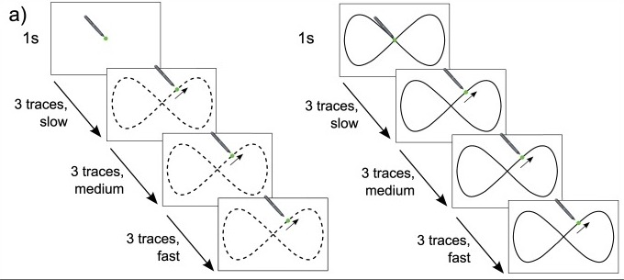
CKAT - Tracking
Relies on predicting target movement
Figure from (Flatters et al. 2014)

Slide 15
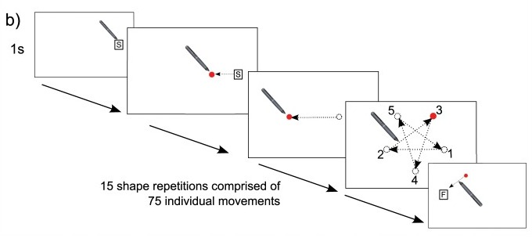
CKAT - Aiming
Relies on accurate feed forward mechanisms of control and fast implementation of online corrections
Figure from (Flatters et al. 2014)

Slide 16
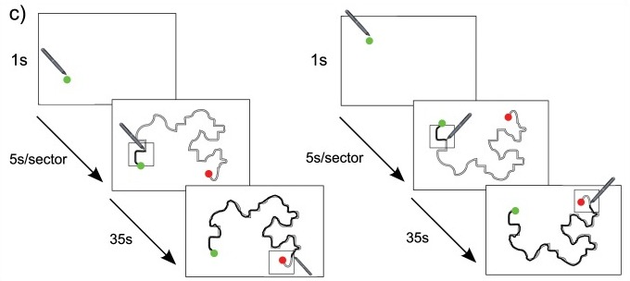
CKAT - Tracing/Steering
Relies on accurate force control
Figure from (Flatters et al. 2014)

Slide 17
Sensorimotor Performance
Children with 22q11.2 DS had lower scores on all sensorimotor tasks:
Increased tracking error
Less smooth aimed movements
Increased steering error
Older children performed better
(⬆ values indicate better performance)

Slide 18
Conclusions
Coordination difficulties are common and likely undertreated in 22q11.2DS
Coordination difficulties may be a marker of other vulnerability
Basic motor skills are impaired

Slide 19
Limitations/Future Work
Confounding sources of coordination difficulty, (e.g. neurological, hypo/hypertonic, eye movements)
Can intervention, such as with occupational therapists, help?

Slide 20








Acknowledgements
Thanks to:
Prof. Marianne van den Bree
Prof. David Linden
Prof. Sir Mike Owen
Sue Delport
Wendy Cumines
Prof. Monica Busse-Morris
Katy Hamana
The ECHO/IMAGINE teams
PAClab – Leeds University
Prof. Mark Mon-Williams
Dr. Liam Hill

Slide 21
References
Van Aken, K. et al., 2007. Motor development in school-aged children with 22q11 deletion (velocardiofacial/DiGeorge syndrome). Developmental Medicine and Child Neurology, 49(3), pp.210–213.
Van Aken, K. et al., 2010. Prospective control abilities during visuo-manual tracking in children with 22q11.2 Deletion syndrome compared to age- and IQ-matched controls. Research in Developmental Disabilities, 31(3), pp.634–641. Available at: http://www.ncbi.nlm.nih.gov/pubmed/20181458 [Accessed October 27, 2014].
Angkustsiri, K. et al., 2014. Social impairments in chromosome 22q11.2 deletion syndrome (22q11.2DS): autism spectrum disorder or a different endophenotype? Journal of autism and developmental disorders, 44(4), pp.739–46. Available at: http://www.pubmedcentral.nih.gov/articlerender.fcgi?artid=4327991&tool=pmcentrez&rendertype=abstract [Accessed October 29, 2015].
Brown, T. & Lalor, A., 2009. The Movement Assessment Battery for Children—Second Edition (MABC-2): A Review and Critique. Physical & Occupational Therapy In Pediatrics, 29(1), pp.86–103. Available at: http://www.ncbi.nlm.nih.gov/pubmed/19197761 [Accessed December 14, 2016].
Burnside, R.D., 2015. 22q11.21 Deletion Syndromes: A Review of Proximal, Central, and Distal Deletions and Their Associated Features. Cytogenetic and genome research, 27709. Available at: http://www.karger.com/Article/FullText/438708 [Accessed August 19, 2015].
Culmer, P.R. et al., 2009. A new tool for assessing human movement: the Kinematic Assessment Tool. Journal of neuroscience methods, 184(1), pp.184–92. Available at: http://www.sciencedirect.com/science/article/pii/S016502700900404X [Accessed July 21, 2014].
Flatters, I. et al., 2014. Manual control age and sex differences in 4 to 11 year old children. PloS one, 9(2), p.e88692. Available at: http://www.pubmedcentral.nih.gov/articlerender.fcgi?artid=3921207&tool=pmcentrez&rendertype=abstract [Accessed July 21, 2014].
Monks, S. et al., 2014. Further evidence for high rates of schizophrenia in 22q11.2 deletion syndrome. Schizophr Res, 153(1–3), pp.231–236. Available at: http://dx.doi.org/10.1016/j.schres.2014.01.020.
Niarchou, M. et al., 2014. Psychopathology and cognition in children with 22q11.2 deletion syndrome. Br J Psychiatry, 204(1), pp.46–54.
Richards, C. et al., 2015. Prevalence of autism spectrum disorder phenomenology in genetic disorders: a systematic review and meta-analysis. The lancet. Psychiatry, 2(10), pp.909–16. Available at: http://www.ncbi.nlm.nih.gov/pubmed/26341300 [Accessed September 8, 2015].
Schneider, M. et al., 2014. Psychiatric Disorders From Childhood to Adulthood in 22q11.2 Deletion Syndrome: Results From the International Consortium on Brain and Behavior in 22q11.2 Deletion Syndrome. Am J Psychiatry. Available at: http://dx.doi.org/10.1176/appi.ajp.2013.13070864.
Sobin, C. et al., 2006. Neuromotor deficits in children with the 22q11 deletion syndrome. Movement disorders : official journal of the Movement Disorder Society, 21(12), pp.2082–9. Available at: http://www.pubmedcentral.nih.gov/articlerender.fcgi?artid=2753869&tool=pmcentrez&rendertype=abstract [Accessed August 21, 2014].
Wilson, B.N. et al., 2009. Psychometric properties of the revised Developmental Coordination Disorder Questionnaire. Physical & occupational therapy in pediatrics, 29(2), pp.182–202. Available at: http://www.tandfonline.com/doi/abs/10.1080/01942630902784761?journalCode=ipop20 [Accessed July 12, 2014].
Cunningham et al. 2017 Developmental coordination disorder, psychopathology and IQ in 22q11.2 deletion syndrome. Br J Psychiatry (In Press).

