Slide 1

The Development of Spirituality Interest Group in the Republic of Ireland- an Innovative Response to an Emerging Hiatus
Dr. Fiona Timmins, Associate Professor, School of Nursing and Midwifery, Trinity College, Dublin

Slide 2

Co-authors
Ms. Jacqueline Whelan
Ms. Maryanne Murphy
Ms. Carole King
and
Dr. Vivienne Brady
Assistant Professors, School of Nursing and Midwifery, Trinity College Dublin.

Slide 3


Spirituality Interest
Group at Trinity College Dublin formed 2013
Agreed* terms of reference are as follows:
To raise awareness about providing spiritual care in the healthcare context.
To develop, conduct and disseminate research in the area of spirituality and spiritual care related to health and well being.
To host discussions about the topic in order hear about the work and
ideas of others in the field, and contribute to this debate.
* Survey 2014 n=17
The group aims:
To provide a platform to develop a greater awareness of the need to provide spiritual care.
To provide a platform to develop a deeper understanding of the concept of spiritual care.
To provide a space to promote, debate and discuss the role of spirituality in health care

Slide 4
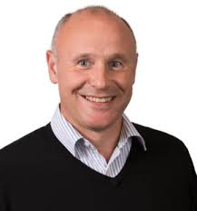
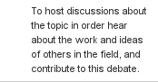
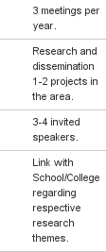
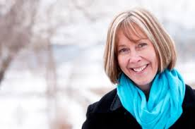
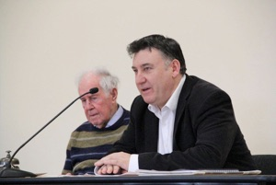
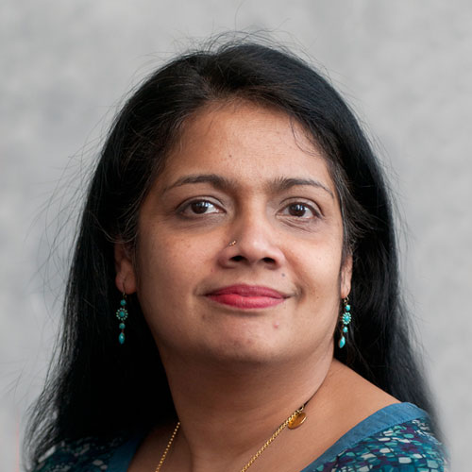
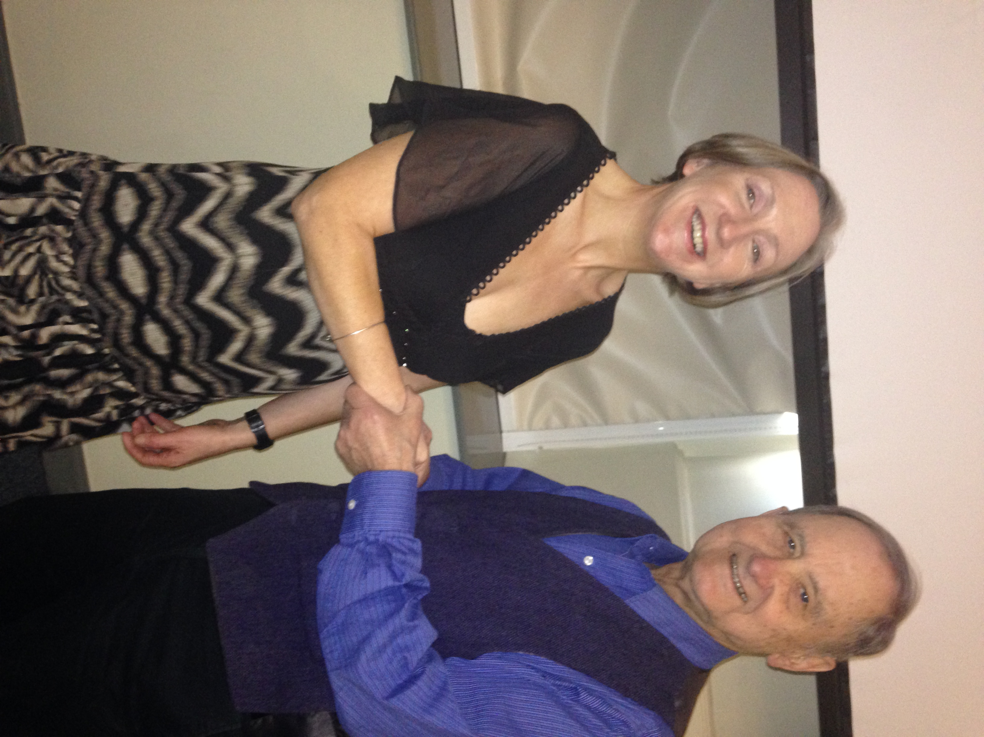
Achievements so far
Interdisciplinary & International
Within End of Life and Palliative Care in Malignancy and Non-Malignancy research theme at SONM
Membership grown from 17 in 2013 to 36 in 2015.
From 82% SONM staff to 44% in 2015.
Hosted 8 meetings, Two visiting professors visits, 15 presentations, 6 public lectures and the first spirituality in healthcare conference in Ireland.
Membership Centre for Spirituality Studies University of Hull, UK.
Membership British Association for the Study of Spirituality, UK

Slide 5
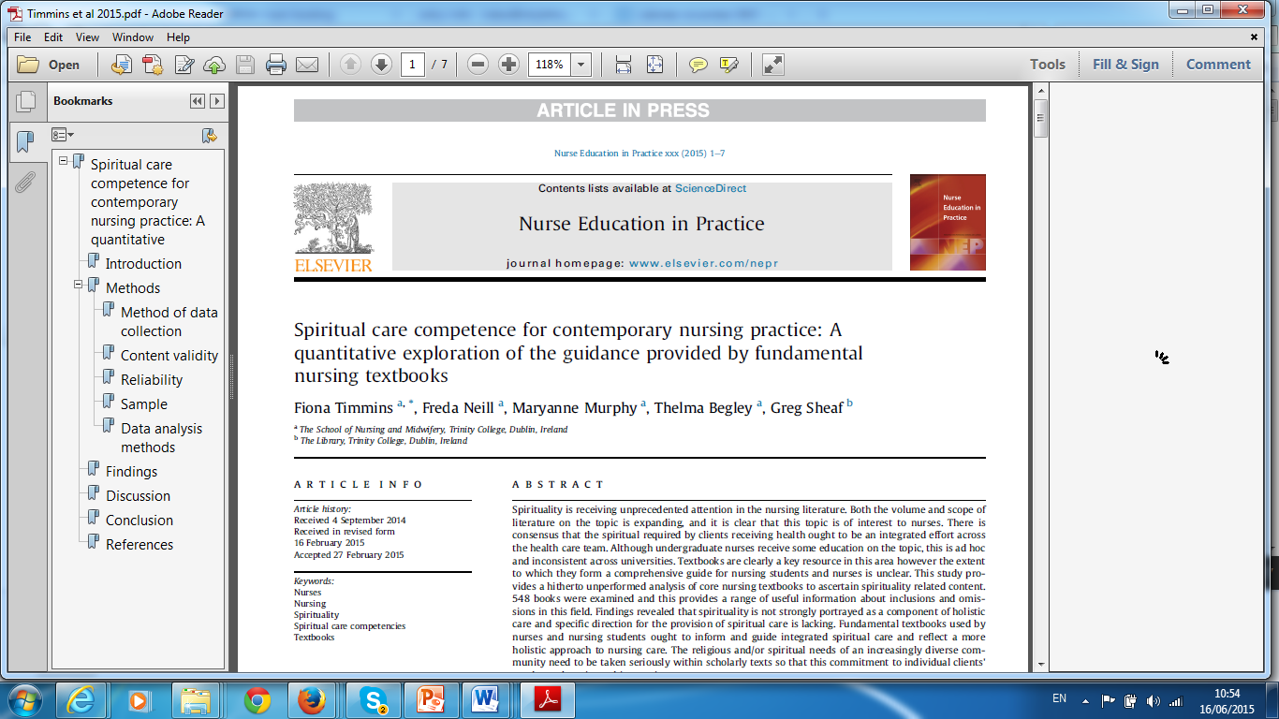
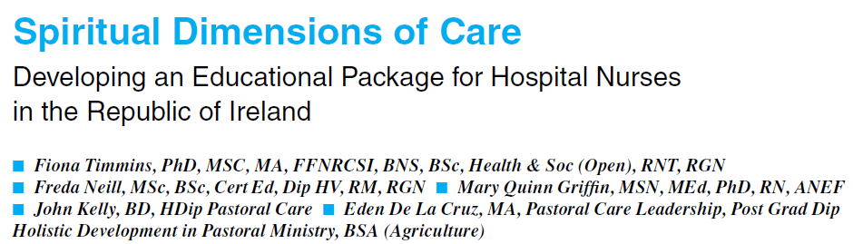
Achievements so far
4 hour educational Package for nurses and other health care workers developed and tested (Timmins et al 2014).
Audit of nursing textbooks 2013.
Future web based provision a possibility.
A Systematic Review (SR) of the Experience of Spirituality from the Perspective of People Living with Dementia

Slide 6
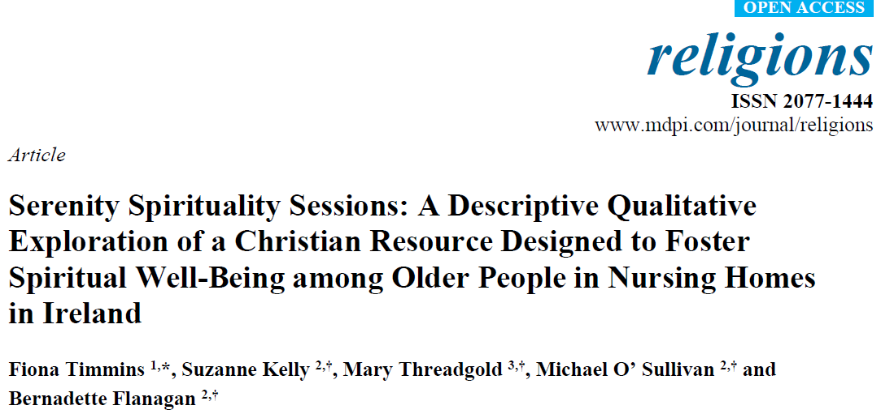
Achievements so far
Funding application (2012 & 2014):
The establishment of a European Spirituality Nursing and Midwifery Research Network to aid the scientific exploration and advancement of spirituality and spiritual care European Committee of Science and Technology (COST)
Funding application (2014):
Wellcome Trust small grants
Funding application (2014):
HRB and Wellcome Trust Post Doctoral Fellowship Support
Funding application (2014):
Marie Curie Post Doctoral Fellowship Support
Member of Centre for Spirituality Studies / University of Hull, UK.
Member of British Association for the Study of Spirituality, UK.
Membership HSE Multifaith Council.

Slide 7
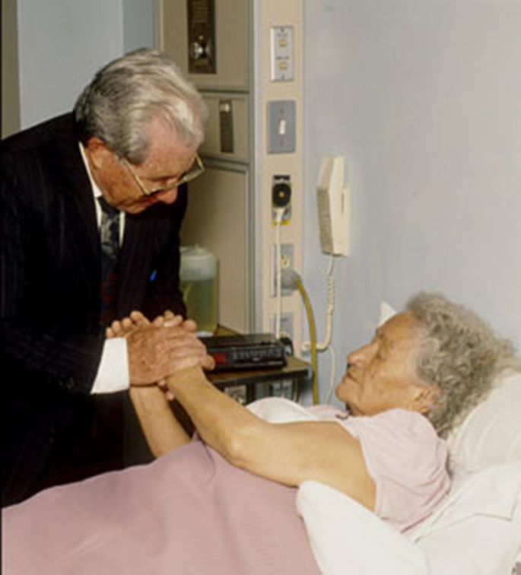
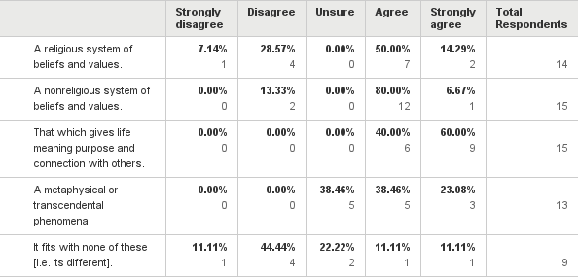
Spirituality is:

Slide 8

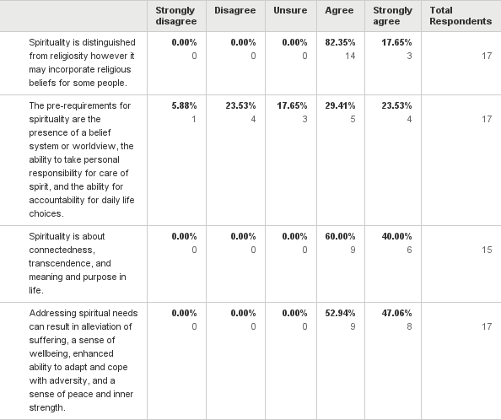
Spirituality (Weathers et al 2013):

Slide 9
Spiritual distress is defined as:

Slide 10
Please indicate whether or not you agree that these related activities are relevant to the provision of spiritual care in health care settings.
Answered: 17 Skipped: 0

Slide 11
Outline the extent to which you agree that the Group needs to do the following:

Slide 12
Our vision for integrated Spiritual Care
“Health care professionals must be guided by the individual patient with his/her individual spiritual needs whether directly or indirectly expressed. ” (Mc Sherry 2006).
“The concept of a shared responsibility underpins the idea of inter-and-intra professional collaboration. Without collaboration spiritual care provision will be only partially effective. ..spiritual care is very much dependent upon a synergy between all health care professionals, patients and their significant others “(Mc Sherry 2006).

Slide 13
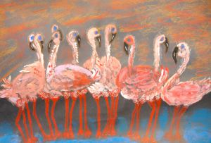
SIG looking forward
Improve practitioners knowledge and awareness in practice.
Link research endeavours nationally (Spiritual Academic Centre).
Focused research agenda.
Contribute to national policy in an active way.
Explore and support stand alone research theme in the SONM.

Slide 14
References
Caldeira, S., Carvalho, E., Vieira, Z. (2013). Spiritual distress – proposing a new definition and defining characteristics. International Journal of Nursing Knowledge, 24(2), 77-84.
McSherry, W. (2006) The principal components model: a model for advancing spirituality and spiritual care within nursing and health care practice Journal of Clinical Nursing 15, (7) 905-917.
Weathers, E., McCarthy, G., Coffey, A. (2015). Concept analysis of spirituality: an evolutionary approach. Nursing Forum, Retrieved from [http://www.ncbi.nlm.nih.gov/pubmed/25644366]. 20 February 2015.

