Slide 1

OpenAIRE and the Case of Irish Repositories
Jochen Schirrwagen, University of Bielefeld
RIAN OpenAIRE Day and Workshop
27 Nov 2015

Slide 2

AGENDA
OpenAIRE explained briefly
Data Provider Guidelines / OA in H2020
The Case of Irish Repositories
Important Metadata Properties
  Referencing funding
  Data-publication linking
Repository Platform Support
Connect your Repository with OpenAIRE

Slide 3
OpenAIRE explained
Briefly
1/6

Slide 4

Open Access infrastructure
OpenAIRE
for research in Europe
www.openaire.eu

Slide 5

From the OA Pilot in FP7 to the Key Infrastructure for the OA Mandate in H2020
OpenAIRE
Dec. 2009 - Nov. 2012
OpenAIREplus
Dec. 2011 – Dec. 2014
OpenAIRE2020
Jan. 2015 a Jun. 2018

Slide 6
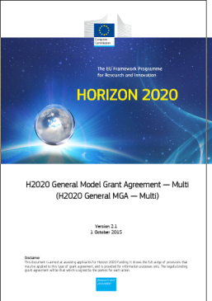
Open Access in Horizon 2020
The grant agreement states:
“Ensure open access…
as soon as possible and at the latest on publication, deposit a machine-readable electronic copy of the published version or final peer-reviewed manuscript accepted for publication in a repository for scientific publications”
http://ec.europa.eu/research/participants/data/ref/h2020/mga/gga/h2020-mga-gga-multi_en.pdf

Slide 7
FUNDERS
Many funders have now stipulated Open Access to results!
MANDATES
Many have Open Access mandates in place!
REPOSITORIES
But how often are these outputs linked to funding details?

Slide 8






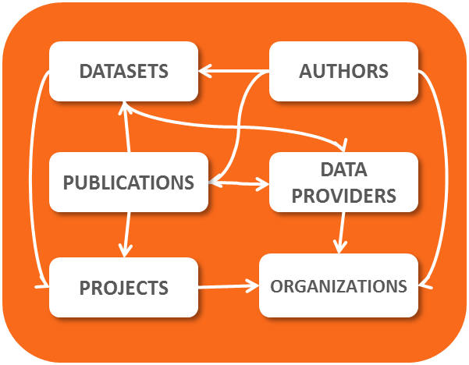

Project & Infrastructure
  Guided by OA funder policies (European Commission)
Participatory approach (human & e-infrastructure)
  Integrated Scientific Information System

Slide 9
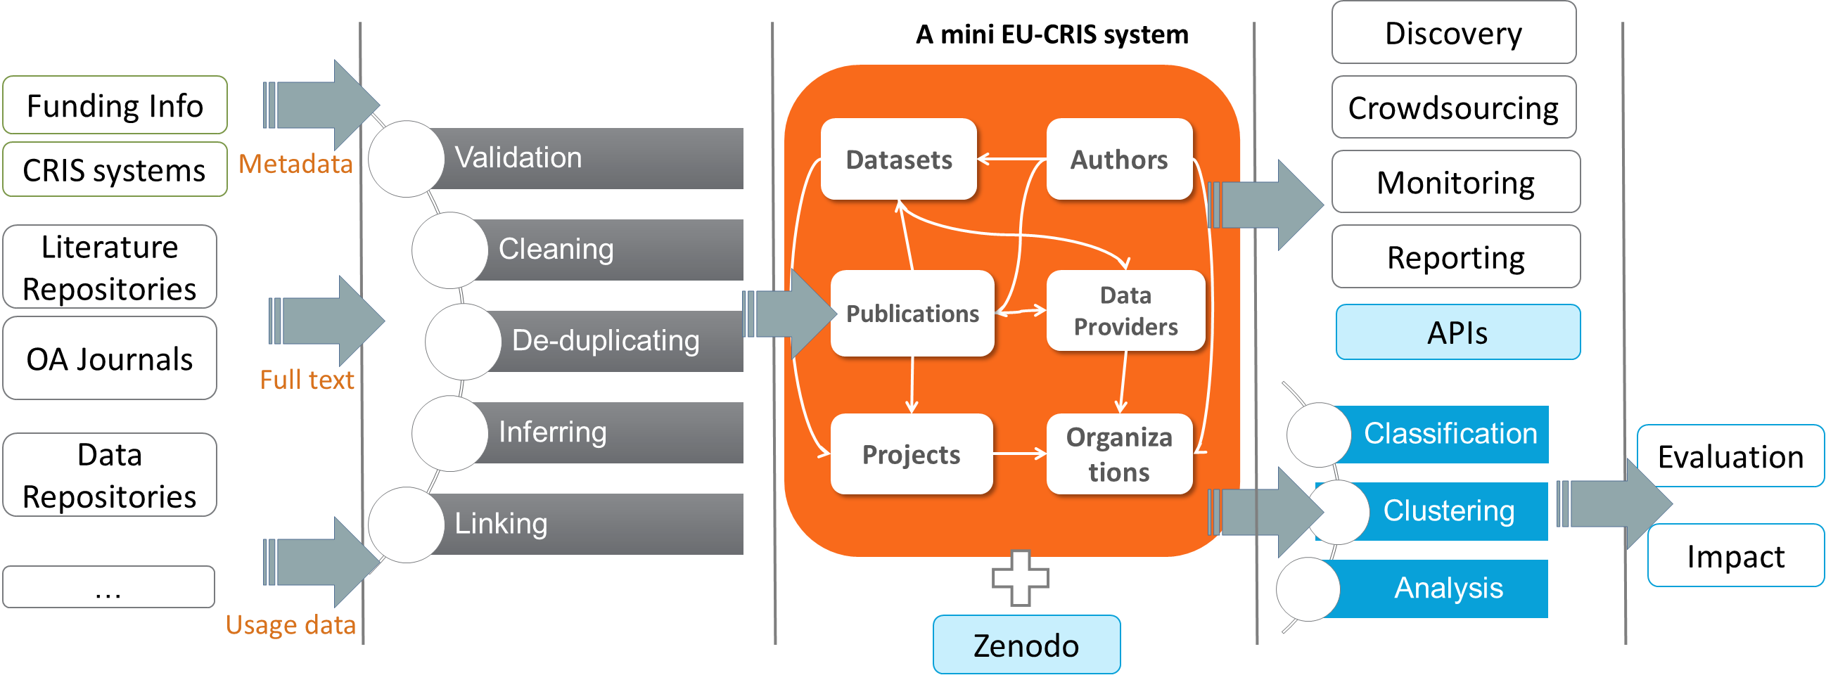
Data Providers
OpenAIRE Platform
Services

Slide 10
Selection of a growing List of OpenAIRE Services - I
Validation and Aggregation
  Repository metadata follow some rules to ease aggregation
Claiming
  Let user set links to funding or related research output
Monitoring and Reporting of research results
OA-Broker Service (in prep.)
  Distributes enriched metadata to subscribed repositories
  Notifies about paper of affiliated author deposited in another repo.
Text & Data Mining (TDM) on fulltext files
  Extracts project references, citations; calculate classification

Slide 11
Selection of a growing List of OpenAIRE Services - II
Usage Statistics about repository content (in prep.)
  As one indicator to assess impact of research output
FP7 Post Grant OA Pilot
  Authors can request funds for post-grant publications
LOD-Service (in prep.)
  Publishes OpenAIRE Information Space into the Linked Data Cloud as part of the global interlinked knowledge space
Data-Literature Interlinking Service
  Prototype outcome of the RDA/WDS Publishing Data Group
  Stakeholder collaboration aiming to interlink research output
Open Peer Review (in prep.)

Slide 12
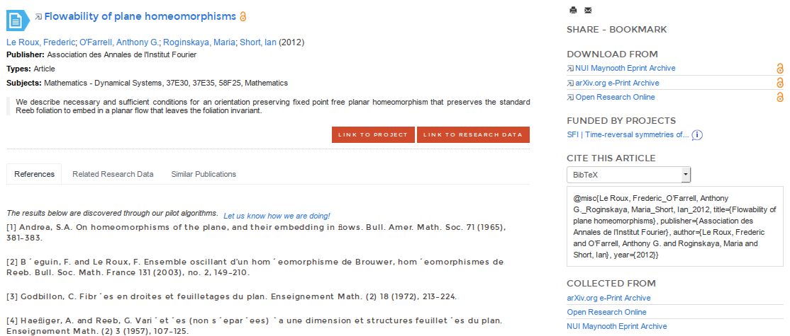
Enriched Document Example
Funding Info either from metadata or by text mining
Multiple Instances host the same document (which is de-duplicated)
Plain Bibliographic information from metadata
Findings from Text Mining / Inference

Slide 13
Data Provider Guidelines
OA in H2020
2/6

Slide 14
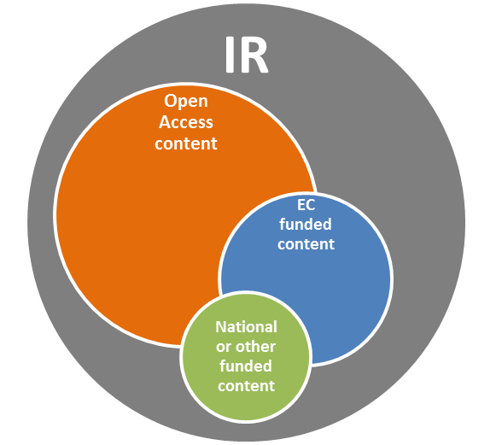
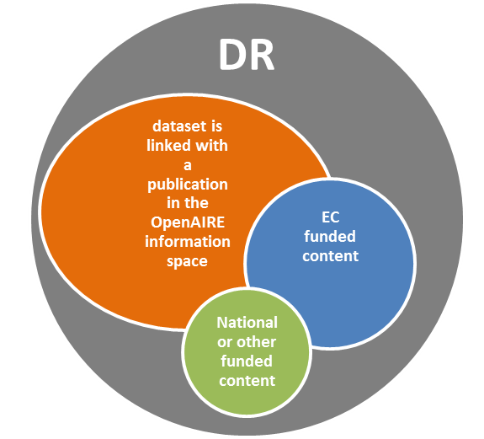
Content acquisition policy
Publications in OpenAIRE
Data in OpenAIRE

Slide 15
OpenAIRE OAI-Set
Using the OAI-Set as a mechanism to follow the Content Acquisition Policy
  See https://www.openaire.eu/content-acquisition-policy/content-acquisition-policy/content-acquisition-policy
 | setName | setSpec*
Literature Repos. | OpenAIRE | openaire
Data Repositories | OpenAIRE Data | openaire_data
Notes:
1. The OAI-PMH protocol states that the Repositories may organize items into sets. Set is a standard component of the OAI-PMH and are used to filter specific parts of a repository. This slide shows the preferred setName and setSpec that can be used to create the OpenAIRE set.
2. For harvesting of records relevant to OpenAIRE, the use of a specific set (OpenAIRE Set) at the local repository is mandatory.
3. EC_fundedresources is the OpenAIRE set. The specific content of the 'ec_fundedresources' set is to be determined at the local repository, but All the resources that will be harvested must be outcomes from research projects funded by the EC, and are peer-reviewed.

Slide 16



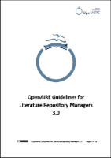
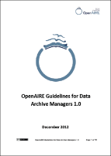
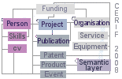



3 Guidelines for Data Providers
Literature Repositories
(and journal platforms)
Dublin Core (DRIVER)
Data Repositories
(and archives/data centres)
Datacite
CRIS systems
  CERIF-XML

Slide 17
OpenAIRE Compatibility – in different versions of the Guidelines
OpenAIRE
basic
Only Open Access content
OpenAIRE
2.0
EC funded content
OpenAIRE
2.0 +
Open Access and/or EC funded and/or National/other funded content
OpenAIRE
3.0
Open Access and EC funded content
via driver oai set
via ec_fundedresources oai set
via driver and ec_fundedresources oai set
via openaire oai set

Slide 18
The Case of Irish Repositories
In BASE and OpenAIRE
3/6

Slide 19
Aggregated Repositories
Repo-Name | Platform | BASE OA-Status | OpenAIRE Compatibility
The Health Well |  | ? | 3.0
National College of Ireland: TRAP@NCI | Eprints | ? | n/a
CUAL Repository | DSpace | 28% | n/a
MIRR | Dspace | ? | n/a
STÓR | Eprints | ? | n/a
DBS Esource | Dspace | ? | n/a
T-Stór | Dspace | ? | n/a
NDLR | Dspace | 56% | n/a
OAR | Dspace | ? | OA-Basic (DRIVER)
National Documentation Centre on Drug Use | Eprints | ? | n/a
CORA | DSpace | 48% | OA-Basic (DRIVER)
LENUS | Open Repository | 1% | n/a
Repo-Name | Platform | BASE OA-Status | OpenAIRE Compatibility
e-publications @RCSI | Digital Commons | 8% | 3.0
ARAN | Dspace | ?
ULIR |  | 19% | 3.0
ARROW@DIT | Digital Commons | 2% | OA-Basic (DRIVER)
UCD | Dspace | ? | OA-Basic (DRIVER)
WIT | Eprints | 1% | OA-Basic (DRIVER)
TARA | Dspace | 10% | 3.0
DORAS | Eprints | 93% | OA-Basic (DRIVER)
NUI Maynooth Eprint Archive | Eprints | 6% | OA-Basic (DRIVER)
UCD-Data |  | n/a | 2.0 Data
SFI |  | n/a | native

Slide 20
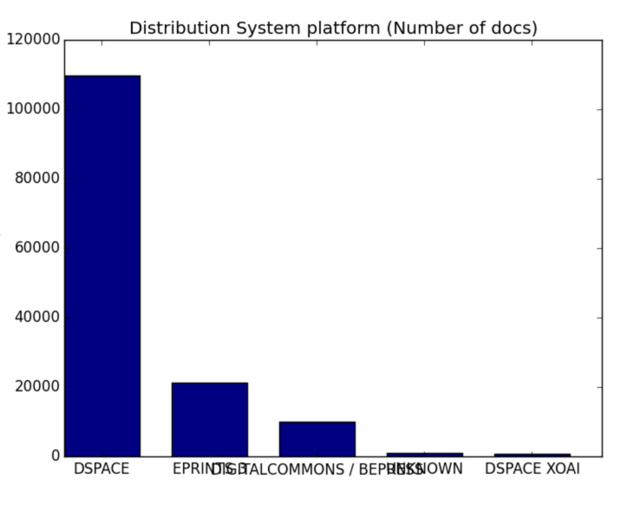
Irish Repositories in BASE
21 Repositories with 148610 documents (27-Nov-2015)
26957 are OA (definitely)

Slide 21
Questions
Are there more repositories which are not registered in OpenDOAR?
There are no OJS installations listed. This is quite uncommon compared with other countries. What could be the reason for that?
Up to now we have not noticed CRIS instances in Ireland. Is there a development on-going to install CRIS systems with repository functionality or vice-versa repositories with CRIS functions (e.g. DSpace IRIS)?
What is the status of the RIAN aggregator?

Slide 22
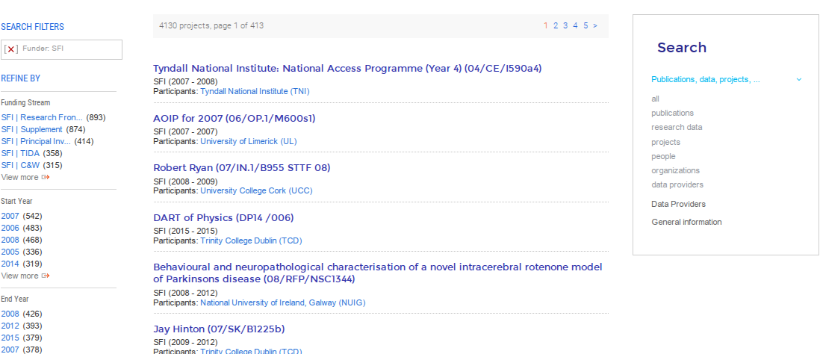
SFI funding information (beta)
4130 grants from SFI (June-2015)

Slide 23
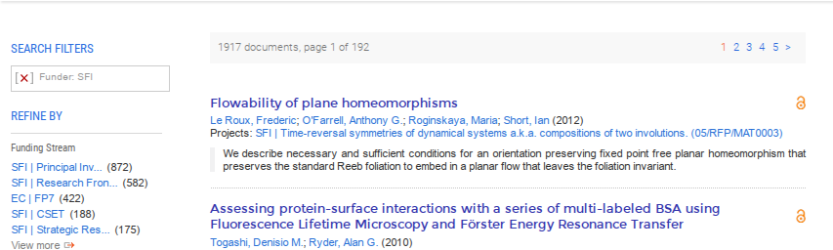
SFI funding information (beta)
1917 documents with references to SFI grants

Slide 24
Important Metadata Properties
Referencing funding
Data Publication Linking
4/6
Notes:
* Explain for oai_dc and oai_datacite

Slide 25
projectID
Element name | projectID
DCMI definition | dc:relation
Usage | Mandatory (if applicable)
Usage instruction | A vocabulary of projects is exposed by the OpenAIRE API: http://api.openaire.eu/#cha_projects_http , and available for all repository managers. Values include funder, project name and projectID. The projectID equals the Grant Agreement number, and is defined by the namespace: info:eu-repo/grantAgreement/Funder/ FundingProgram/ProjectNumber/ Jurisdiction/ProjectName/ProjectAcronym/
Example: <dc:relation> info:eu-repo/grantAgreement/EC/FP7/123456 </dc:relation> <dc:relation> info:eu-repo/grantAgreement/EC/FP7/12345/EU//Acronym </dc:relation>
Notes:
projectID is needed to connect project information to the publication in the OpenAIRE information space. It equals to the Grant Agreement number as found in all documentation/correspondence between the EC and the researcher/coordinator. The projectID equals the Grant Agreement number, and is defined by the namespace info:eu-repo/grantAgreement/EC/FP7.
The namespace defines the grant agreement number from the funder (EC) and funder program (FP7).
The project information itself (project period, acronym, funding area etc.) will be ingested into the OpenAIRE information space by other means.

Slide 26
accessRights
Element name | accessRights
DCMI definition | dc:rights
Usage | Mandatory
Usage instruction | Use values from vocabulary Access Rights at http://purl.org/eu-repo/semantics/#info-eu-repo-AccessRights info:eu-repo/semantics/closedAccess info:eu-repo/semantics/embargoedAccess info:eu-repo/semantics/restrictedAccess info:eu-repo/semantics/openAccess
Examples: <dc:rights> info:eu-repo/semantics/openAccess </dc:rights>
Notes:
1. accessRights will define the type of access to the publication.

Slide 27
embargoEndDate
Element name | embargoEndDate
DCMI definition | dc:date
Usage | Mandatory (if applicable)
Usage instruction | Recommended when accessRights = info:eu-repo/semantics/embargoedAccess The date type is controlled by the name space info:eu-repo/date/embargoEnd/, see http://wiki.surffoundation.nl/display/standards/info-eu-repo/#info-eu-repo-DateTypesandvalue. Encoding of this date should be in the form YYYY-MM-DD (conform ISO 8601).
Examples: <dc:date> info:eu-repo/date/embargoEnd/2011-05-12 <dc:date>
Notes:
When the value of accessRights is “embargoedAccess” embargoEndDate will define the date of the embargo period.
This is a Recommended element when accessRights = info:eu-repo/semantics/embargoedAccess

Slide 28
Alternative Identifier
Element name | Alternative Identifier
DCMI definition | dc:relation
Usage | Recommended
Usage instruction | List alternative identifiers for this publication that are not the primary identifier (repository splash page), e.g., the DOI of publisher’s version, the PubMed/arXiv ID. The term is defined by info:eu-repo/semantics/altIdentifier info:eu-repo/semantics/altIdentifier/<scheme>/<identifier> where <scheme> must be one of the following: ark,arxiv, doi, hdl, isbn, purl…
Example <dc:relation> info:eu-repo/semantics/altIdentifier/doi/10.1234/789.1 </dc:relation>
Notes:
1. accessRights will define the type of access to the publication.

Slide 29
Referenced Dataset
Element name | Referenced Dataset
DCMI definition | dc:relation
Usage | Recommended
Usage instruction | Encodes links to research datasets connected with this publication. The syntax of info:eu-repo/semantics/dataset is: info:eu-repo/semantics/dataset/<scheme>/<identifier> where <scheme> must be one of the following: ark,arxiv, doi, hdl, isbn, purl…
Example <dc:relation> info:eu-repo/semantics/dataset/doi/10.1234/789.1 </dc:relation>
Notes:
1. accessRights will define the type of access to the publication.

Slide 30
Referenced Publication
Element name | Referenced Publication
DCMI definition | dc:relation
Usage | Recommended
Usage instruction | Encode links to publications referenced by this publication. The syntax of info:eu-repo/semantics/reference is: info:eu-repo/semantics/reference/<scheme>/<identifier> where <scheme> must be one of the following: ark, arxiv, doi, hdl, isbn…
Examples: <dc:relation> info:eu-repo/semantics/reference/doi/10.1234/789.1 </dc:relation>
Notes:
1. accessRights will define the type of access to the publication.

Slide 31
Map Requirements from
H2020 OA Guidelines in Metadata
https://www.iprhelpdesk.eu/sites/default/files/newsdocuments/Open_Access_in_H2020.pdf
Property | DC Field | Value
EU funding acknowledgment | dc:contributor | “controlled” terms : ["European Union (EU)" and "Horizon 2020"]["Euratom" and "Euratom research and training programme 2014-2018"]
Peer reviewed | dc:type | info:eu-repo/semantics/publishedVersion
Embargo period | dc:date dc:rights | info:eu-repo/date/embargoEnd/<YYYY-MM-DD> <YYYY-MM-DD> (as publication date) info:eu-repo/semantics/embargoedAccess
Project information | dc:relation | info:eu-repo/grantAgreement/EC/H2020/[ProjectID]/[Jurisdiction]/[ProjectName]/[ProjectAcronym]/
Persistent identifier | dc:identifier or dc:relation | e.g.: info:eu-repo/semantics/altIdentifier/doi/10.1234/789.1
License | dc:rights | URL of license condition
Persistent IDs for authors and contributors | dc:creator dc:contributor | <Lastname, Firstname; id_orcid 0000-0000-0000-0000>
Reference to related research outcome | dc:relation | info:eu-repo/semantics/dataset/<scheme>/<id>

Slide 32
Repository Platform Support
Addons and Plugins
5/6
Notes:
* Reuse webinar slides

Slide 33
Addons, Patches and Plugins available for standard platforms:
Dspace add-ons and versions compliance https://wiki.duraspace.org/pages/viewpage.action?pageId=33238567
OpenAIRE Plug-in (OpenAIRE 2.0) http://files.eprints.org/649/ EPrints - OpenAIRE compliance example (3.0) https://gist.github.com/alenkovich/9596992
OJS Plugins: OpenAIRE + DRIVER
http://pkp.sfu.ca/support/forum/viewtopic.php?f=28&t=7085
OAI_DC_OpenAIRE implementation for Zenodo
https://github.com/zenodo/zenodo/blob/master/zenodo/base/format_templates/OAI_DC_OpenAIRE.xsl
OPUS 4
http://www.kobv.de/entwicklung/software/opus-4/
MyCoRe, OpenAIRE-Compliance
http://mycore.de/documentation/interfaces/oai.html#OpenAIRE-Compliance
https://www.openaire.eu/repmanager-guide

Slide 34
OpenAIRE compatibility for different Dspace versions
Dspace 1.8.2
Via OAIextended add-on and also via XOAI add-on
DSpace 3
OAI 2.0 is a standard part of DSpace 3.0
Compatibility with OpenAIRE 2.0 guidelines via XOAI (and DRIVER).
DSpace 4
OAI 2.0 is a standard part of DSpace 4.0
OpenAIRE 2.0 and DRIVER compatibility via XOAI.
DSpace 5
OAI 2.0 is a standard part of DSpace 5.0
OpenAIRE 2.0 and DRIVER compatibility via XOAI (can be adapted to OpenAIRE 3.0).
(fix ‘info:eu-repo/grantAgreement/EC/FP’ on the filter ‘openairerelationFilter’)
Compatibility with OpenAIRE 2.0 guidelines and DRIVER.

Slide 35
Dspace Add-ons for project ids
Using the projects list provided by the OpenAIRE API
OpenAIRE Authority Control
  Dspace 3.2
    http://goo.gl/cEPTZN (updated March 2014)
  Dspace 1.8.2
    http://projeto.rcaap.pt/index.php/lang-en/consultar-recursos-de-apoio/remository?func=fileinfo&id=354
OpenAIRE funders projects list addon (NEW)
  In use on the RCAAP Project (PT repositories)
    https://gitlab.fccn.pt/dev-rcaap/addon-openaire/tree/OpenAIRE5.X
    https://gitlab.fccn.pt/dev-rcaap/addon-openaire/tree/OpenAIRE3.X
Allows users to search and include EC (+ WT + FCT) projects ID in the metadata of the records disposed in accordance with OpenAIRE

Slide 36
Dspace Add-ons for project ids
OpenAIRE
Authority Control Add-on
OpenAIRE Funders Projects List Add-on
  Only FP7 projects (Openaire API)
  Dspace 3.2
    http://goo.gl/cEPTZN (updated March 2014)
  Dspace 1.8.2
    http://projeto.rcaap.pt/index.php/lang-en/consultar-recursos-de-apoio/remository?func=fileinfo&id=354
  Dspace 4 and 5
  Configured in 30 PT repositories
  (all OpenAIRE projects API:
  EC, WT + FCT)
  https://gitlab.fccn.pt/dev-rcaap/addon-openaire/tree/OpenAIRE5.X
  https://gitlab.fccn.pt/dev-rcaap/addon-openaire/tree/OpenAIRE3.X

Slide 37
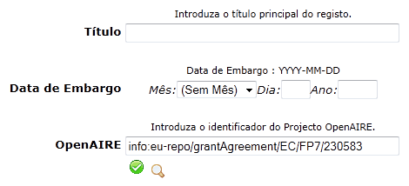
OpenAIRE
Authority Control Add-on
Allows users to search and include FP7 project IDs in the metadata of the records disposed in accordance with the guidelines
* Needs the OAIextended Add-on to create the set (ec_fundedresources)

Slide 38
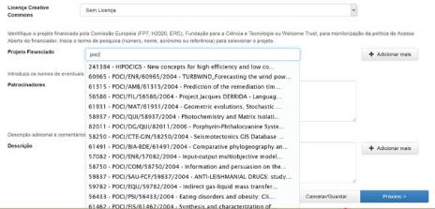
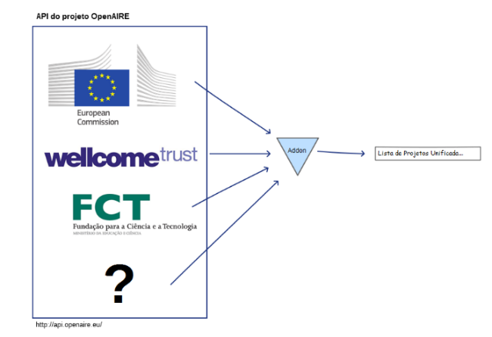
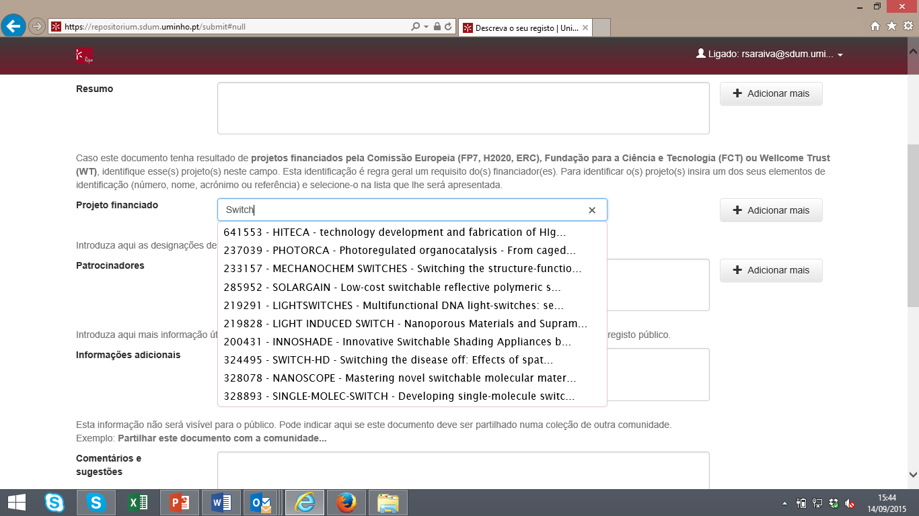
OpenAIRE Funders Projects List Add-on
Portugal

Slide 39
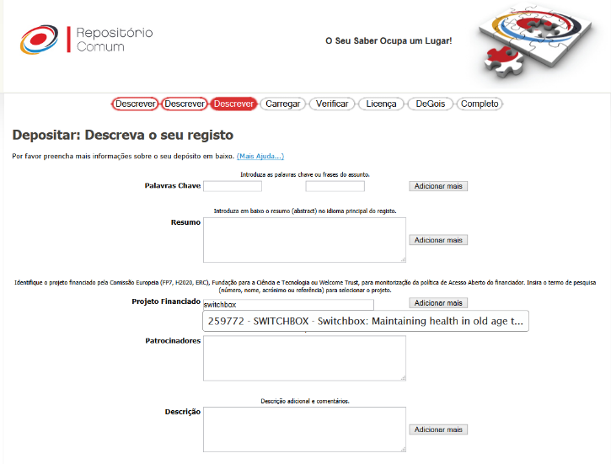
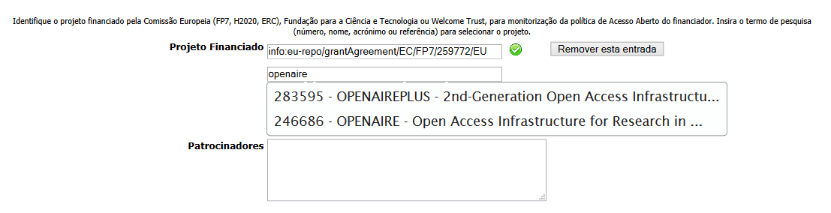
OpenAIRE Funders Projects List Add-on

Slide 40
Connect Your Repository With OpenAIRE
In just a few steps
6/6
Notes:
* Take slides from Gent

Slide 41
Use the OpenAIRE Validator Service
  Make sure your repository is registered in OpenDOAR / r3data
  Test Compatiblity
    Of the OAI-PMH Protocol implementation
    Of metadata compatibility with the OpenAIRE Guidelines
  Register Your Repository, Journal or Aggregator
    Await notification from OpenAIRE once successfully
    aggregated and indexed
  Update Data Provider Configuration if needed
  In preparation: agreement to TDM of fulltext files
  In preparation: continuous validation reports over time
  ☞ https://www.openaire.eu/validator

Slide 42
Useful Links:
Find and discuss the guidelines at: https://guidelines.openaire.eu
Test and register the repository at: http://validator.openaire.eu
Find support at: https://www.openaire.eu/support/helpdesk
Access the OpenAIRE API documentation: http://api.openaire.eu
About COAR Repository Interoperability:
http://coar-repositories.org/activities/repository-interoperability
Find the guide for Repository Managers at:
https://www.openaire.eu/rep-man-toolkit/repository-managers
Search for OpenAIRE data providers at:
https://www.openaire.eu/search/openaire-data-providers
See the OpenAIRE Content Acquisition policy at:
https://www.openaire.eu/openaire-s-content-acquisition-policy/download

Slide 43
Q&A
Contact us: info@openaire.eu

