Slide 1


STEM Education:
Navigating a Complex Network of Opportunity
Alan Cheville
Bucknell University

Slide 2
Rising Cost of College
Private Universities
Average Tuition (US $)
Consumer Price Index
Academic Year Beginning

Slide 3
Curt Carlson’s Value Proposition Method
Need
Approach
Benefit:Cost Ratio
Competition

Slide 4
Need

Slide 5
= Public
= Private
= 10⁶ persons
= 10⁶ persons/year
= 10⁶ engineers
K – 12
4 yr. college
Graduate
Workforce
?
2 yr. college
?
K-12 Non-Completion
?
Notes:
Engineering in K-12: Only about ten states have implemented some form of standards in engineering; there as yet has been no national consensus on the need for K-12 engineering standards¹.
2-Year School to 4-Year School Transition: About 12% of all students in two year programs earn a bachelor’s degree within six years after first enrolling, and another 7% are enrolled in a four year institution².
Engineering and the Economy:
Engineers play key roles in knowledge and technology intensive (KTI) firms.
Worldwide, KTI firms contributed $18.2 trillion to global GDP in 2010, 30% of the total³.
In the United States the contribution to GDP was 40%, or $3.6 trillion; over half of the growth in GDP is due to technological innovation.
Current ideas being considered⁴:
Link educational pathways to workforce needs.
Provide students information on post-education outcomes.
Learning standards tied to competencies rather than credit hours.

Slide 6
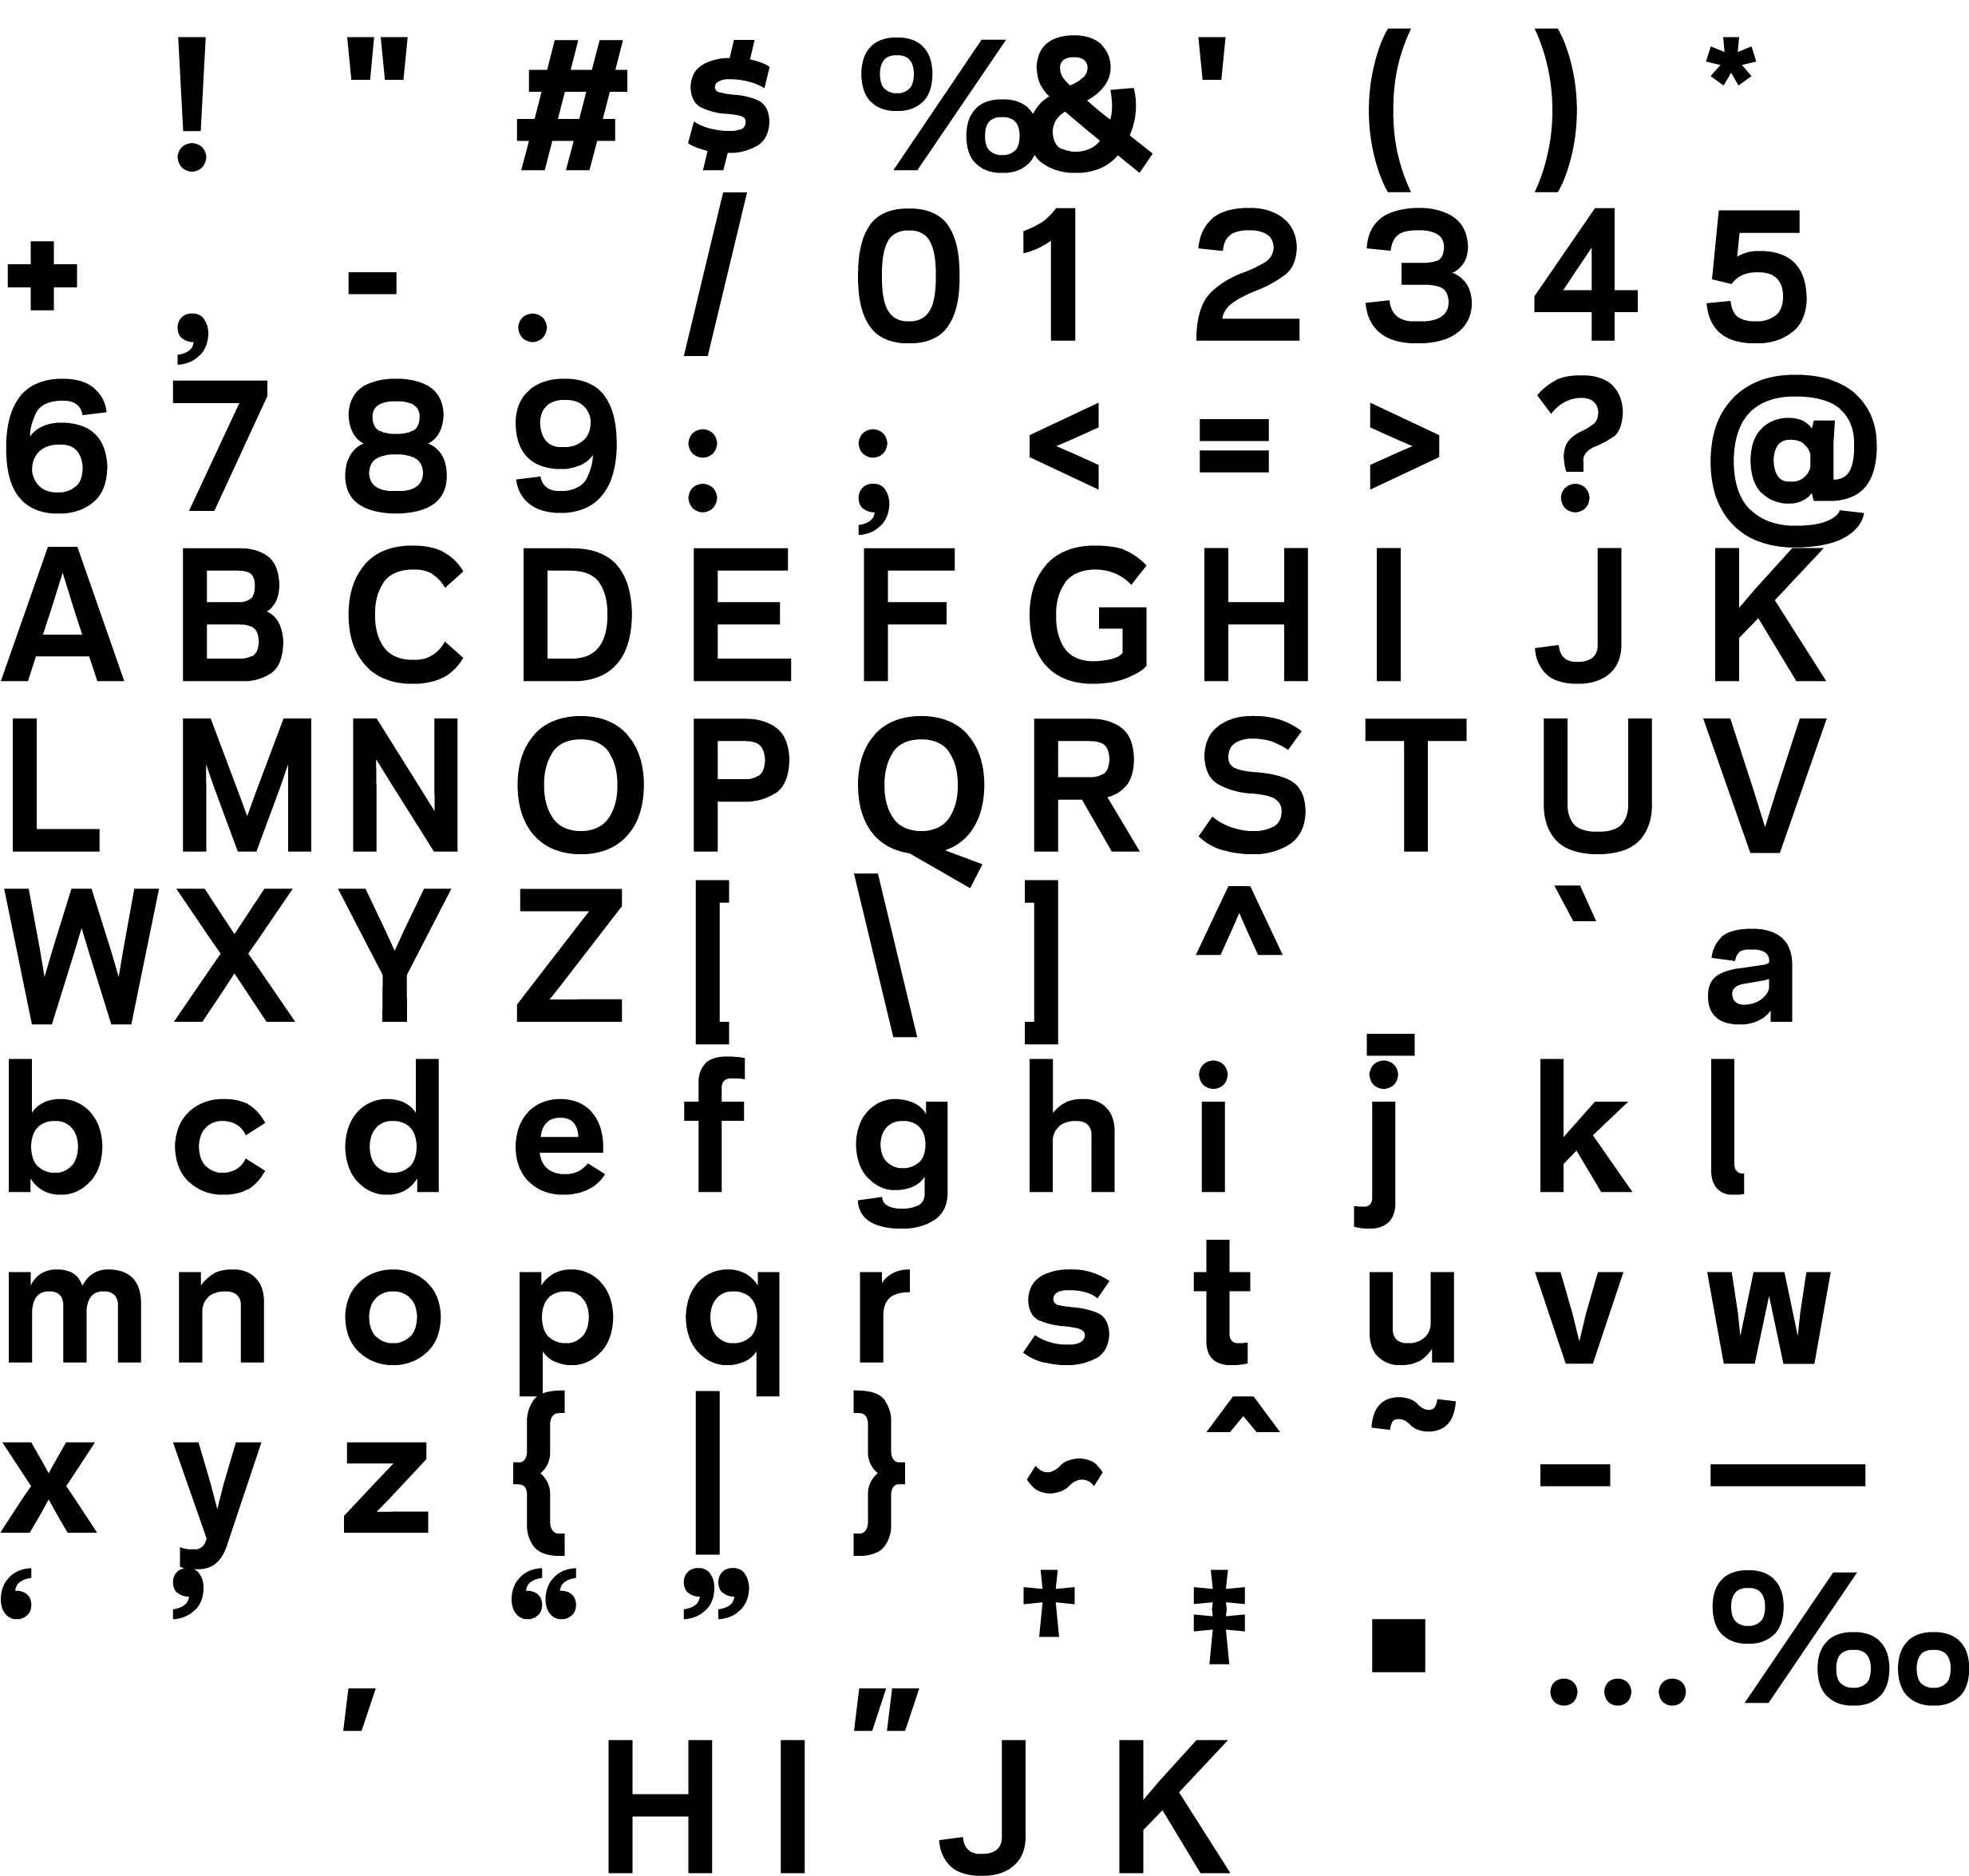
Engineers’ Contributions to Economic Growth
All numbers are very rough estimates!
Public Tuition = $2.3×10⁴
Private Tuition = $4.5×10⁴
Investment
Engineers in the workforce
×
+
~$2×10¹⁰ / year
investment
10⁵ Engineering Students / year
Public Funding
5×
Creation of
one new job / (engineer year)
2% GDP growth
Over 30% from engineers¹
$75,000 economic growth per
(engineer-year)
×
Δ_{GDP} ≅ $3×10¹¹
/ year
×
Δ_{ENGR} ≅ $1×10¹¹ / year
÷
US GDP $1.5×10¹³ / year
Return
1.4×10⁶ Engineers
[1] N. R. Augustine, "No Place Like Home," Innovation America, vol. 11, 2013.

Slide 7
Benefit:Cost Ratio

Slide 8
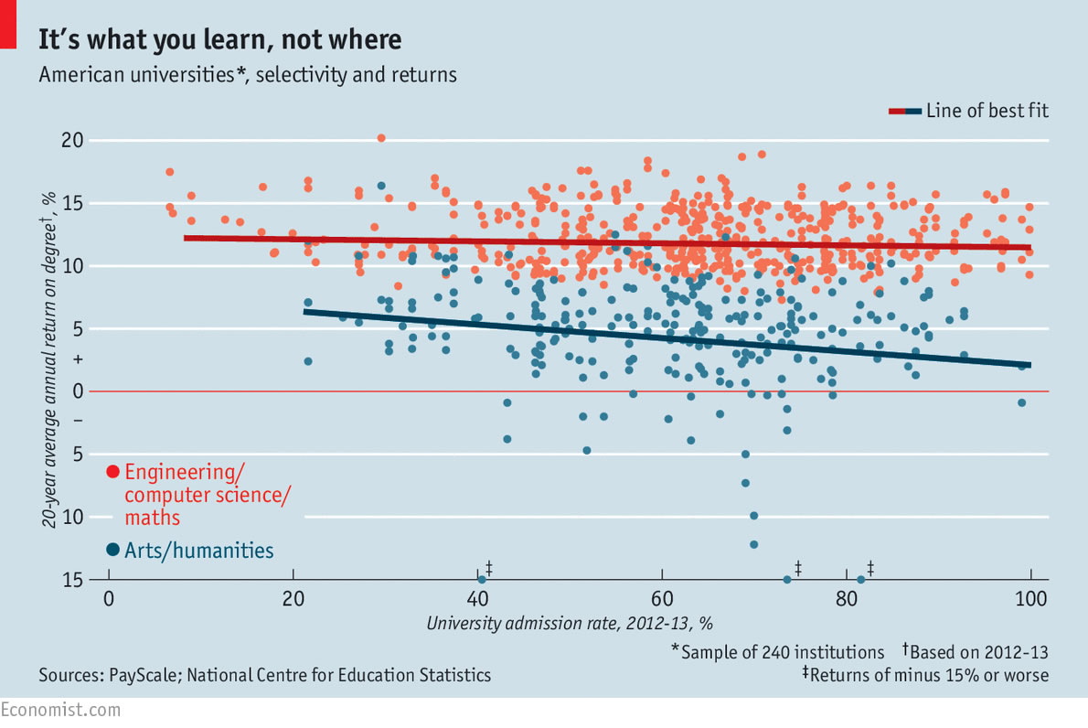
20 Year RoI vs. Selectivity of Institution
It depends what you study, not where, The Economist, 3/12/2015
https://www.economist.com/news/united-states/21646220-it-depends-what-you-study-not-where

Slide 9
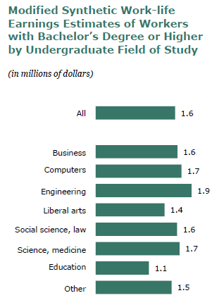
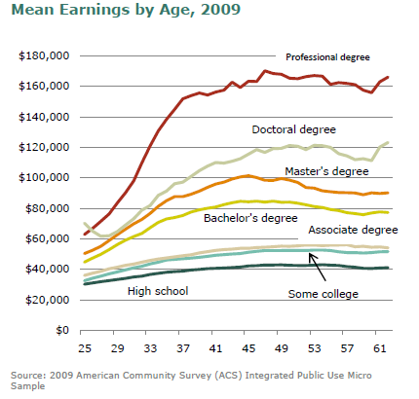
College RoI by Attainment Level
Present Disruptors
Is College Worth It? Pew Research Center Report, 2011

Slide 10
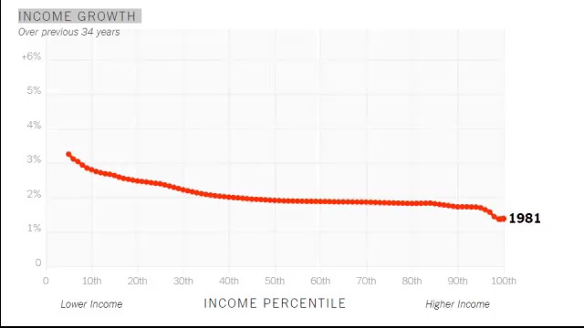
Past Performance is no Guarantee of Future Results
Our Broken Economy, in One Simple Chart By DAVID LEONHARDT New York Times, Aug 7 2017

Slide 11
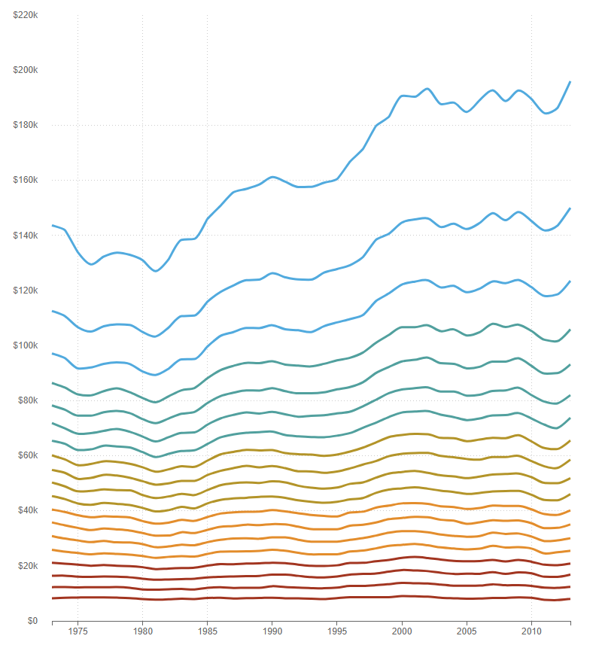
$200,000
$150,000
$100,000
$50,000
$0
Change in Household Income by Income Percentile
+36% (95th)
+7.7% (75th)
+3.1% (50th)
-1.4% (25th)
-2.5% (5th)
1975 1980 1985 1990 1995 2000 2005 2010
Q. Bi, 40 Years Of Income Inequality In America, In Graphs, National Public Radio, 10/2/2014
http://www.npr.org/sections/money/2014/10/02/349863761/40-years-of-income-inequality-in-america-in-graphs

Slide 12
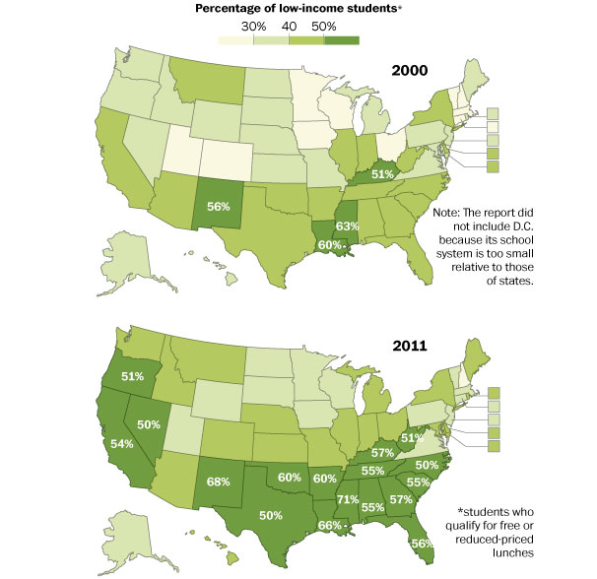
% of primary education students with low family income ($20K - $40K)
Southern Education Foundation

Slide 13
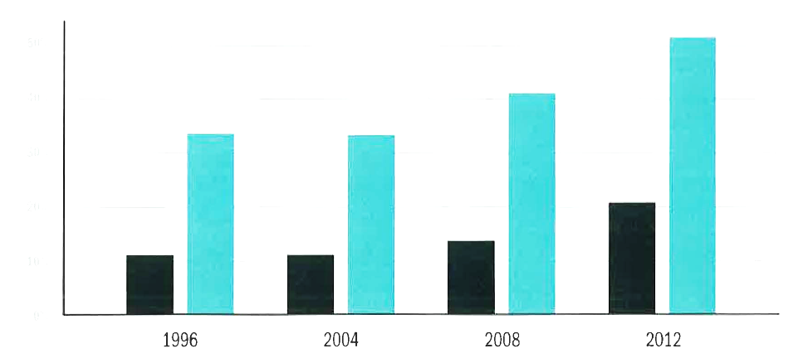
Affordability of College is Dropping
% Families Paying > 100% of Annual Income for College
50%
40%
30%
20%
10%
All Students
Lowest Income Quartile
1996 2004 2008 2012
Chronicle of Higher Education: 2026 The Decade Ahead

Slide 14
“…the America we have taken for granted for more than a generation is changing. Our society is changing: More people are old, fewer are young, more come from minority groups. Our industry is changing: We are not the world economic leader we were for so long, but a competitor with other industrial nations. Our education system is changing: Although our colleges and universities are the envy of the world, they are becoming more and more dependent on foreign students and faculty. Our pre­college education system has reached a crisis state in which U.S. students are no longer competitive with those in other industrialized countries. Our present scientific and engineering workforce-the foundation for U.S. technological, economic, and military leadership is eroding due to retirements and declining student interest.”
“Changing America: The New Face of Science and Engineering”
The Task Force on Women, 1989.

Slide 15
Long-Tailed Distributions
Cumulative # Eng. Students
25% of Engineering Students
40 Schools
20 Schools
204 Schools
74 Schools
1
100
200
300
Program Sorted by Size

Slide 16
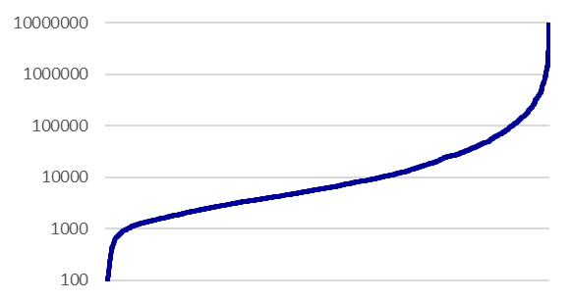
10⁷
10⁶
10⁵
10⁴
10³
10²
US $
Universities Rank Ordered by Assets per Student Enrolled

Slide 17
Competition

Slide 18
Rising Cost of College
Private Universities
Average Tuition (US $)
Consumer Price Index
Academic Year Beginning

Slide 19
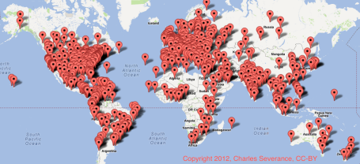
Geographical Distribution of Early MOOC
Present Disruptors

Slide 20
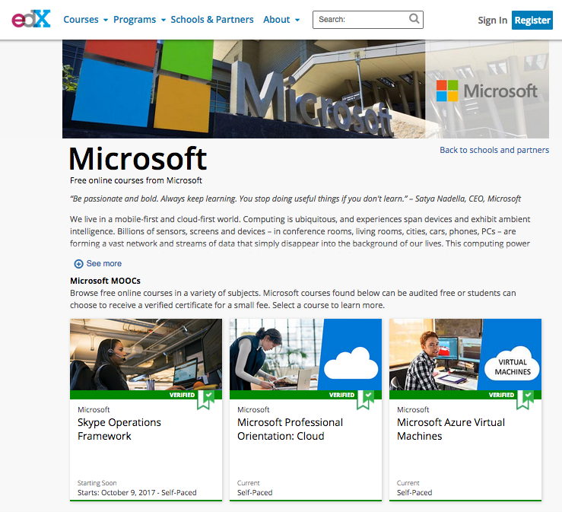

Slide 21
Approach

Slide 22
Knowledge Skills
+
Does not develop
Hire
-
+
People Skills
Is not respected
Do not hire
-

Slide 23
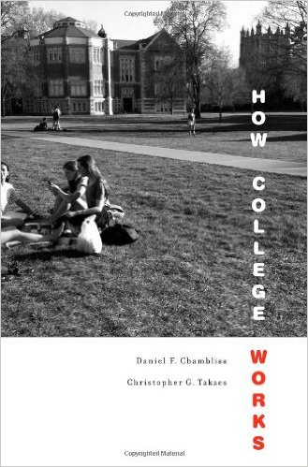
What Works in College?
+
Ecosystem Metaphor:
Rich, nurturing environments with strong personal relationships.
Does not develop
Hire
-
+
Do not hire
Is not respected
What Works
A few committed teachers/mentors.
Tight social network.
An ecosystem with many opportunities to become involved.
Diversity of people and opinions.
-
What Doesn’t Work
Micro-engineer human behavior.
Over-investment in facilities.
Over-investment in new pedagogies.

Slide 24
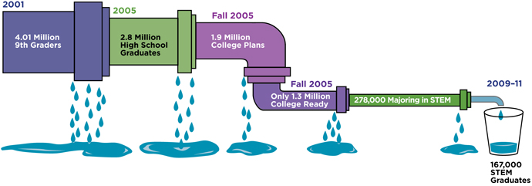
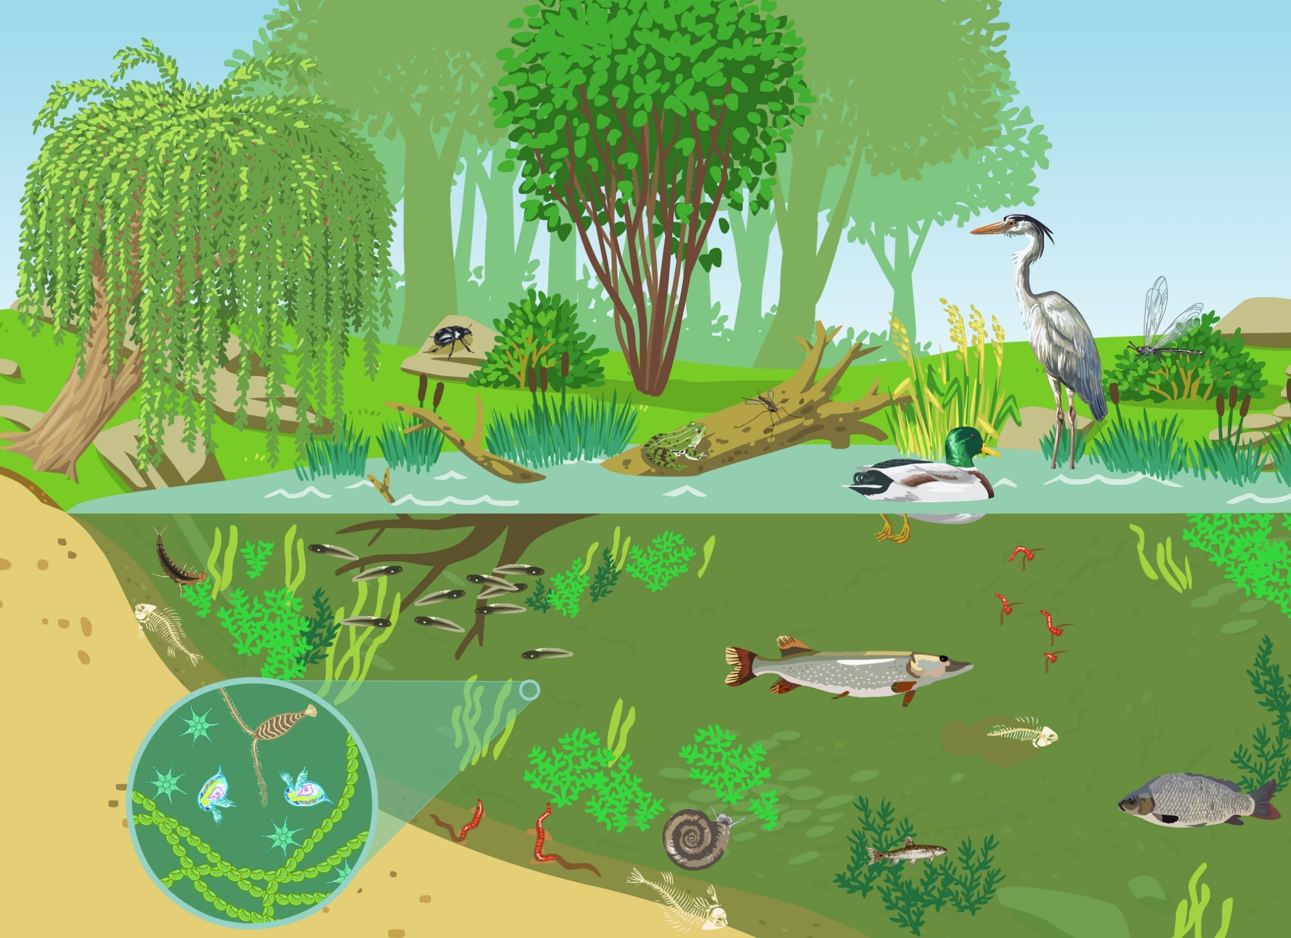
Predominant Mental Model of STEM Education
http://www.businessandeducation.org/supporting-stem-pipeline

Slide 25
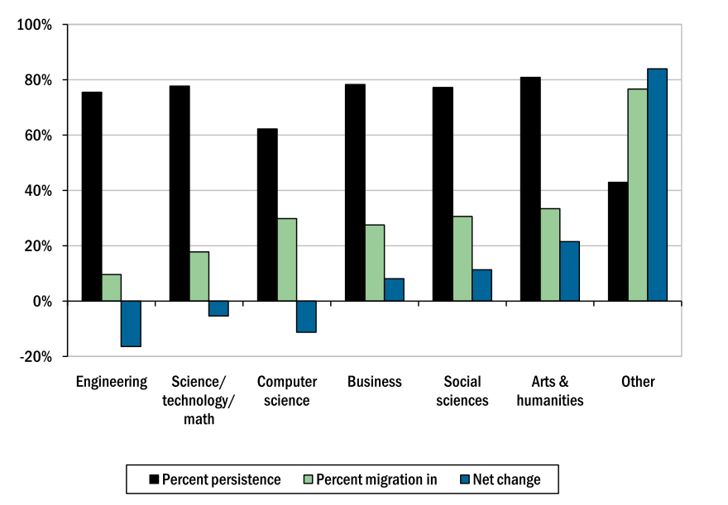
Center for Advancement in Engineering Education

Slide 26


“T” technology
Understanding of Learning
Big Data
Nature of Work
Value Creation
  Cost
  Convenience
  Credentials
Industry Needs
College Affordability
More Diverse Population
Changing Economy

Slide 28

Knowledge Skills
+
-
People Skills
-
+
Navigation in Puluwat Atoll by Dead Reckoning:
“Steer by the shape of the sky” – have the ability to see the whole
Canoes are designed for dynamic instability so constant attention to direction is needed.
Ptolemaic rather than Copernican view – more attention to local detail.
+
Navigational Skills
-
Navigation is the skill of making adjustments to learning based on current utility of acquired knowledge to new situations (transfer) and an ability to adopt a systems thinking perspective centered on one’s own place within the system.

Slide 30
Education as a Science of the Singular
Unit of Analysis = Student

Slide 31
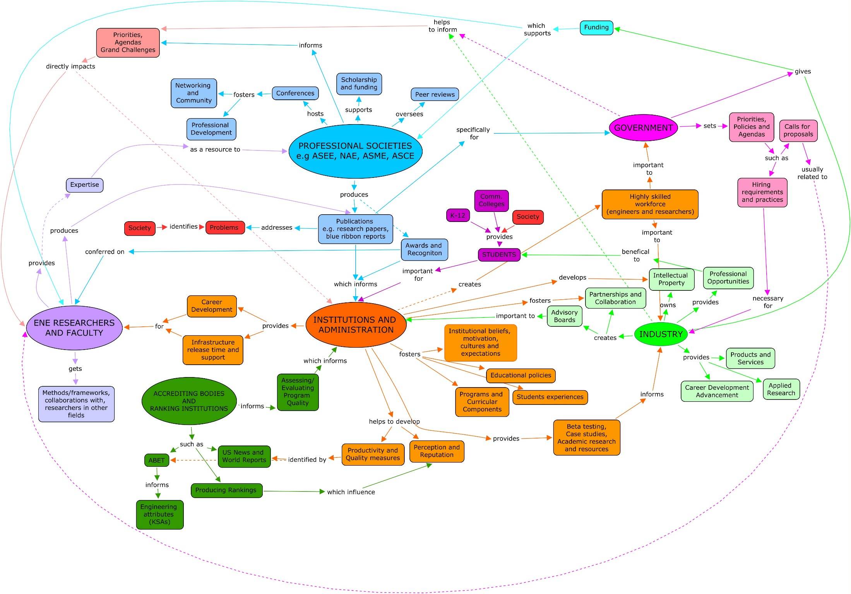

Slide 32
Dead Reckoning and Design
Prospectus
Knowledge advances aided by technology.
Technology is ultimately about convenience. What effort can I save? Evolutionarily driven by saving energy.
The work technology displaces is human work, often backbreaking or degrading, sometimes sublime.
The next generation of knowledge subsumes the technologies of today. The work, no longer valued, fades from memory and takes on the shade of the ridiculous.
This is as true in education as it is in engineering.
Yet if technology is ultimately for convenience, what other values does it ignore in it quest for efficiencies?
What else is shed along the way, to be forgotten by the roadside?
Are these things best lost, relics of a dimly remembered time, of sentimental value only when context has moved beyond them, or do they point to deeper, human truths that should not be forgotten?
This is an exploration of a technology that is now taken for granted, and what it displaced.
It is a story of technology itself, how it comes to be, and how it influences its own path.
Here the question is what lessons about the design, the never-ending search for appropriateness [Lyons], can be learned from technologies at first glance seem antiquated or counter-intuitive.
It is a question about what an endless quest for appropriateness, convenience, and efficiency do to us as humans, to our ability to revel in our skills, to struggle, and to our ability to find meaning in life through its uncertainties.
Here I draw predominately from three sources: my own experiences teaching design to senior electrical and computer engineering students, East is a Big Bird an anthropological study of navigation among remote Pacific Islanders, and John Fowles’ The Aristos which itself was stimulated by the pre-Socratic philosopher and teacher Heraclitus.
Reasons for Writing This
The first are philosophical: Draw from my own dissatisfactions and hope they are shared. Society increasingly frames education as a means to economic ends—in a utilitarian way—and in this forget often that education is the way an individual learns their own path through life.
There is a need to reinfuse the personal into education, informed by scholarship, implemented by the personal. This is most true in design, the “art” in engineering. [side note, I could infuse some Macmurray here…]
These are the unlearnings that need to be done to get students to take risks in design.
The tension between “learning the basics” and “being creative” that has led to stasis. I suppose resolving this tension is one of the real aims of this paper. Tensions can be generative but this is not one of those tensions.
What does the personal mean? Is it Plotinus’ inner education, learning to satisfy one’s own needs above and before the needs of society? But each of us is inextricably linked to many others—friends, family, colleagues—with whom we have personal interactions each day. In our educations we constantly design ourselves in fellowship with others. We increasingly shell off this fellowship to media or to “processes” which gives us new forms an ways to interact but the experiment of whether these can or will supplement or supplant personal interactions is still up in the air. Thus we need to navigate relationships if we wish to grow in our lives.
The second is systemic: Education and educational systems serve critical purposes in society. As others [Senge] have written education is structured for certain outcomes, structure determines outcomes in a way that is often invisible to those who exist within the structures. An argument is that the structures we currently exist in were established in an age where a transition from an agricultural to an industrial society were underway. It is clear we are now transitioning from a manufacturing to some other form of society- a lot of people have said service- or information-based, but my own bet is on an experience-based society and economy. The transition to whatever comes next is going to cause a significant amount of restructuring and likely fragmentation of the education system. This means students need a guide, a handbook of the necessary knowledge, a Girl’s Guide, to navigate a restructured landscape.
1 Dead Reckoning
Origin o

Slide 34
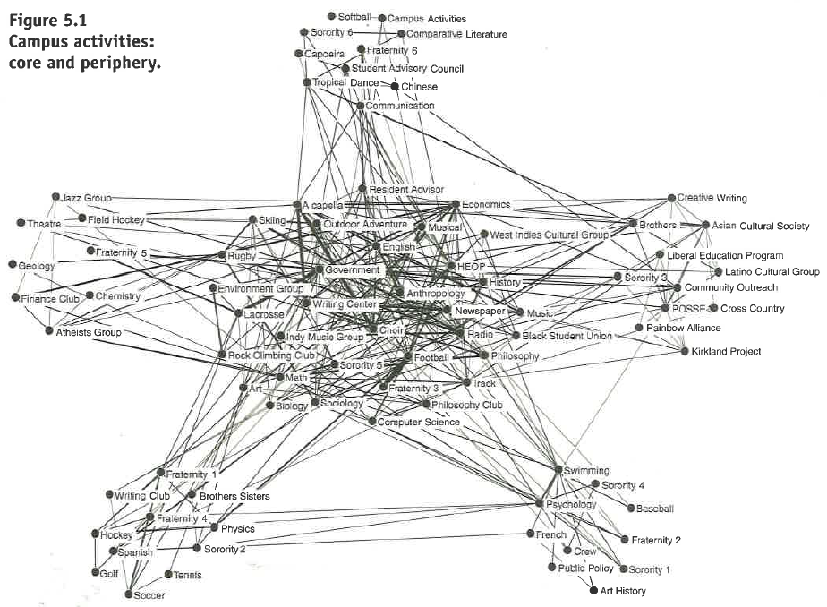
Peripheral Activities
Central Activities

Slide 35
Why Should NSF Care?
“To promote the progress of science; to advance the national health, prosperity, and welfare; and to secure the national defense; and for other purposes.
National Science Foundation Act of 1950 (P.L. 81-507)
Disruptions in higher education fundamentally affect your ability to fulfill parts of your mission.
Higher Education is not a business, it is status-driven and NSF plays a disproportionate role as a bully pulpit.
Only Government has the reach, oversight, and mission to address these issues.

Slide 36
Risk to University
Financial
Models
$1000’s
Students in System
"National Association of College and University Business Officers".
Endowment B$

