Slide 1


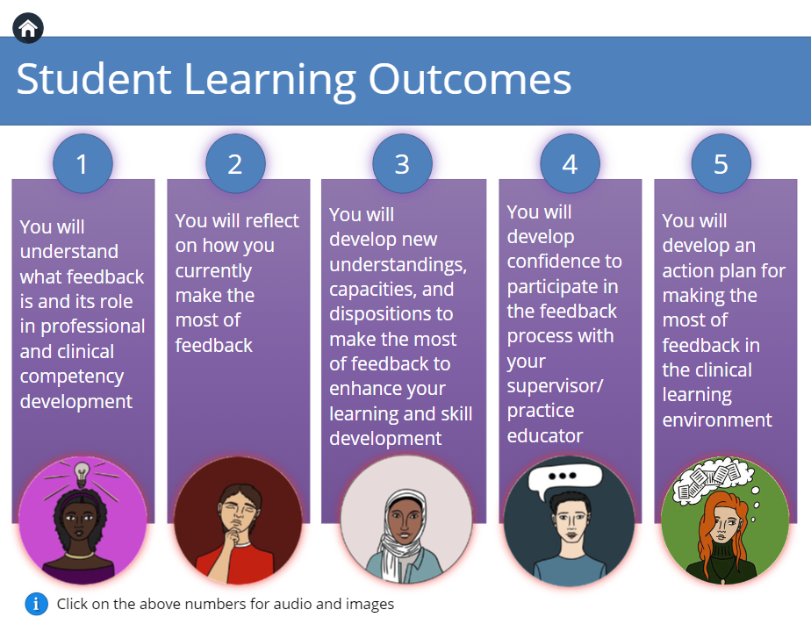
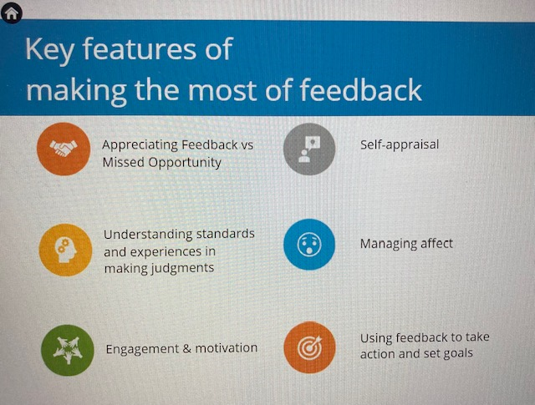
ADEE ANNUAL MEETING LIVERPOOL 2023
COLLABORATIVE EDUCATION IN A DIGITAL ERA
POSTER: THEME-TECHNOLOGY ENHANCED LEARNING
An investigation to facilitate and evaluate the development of students’ feedback literacy in the dental science undergraduate curriculum.
Siobhán Davis, Mary O’Neill, Maria van Harten, Professor Blánaid Daly (Dean), Dublin Dental University Hospital.
Background:
Educators in the clinical learning environment should provide more than didactic supervision of practice and performance scoring. Appropriate feedback in this context is critical to the development of student competence and confidence¹.
Numerous calls made for healthcare (HC) students to be supported to increase their agency and active engagement with the feedback process, that is, to intentionally support their feedback literacy skills ².
We have developed an evidence-based, online multimedia resource designed to facilitate the development of
feedback skills for HC undergraduate students.
Figure 1:
Screenshot
of first slide of
module
Aims & Objectives
The aim of this pilot study:
To develop and enhance student feedback literacy at DDUH so that students know what good feedback is.
To support them to develop the tools to obtain good feedback when they need it in relation to their learning and development of clinical skills and competence in the clinical learning environment.
Table 1: Challenges related to Feedback
Materials & Methods
All undergraduate dental students from the third and fourth year were invited to participate in this study.
Three evaluations were performed:
1. Pre-course evaluation to check prior knowledge and identify learning needs
2. Post-course evaluation to measure students’ perceptions of content
3. Evaluation three months after completion to determine long-term benefits or impact of the resource.
Descriptive and inferential statistics to analyse the quantitative data collected and thematic analysis with the qualitative data
Figure 2:
Each icon when
clicked plays an
animation showing
the principle in
action
Challenges related to Feedback ^{2,3,4}
Defensiveness
Non-engagement with information provided
Poor quality feedback
Emotional distress
Limited skills and understanding of Feedback processes
Discussion
Principles of good feedback literacy skills support students in being active agents in the feedback process. ^{2,5}
There is scope in acknowledging that students should be active participants in the process of feedback and the importance of student knowledge regarding pedagogy around feedback, especially, in relation to the dental clinical learning environment, which is a unique learning environment.
References
Davis S, Duane B, Loxley A, Quigley D. The evaluation of an evidence-based model of feedback implemented on an undergraduate dental clinical learning environment. BMC Medical Education (2022) 22:588
Nash R, Winstone N. Responsibility-sharing in the giving and receiving of assessment feedback. Front Psychol. 2017; 8:1–9.
Boud D and Molloy E. Rethinking model of feedback for learning: the challenge of design. Assessment and Evaluation in Higher Education. 2013; 38(6):698-712.
Groves M, Sellars C, Smith J, Barber A. Factors affecting student engagement: a case study examining two cohorts of students attending a post 1992 university in the UK. International Journal of Higher Education. 2015; 4(2):27.
Carless D, Boud D. The development of student feedback literacy: enabling uptake of feedback. Assess Eval High Educ. 2018;43(8):1315-1325.
Results and conclusions
Pilot respsone rate low in DDUH
Plan to re run with wider cohort of Health Science students Sept-Jan 2023
Many dental students (90%) accessed the resource but didn’t complete all three evaluations
Wider access may permit rigorous evaluation and measure impact

