Slide 1

Who are the CPT and what do they do?
Prison Oversight: Improving Rights in Europe (POIRE) Project, Trinity College Dublin, Ireland
The POIRE project has received funding from the European Research Council (ERC) under the European Union's Horizon 2020 research and innovation programme under grant agreement No. 101069413.

Slide 2

About the CPT
The CPT is short for The European Committee for the Prevention of Torture and Inhuman or Degrading Treatment or Punishment.

Slide 3

Independence
The CPT is a European organisation that is independent from the government and the prison administration.

Slide 4
What do the CPT do?
The CPT visit prisons all over Europe
Visits happen every 4–5 years (or sooner if needed)
During a visit, they can:
🔎 Check all areas of the prison
📂 Read records (like health files)
🗣️ Speak to any prisoner in private
👮 Talk to staff
The CPT do not deal with individual complaints.

Slide 5
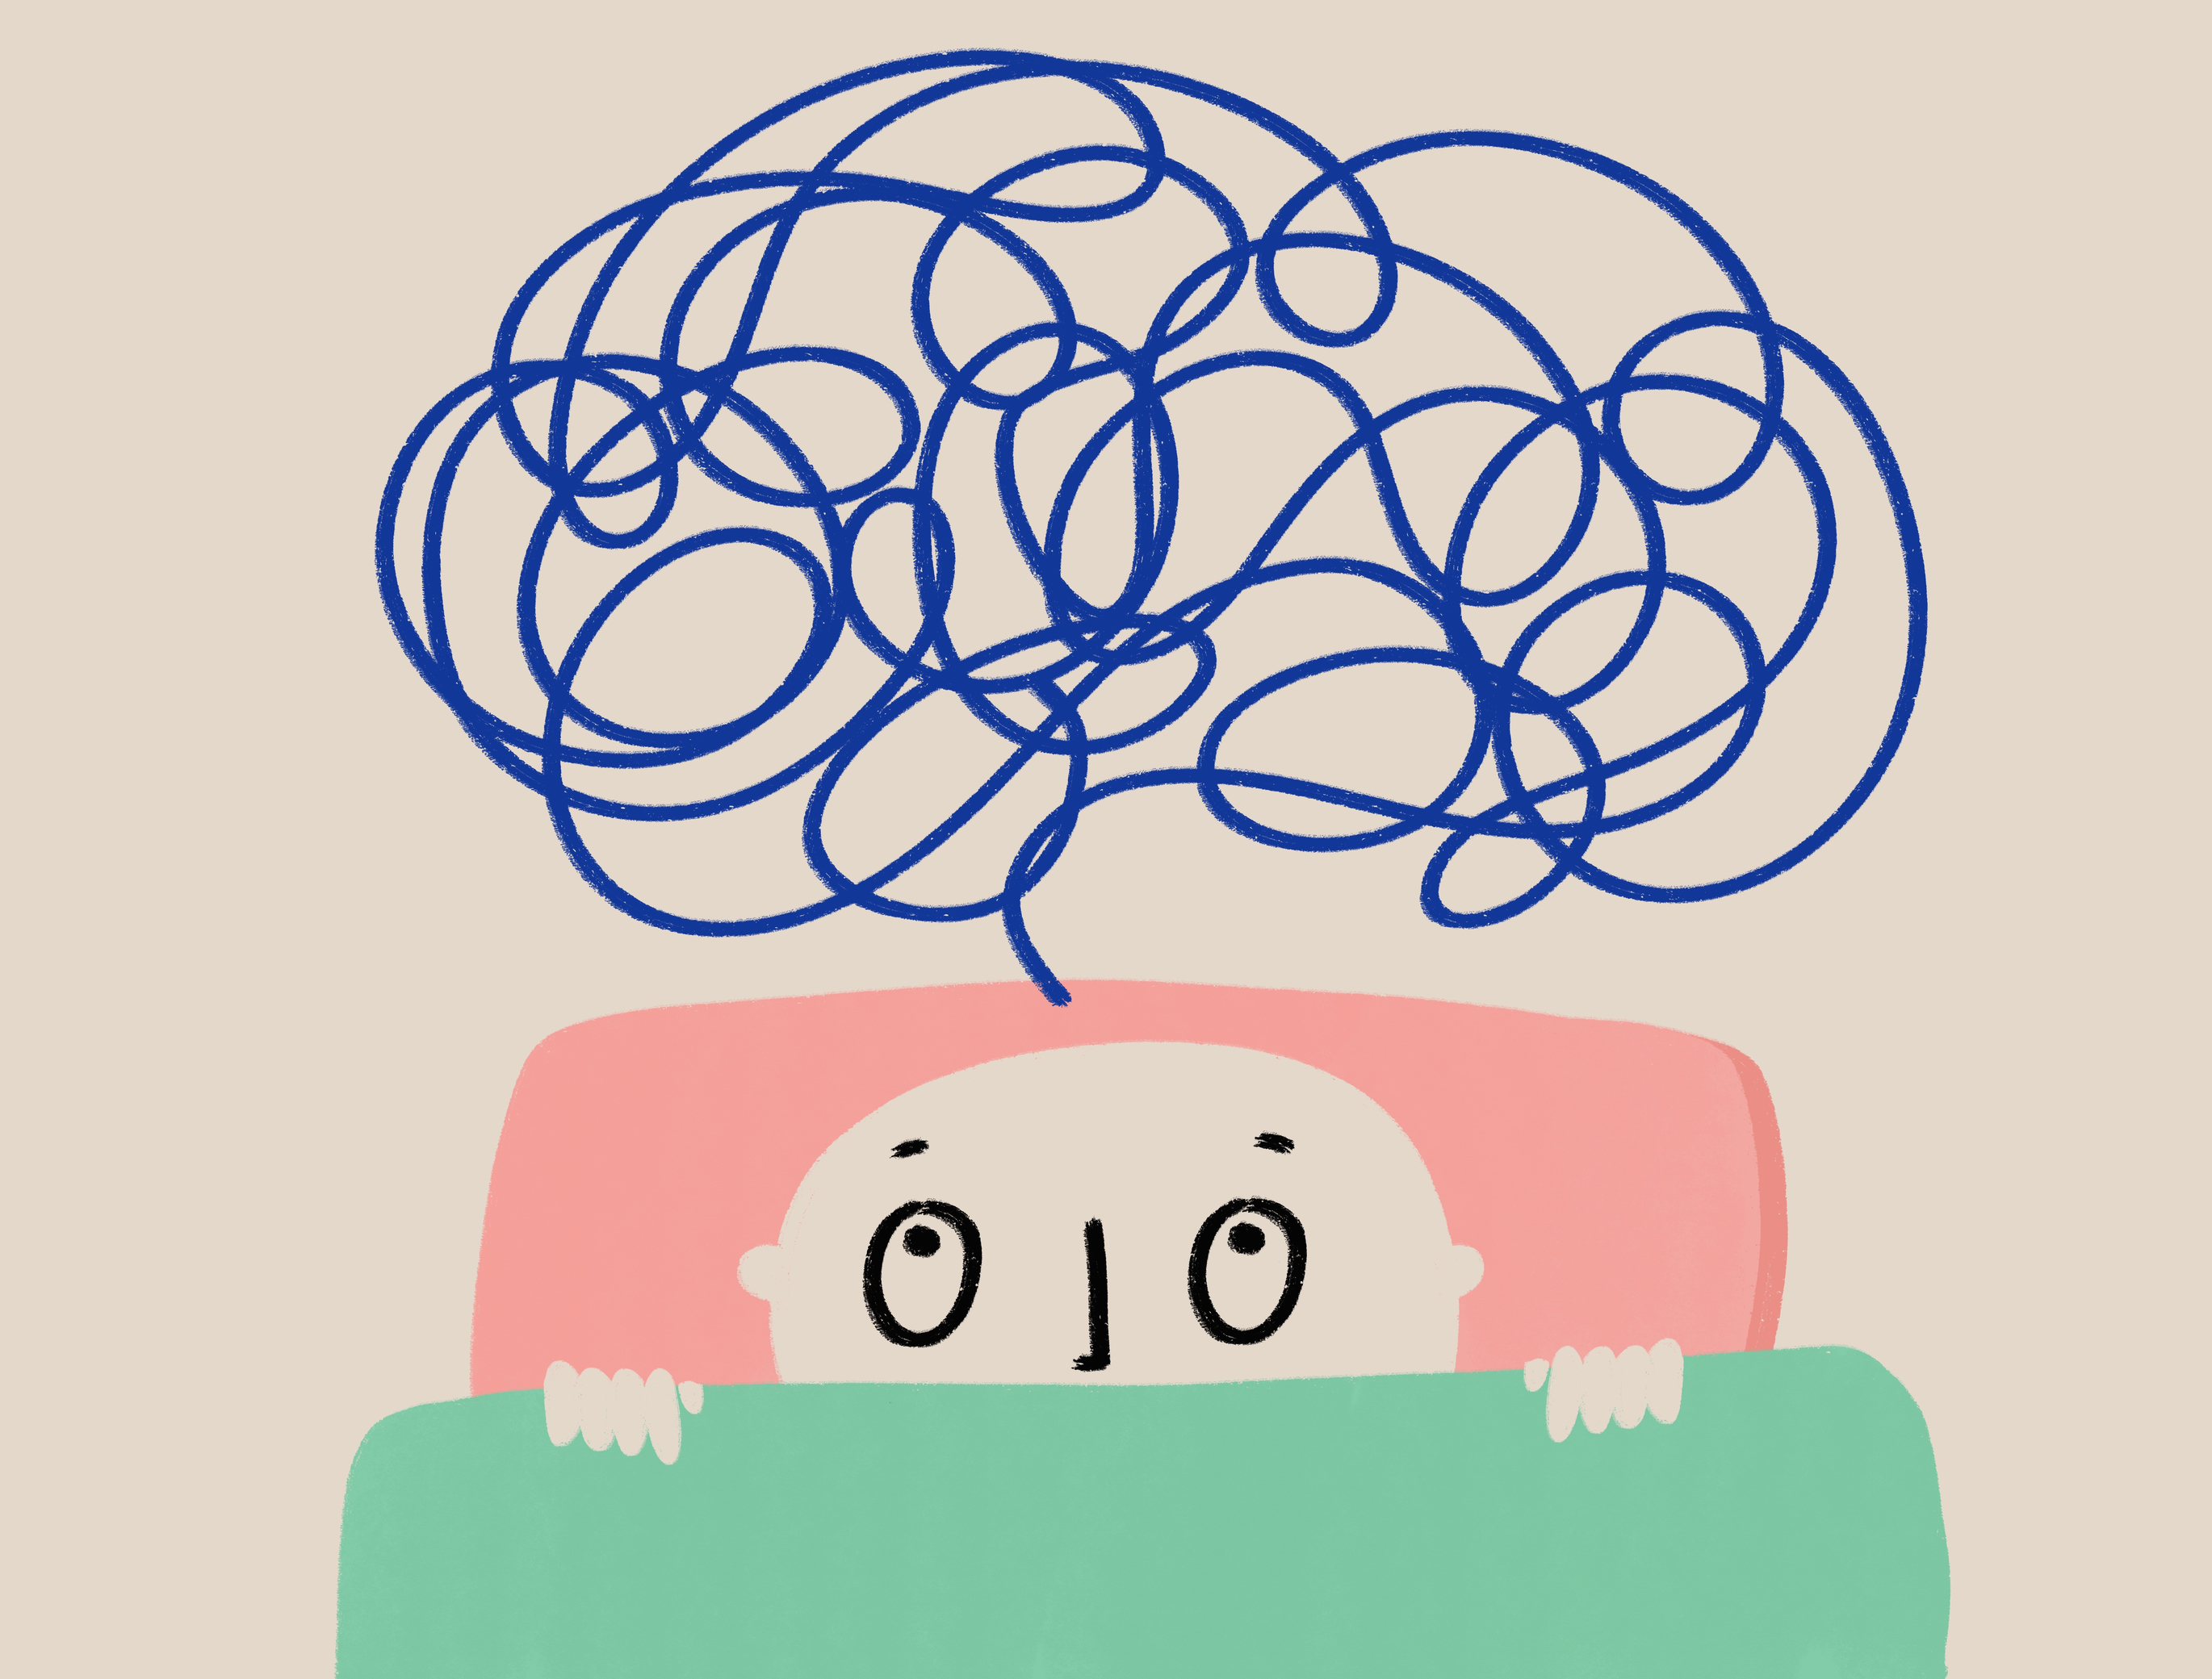
Why should you know about the CPT?
Research shows most people in prison:
Have never heard of the CPT
Don’t know what it does
Don’t know it is okay to talk to them
When people learn more, they feel:
👍 Better informed about the CPT
👍 Glad that someone checks on prison conditions

Slide 6

What happens after a CPT visit?
The CPT will:
Write a report (no names are used).
Share the report with the government.
The government writes back with a plan to fix problems.

Slide 7
✉️ How Can You Contact the CPT?
You can send them a private letter.
📬 Address:
CPT Secretariat
Council of Europe
F-67075 Strasbourg Cedex
France
📞 Phone: +33 388 412772
🌐 Website: www.coe.int/en/web/cpt/home

