Slide 1

Care erosion and what to do about it
Jan de Vries, PhD
Fiona Timmins, PhD
Department of Health 16 May 2017

Slide 2


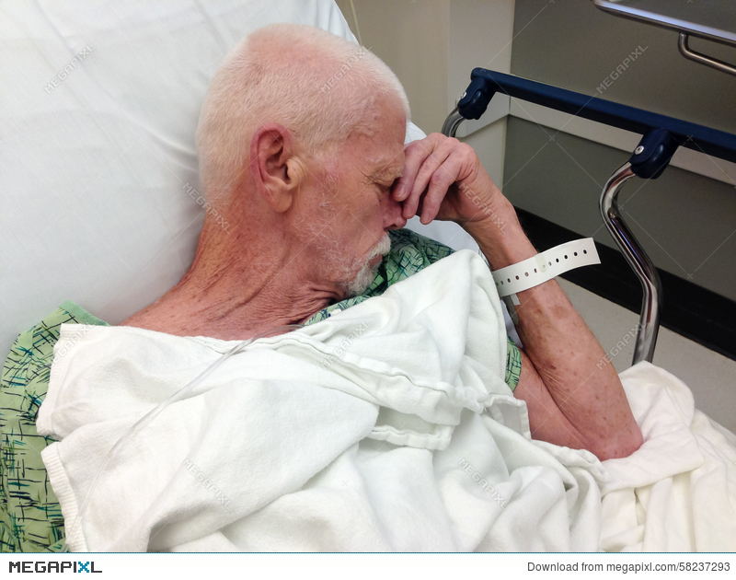

1) Slips in care/care deficiencies are upsetting …..
Oh dear, I forgot to tell the patient something essential ……….
I forgot to wash my hands before a procedure …..
I was going to come back to him when I saw him cry, but I didn’t ……..
I may have given the wrong medication …..

Slide 3

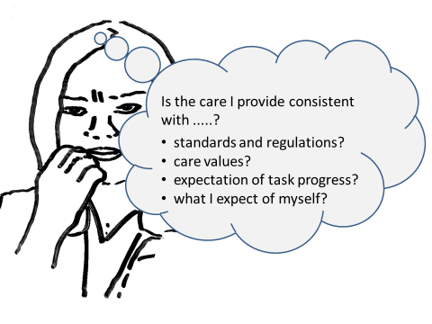
Oops…..!
Let’s look at the psychological mechanism behind this process ……
Try not to think about it!
I feel bad
Correct my mistake!
How can I make myself feel less bad?
It wasn’t really my fault!

Slide 4
2) The psychological mechanism: Why do we feel bad?
Also, in each of the examples the slips in care are inconsistent with the notion of being a good and competent health care worker ……
The discomfort is the result of an inconsistency between the slips in care and expected levels of care, standards, values and regulations
Cognitive Dissonance (Festinger 1957):
An unpleasant state of tension that
occurs whenever an individual
simultaneously holds two
cognitions that are
psychologically inconsistent.
Dissonance is strongest when we
do something that is inconsistent
with beliefs of ourselves as good,
smart, correct, competent
(Aronson 1969, 2006)

Slide 5
Cognitive Dissonance Theory Festinger (1957) Aronson (1969, 2006)
Dissonance theory further suggests
that the discomfort motivates
efforts to reduce it, which will
continue until we manage to
restore our peace of mind
This can be done by changing
inconsistent behaviour, perceptions,
or beliefs …. however seeking
distraction, ignoring it, or denial can
also reduce the discomfort

Slide 6
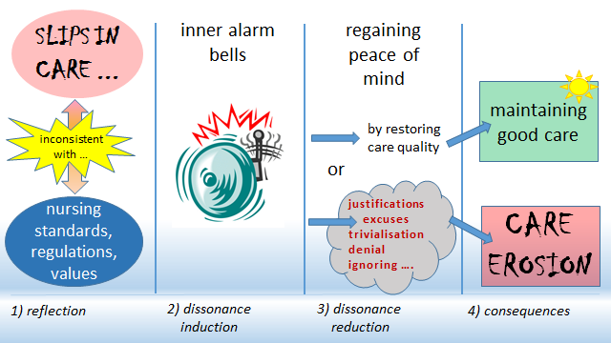
3) Process model of care quality regulation v care erosion

Slide 7
Process model of care quality regulation v care erosion

Slide 8
Process model of care quality regulation v care erosion

Slide 9
Common justifications used by health care workers
  ‘There is just not enough time to do everything’
  ‘We are so understaffed’
  ‘I can only focus on really important tasks’
  ‘We are in crisis, what do you expect?’
  ‘Most colleagues do worse than I do’
  ‘We are under too much pressure’
  ‘If the organisation does not care, why should I?’
  ……………..

Slide 10
Process model of care quality regulation v care erosion

Slide 11
Process model of care quality regulation v care erosion

Slide 12
4) Reflection is the first line of defence against care erosion
How should reflection work?
  in a (self-) critical way
  in time
  like a circuit breaker or a fuse. It needs to work instantly, if it works too late, the damage has already been done.
  If not done this way, justifications will have been made and not taking action will be defended during retrospective reflection.

Slide 13
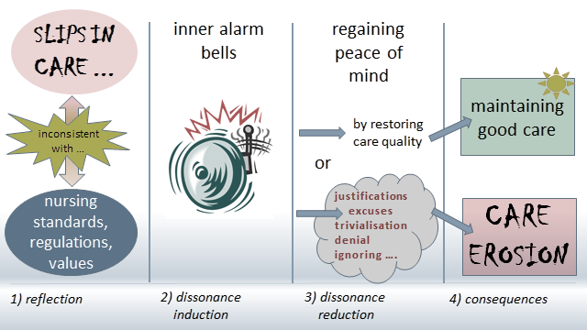
So when should we reflect……
Retrospective reflection comes too late!!!
Critical Reflection
in Action

Slide 14
5) Why do we not reflect instantly?
most retrospective models are complex and not appropriate for instant reflection (Schön, 1983).
often we are in ‘fast thinking’ mode and experience ‘slow thinking’ as a disruption (Kahnemann, 2011)
Health care workers are not taught to reflect in action
If done right, instant reflection is likely to be unpleasant ….. !
It is good to feel bad about slips in care: this is a core point of Critical Reflection in Action!

Slide 15
6) The need for Critical Reflection in Action:
Motto: Being prepared to see what we are doing wrong, and putting it right.
Reflection in which a critical or self-critical approach is taken (De Vries and Timmins, 2016)
Finding ways of enabling students to raise unconsciously held personal beliefs, so that they can be consciously inspected (Rolfe, 2005)
this involves allowing ourselves to ‘feel bad’
which is ‘good’, because it motivates restoring quality of care, correcting slips in care, etc.

Slide 16
7) Outline of Critical Reflection in Action Module (2 hrs):
Three steps:
Step 1: The Oops moment
Step 2: Avoiding justifications (denial, trivialisation etc.)
Step 3: Taking Action

Slide 17
Step 1: the Oops moment
I feel bad
Examine the dissonance

Slide 18
Critical Reflection in Action Module (2 hrs)
Step 1: The Oops moment
Recognising and understanding the ‘oops’ moment
Oops means STOP AND THINK
teaching students/staff to think beyond the ‘I feel bad’ realisation and analyse the dissonance / inconsistency in the moment
Activate values, standards, regulations violated in the moment
Learn to see ‘feeling bad’ as ‘a good sign‘
Strengthen tolerance for self-criticism

Slide 19
Step 2: Avoiding justifications
I make myself feel better, but how …
Am I using justifications, excuses, denial, trivialisation, ignoring it?

Slide 20
Critical Reflection in Action Module (2 hrs)
Step 2: Avoiding justifications (denial, trivialisation etc.)
Outlining justifications often used for substandard practice
Invalidate these justifications
Highlight the risks of dissonance reduction through denial, trivialisation, seeking distraction, ignoring it etc.

Slide 21
Step 3: Taking Action
If I know what should be done … let’s do it!

Slide 22
Critical Reflection in Action Module
Step 3: Taking Action
Outlining that taking action is generally the best way of maintaining high levels of care
Understanding that taking remedial action reduces dissonance more effectively than the other strategies
Outlining that taking action reduces stress, while the other approaches may not
Clarifying the overall mechanism of care erosion and how taking action is pivotal to avoiding it
Making notes about the episode
Outlining the importance of recording and reporting ‘near misses’

Slide 23
8) Summary
Critical Reflection in Action is necessary to trigger action oriented reflection.
It is intended to reflect on slip-ups or deficient care, which will strengthen the pathway to instant remedial action.
This reduces the risk of care erosion and promotes better healthcare.
Critical Reflection in Action is based on the principle that health care workers will regulate their quality of care based on the experience of cognitive dissonance and its resolution.
Critical Reflection in Action is intended to reduce denial, trivialisation, justifications and ignoring of substandard care.

Slide 24
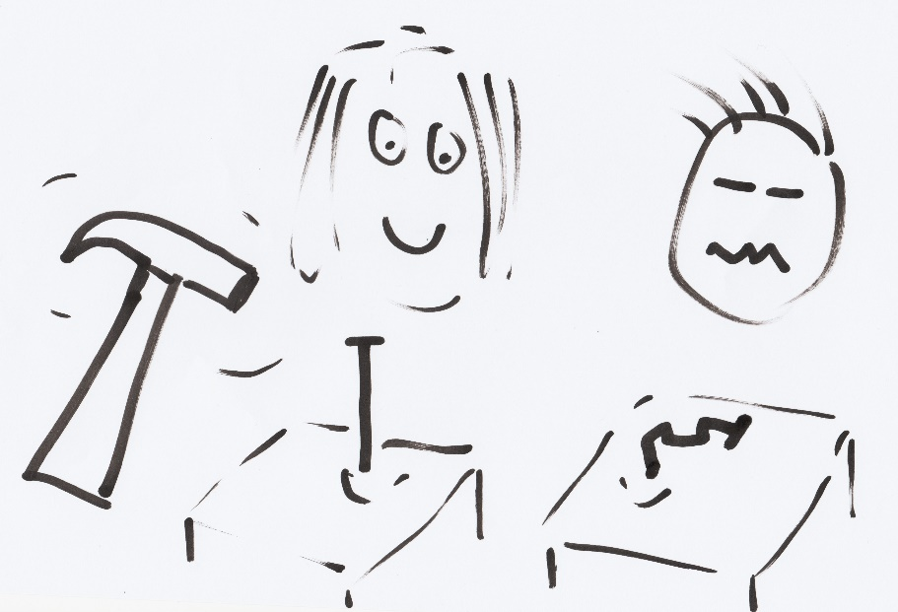
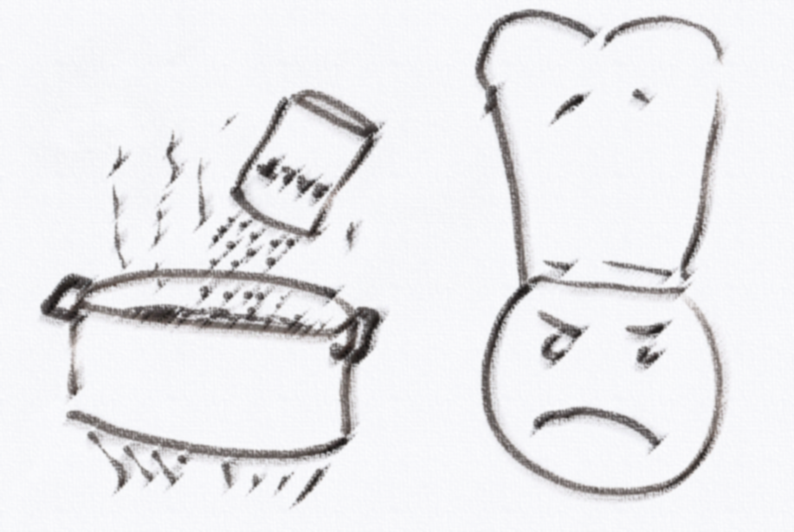
Exercise1: Basic consistency/inconsistency processing
Discuss:
What is the function of your annoyance?
Discuss possible OOPS moment.
What is the goal? hammer in the nail
Consistent action: hitting the nail on the head
How do you feel: good
Inconsistent action: missing the nail
How do you feel: annoyed with yourself
How does your annoyance motivate you?
Concentrate, aim better, hit it less hard, etc.
What is the goal? add salt to enhance flavour
Consistent action: put enough salt in
How do you feel: good
Inconsistent action: put too little/too much salt in
How do you feel: annoyed with yourself
How does your annoyance motivate you?
Add more/less salt, taste dish more often,
Introduce
Action-based model of dissonance (Harmon-Jones)

Slide 25
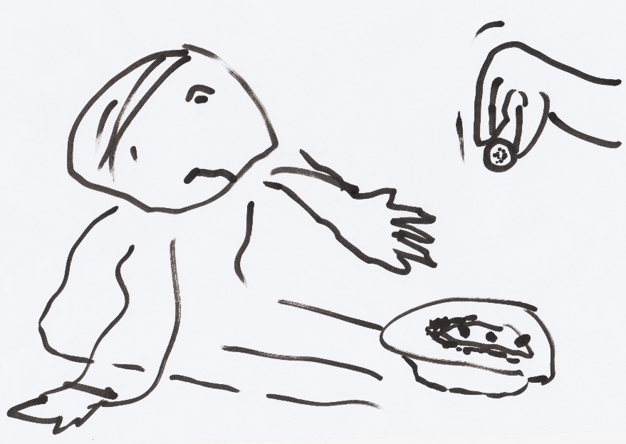
Exercise 2: Inner conflict in everyday life
Discuss in teams (3-5 students)
PART 1: As happens to most of us, we pass by beggars in the street. You probably remember an occasion when you walked on without giving any money. You may have felt a vague discomfort and realised that you thought that perhaps you should have helped and felt bad because you didn’t.
Can you remember how you felt at that moment?
What kind of inner conflict may be involved in this situation?
PART 2: Now consider that you went back to the beggar and gave some coins.
Can you remember whether you felt better after doing this?
What if you had not given money, what else could make you feel better about yourself?
Does it feel different when you act according to your beliefs or go against them?
If you cannot remember encountering this kind of situation, please try to imagine it!

Slide 26
Exercise 2b: Connecting Example and Theory
Dissonance induction
Not helping a beggar is inconsistent with seeing yourself as a good and helpful person
This leads to discomfort and in this case probably mild arousal
The discomfort has drive-like properties and motivates efforts to reduce it
Dissonance reduction
The purpose is to reduce dissonance and restore peace of mind
This can be done in a variety of ways:
  Action (Turn around to give money)
  Change attitude/belief (There is no point in helping beggars)
  Justification (I am in a hurry)
  Denial (I did not see the beggar)
  Trivialisation (My help is irrelevant)
  Add consonant thought (I give lots of money to charities)
  Seek distraction (I found myself looking the other way)
Relate to Festinger’s original model and Aronson’s self-related approach

Slide 27
Exercise3: Which experience is likely to include most dissonance?
Jack (69) has been drinking whiskey all his life. He has just been diagnosed with liver disease and will probably not survive long.
The minister in a church tells his parishioners from the pulpit he does not believe in God.
You are reading that a diet you have been following for a couple of years is now considered a health risk.
You are driving through a red light and almost hit a pedestrian who started to cross. You are not alone in the car.
You find out that your lover has had a secret affair with someone else for the last year.
Mary (34) has been depressed for the last few months, she is not going to work, stays in bed, and feels worthless. She is ruminating constantly.
A child refuses to go to school. The parent yells at the child and tells the child how bad this is. It does not help. The child ignores the parent.
Analyse:
What is the dissonance about?
How can it be reduced?
How serious is it?

Slide 28
Questions?
Thanks for your attendance.
Feel free to email me at jan.devries@tcd.ie

Slide 29
references
Aronson, E. (2006) The Social Animal (9th Ed). New York: Worth.
de Vries, J. M. A. & Timmins, F. (2016). Care erosion in hospitals: problems in reflective nursing practice and the role of cognitive dissonance. Nurse Education Today, 38, 5-8.
de Vries, J. M. A. & Timmins, F. (2017a). Recognising and responding to care erosion: part 1. Nursing Standard, 31(51).
de Vries, J. M. A. & Timmins, F. (2017b). Recognising and responding to care erosion: part 2. Nursing Standard, 31(52).
Festinger, L. (1957). A theory of cognitive dissonance. Stanford CA: Stanford University Press.
Gibbs, G. (1988). The reflective cycle. In: Kitchen S (1999) An appraisal of methods of reflection and clinical supervision. Br J Theatre Nurs, 9 (7), 313-7.
Johns, C. (1994). Nuances of reflection. Journal of clinical nursing, 3(2), 71-74.
Kahnemann, D. (2011) Thinking, fast and slow. London: Penguin.
Murphy, K. & Atkins, S. (1994). Reflection with a practice-led curriculum. In Palmer AM, Burns S, Bulman C. Reflective practice in nursing. The growth of the professional practitioner. Oxford: Blackwell Scientific Publications.
Rolfe, G. (2005). The deconstructing angel: nursing, reflection and evidence‐based practice. Nursing Inquiry, 12(2), 78-86.
Schön, D. (1983). The reflective practitioner; how professionals think in action. London: Maurice Temple Smith Ltd.
Timmins, F. & de Vries, J.M.A. (2014) Nurses are not bystanders: a response to Paley. Nurse Education Today, 34 (10), 1269-1271,

Slide 30
What is reflective practice?
Clinical practice in which reflection is integrated
Distinction between superficial, dialogic, critical (or deep) reflection
There are many models of differing degree of complexity (Gibbs 1988; Johns 1994; Murphy & Atkins 1994)
What? So What? Now What? (Rolfe 2005)
Reflection ‘in action’ or reflection ‘on action’ (Schön 1983)
There are interesting materials on-line you might want to access: https://blogs.bmj.com/ebn/2017/01/30/the-power-of-reflection-in-nursing/ http://libguides.scu.edu.au/c.php?g=185038&p=1548939

Slide 31
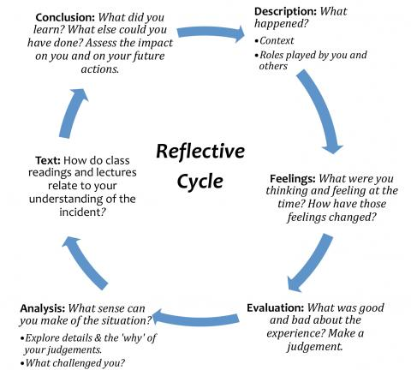
(Gibbs 1988)

Slide 32
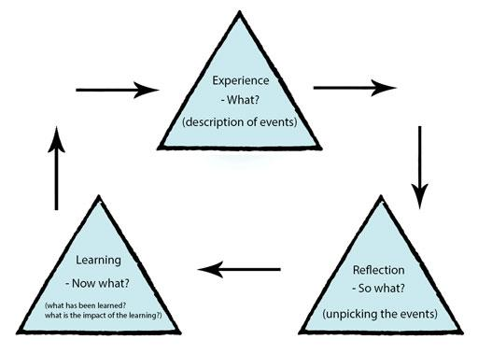
(Rolfe 2005)

Slide 33
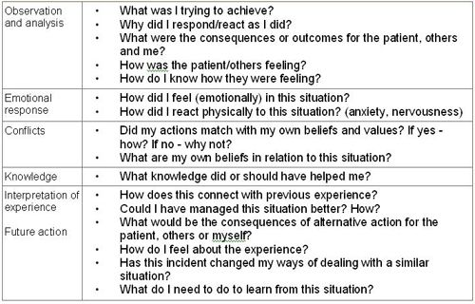
????

Slide 34


