Slide 1

Workshop:
Who are the CPT and what do they do?
Prison Oversight: Improving Rights in Europe (POIRE) Project, Trinity College Dublin, Ireland
The POIRE project has received funding from the European Research Council (ERC) under the European Union's Horizon 2020 research and innovation programme under grant agreement No. 101069413.

Slide 2
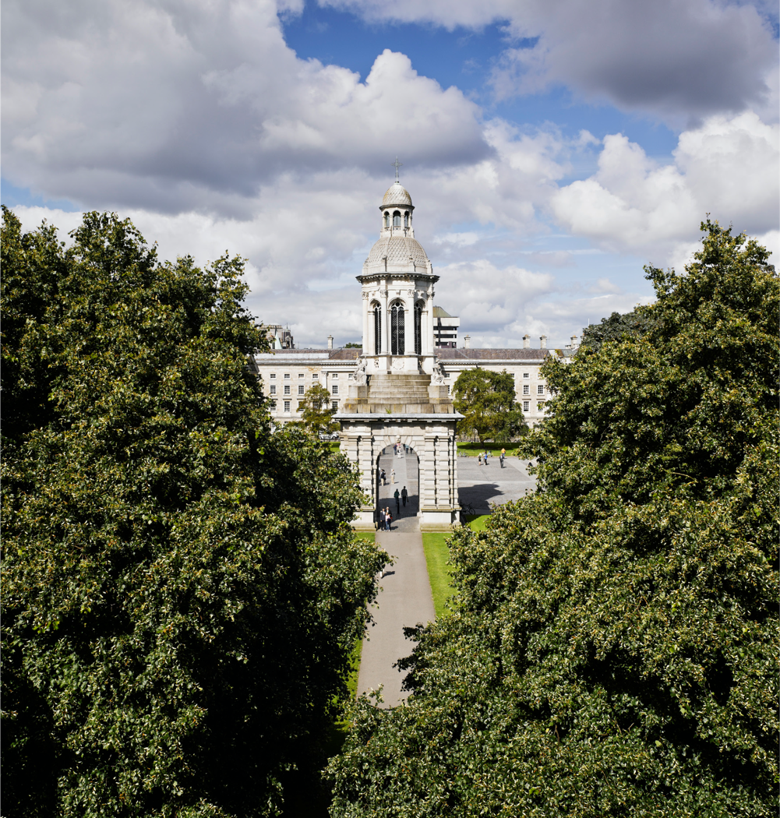
Why are we here?
  Members of the POIRE Project team from Trinity College Dublin came to this prison and asked how best to tell people about the CPT.
  Most common answer was an in-person workshop.
  The purpose of this workshop is to help you to learn more about the CPT.

Slide 3

Rights
When we talk about rights, what do we mean?
What rights do you think you have?

Slide 4

Rights
Even though you are in prison, you still have rights.
These are basic things that every person should have or be able to do.
The purpose of rights are to help keep you safe, respected, and treated fairly.

Slide 5
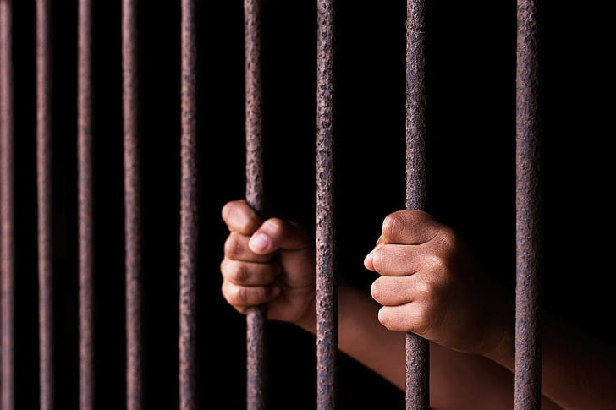
Why is prison monitoring needed?
You know that things can sometimes go wrong in prisons e.g. there can be bad conditions or ill-treatment.
One way to try to prevent these bad things from happening is to have visits from people independent of the prison.
Do you think independence matters?

Slide 6

About the CPT
The CPT is short for The European Committee for the Prevention of Torture and Inhuman or Degrading Treatment or Punishment.
The CPT is an independent organisation.

Slide 7
Torture and Inhuman or Degrading Treatment
What do you think of when you hear the term ‘torture’?
Do you know what is meant by ‘inhuman or degrading treatment’?

Slide 8

What We Know
Conducted survey of awareness in Penitentiary of Timisoara and found:
Just under 25% of people who took our survey had heard of the CPT
Out of 21 interviews, no one had heard of the CPT
This is similar to other places in Europe!

Slide 9
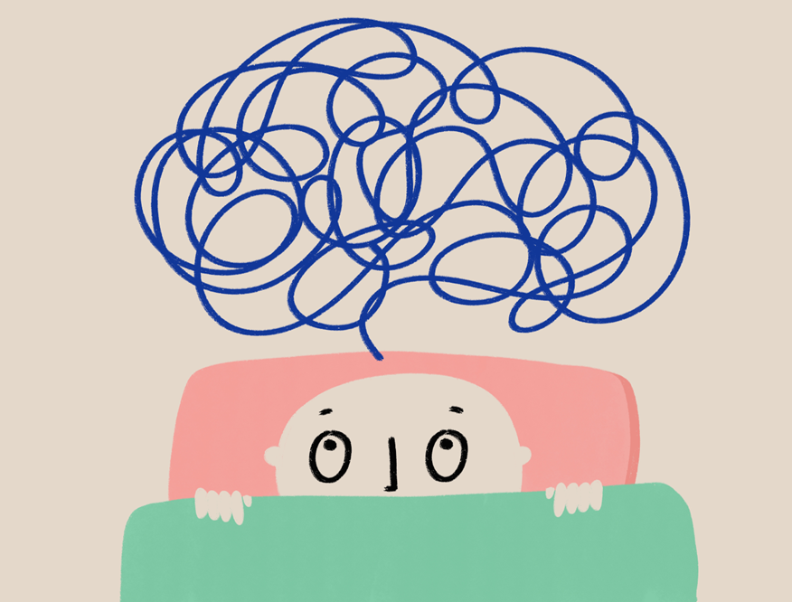
Why should you know about the CPT?
Research shows many people in prison:
Have never heard of the CPT
Don’t know what it does
Don’t know it is okay to talk to them
When people learn more, they feel:
👍 Better informed about the CPT
👍 Glad that someone checks on prison conditions

Slide 10
What do the CPT do?
The CPT visit prisons all over Europe
Visits happen every 4–5 years (or sooner if needed)
During a visit, they can:
🔎 Check all areas of the prison
📂 Read records (like health files)
🗣️ Speak to any prisoner in private
👮 Talk to staff
The CPT do not deal with individual complaints.

Slide 11

What happens after a CPT visit?
The CPT will:
Write a report (no names are used).
Share the report with the government.
The government writes back with a plan to fix problems.

Slide 12

What will change?
Latest visit to prisons in April 2025.
Latest published report on prisons is from 2021.
Recommendations focused on:
Living conditions
Purposeful activities
Staff numbers
Healthcare services
Overcrowding
Physical ill-treatment
Inter-prisoner violence
Complaints system

Slide 13
✉️ How Can You Contact the CPT?
You can send them a private letter.
📬 Address:
CPT Secretariat
Council of Europe
F-67075 Strasbourg Cedex
France
📞 Phone: +33 388 412772
🌐 Website: www.coe.int/en/web/cpt/home

Slide 14
Thank you for your attention!
Any questions?
Please complete our short survey.
Prison Oversight: Improving Rights in Europe (POIRE) Project, Trinity College Dublin, Ireland
The POIRE project has received funding from the European Research Council (ERC) under the European Union's Horizon 2020 research and innovation programme under grant agreement No. 101069413.

