Slide 1

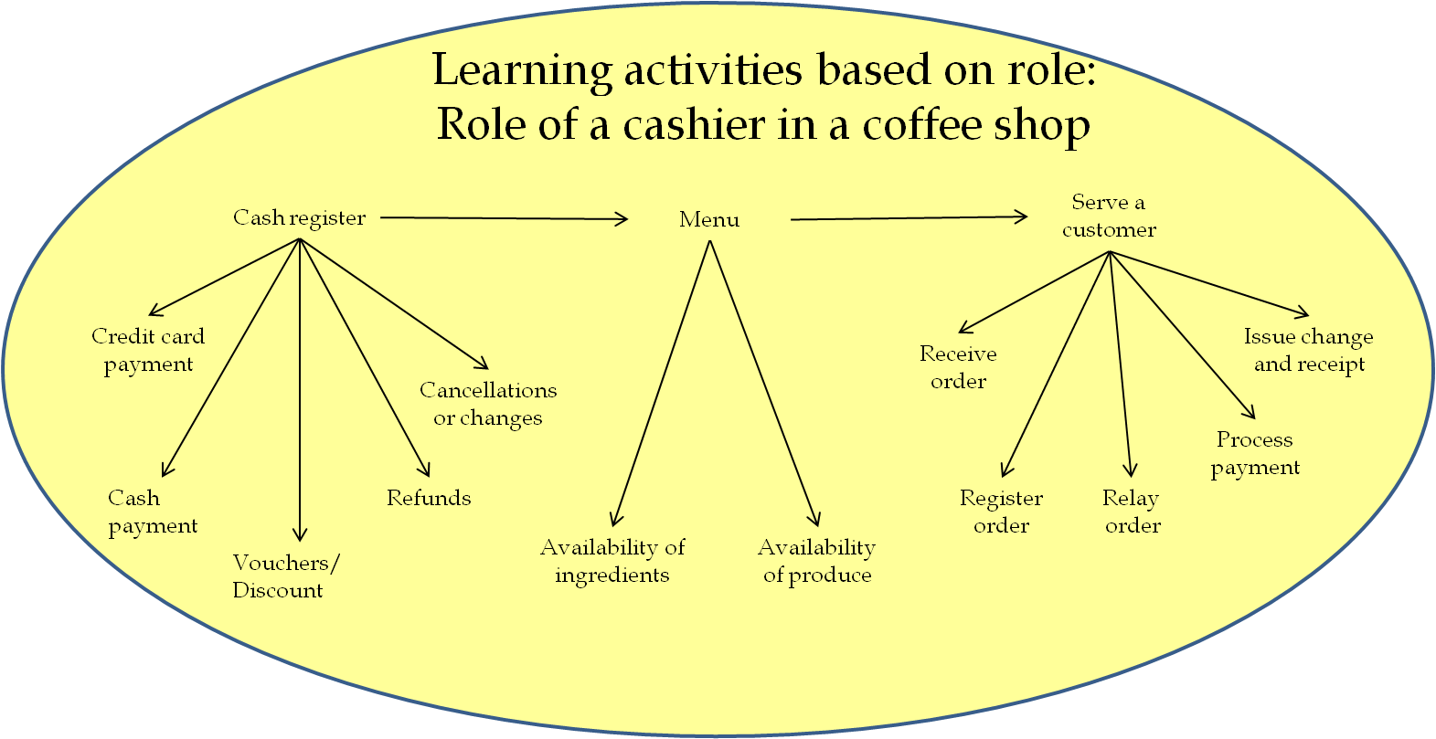
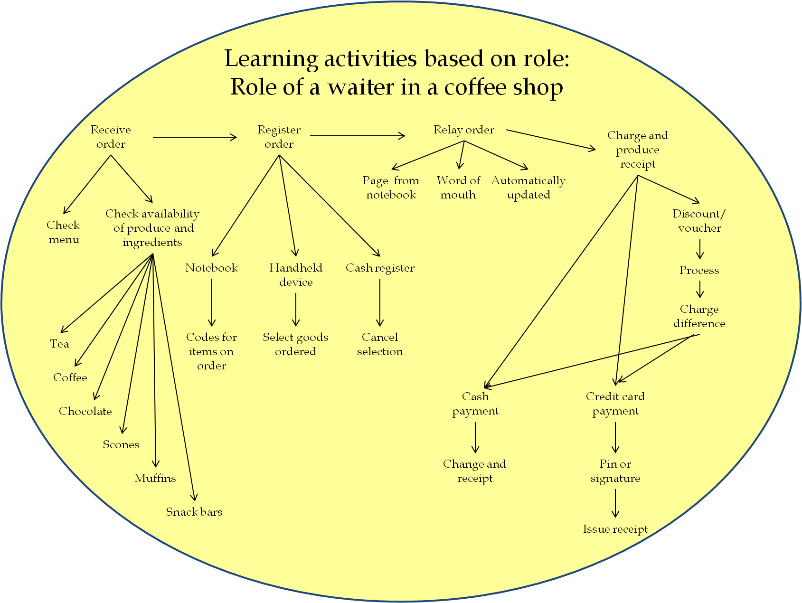
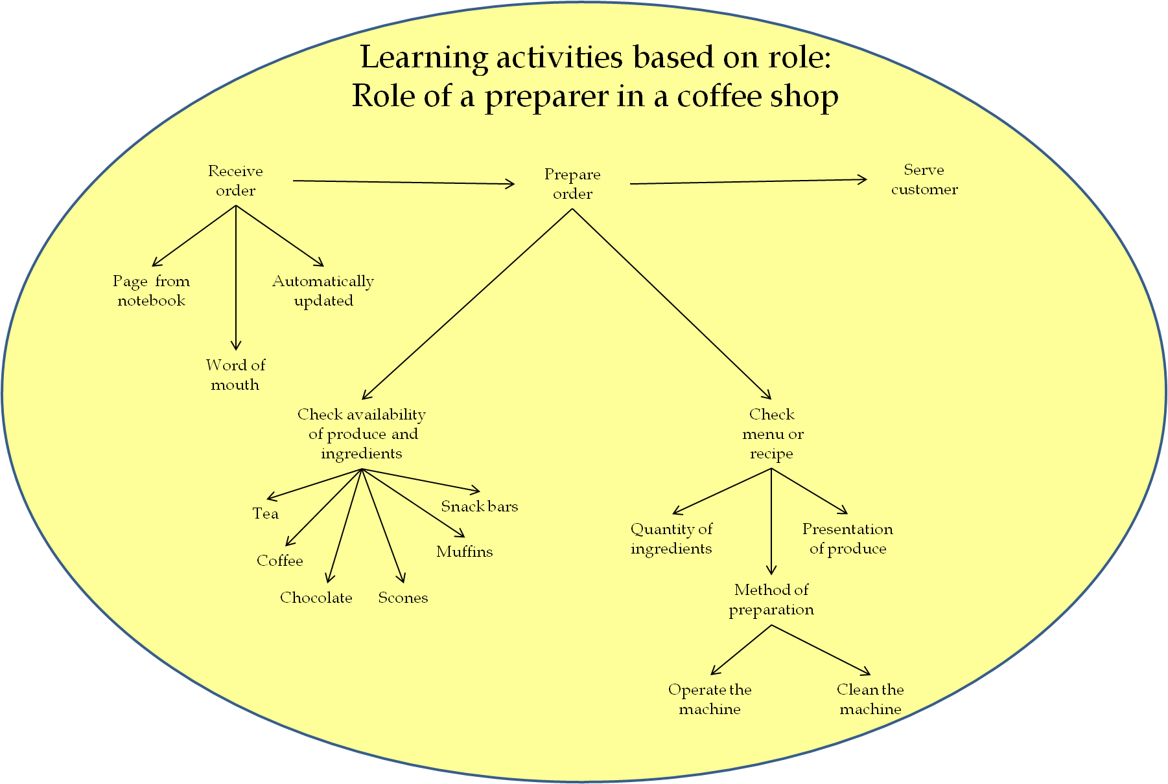
Personalised E-Learning
Facilitating students' understanding and mastery of new concepts
Eileen O’Donnell, Victoria Macarthur & Mary Sharp
Eileen.ODonnell@dit.ie Victoria.Macarthur@ncirl.ie Mary.Sharp@scss.tcd.ie
Introduction
Each individual perceives and experiences life and learning in their own unique way. Past experiences can influence our understanding and mastery of new concepts. Occasionally, learners meet obstacles in their learning experiences which they find difficult to surmount. Not all learners require the same learning experience to reach the required thresholds or basic units of understanding which are expected to succeed with their course of study.
Threshold concepts
Threshold concepts are part of the fundamentals of a subject which one builds upon to eventually achieve the required learning outcomes. The provision of personalised e-learning activities to assist students to surmount their personal learning difficulties could improve student engagement with the required threshold concepts and therefore assist each individual student in achieving their full potential. Tailored learning experiences which have been specifically selected to suit individual students learning requirements could be made available to the students who felt a need to use these activities to help them through frustrating times on route to grasping new concepts.
Personalised learning activities based on role playing
Role of cashier
Role of waiter
Role of preparer
Authoring personalised learning resources
This research reviews the functionality which non-technical educators would need to enable them to create personalised learning activities. The objective is to develop an authoring tool which will enable non-technical authors create personalised learning activities. These personalised e-learning activities could be used to assist students in grasping a deeper understanding of the threshold concepts required for their discipline. A deeper understanding of the fundamental topics will help students during their progression through the rest of the curriculum and course of study.
Conclusion
Authoring tools for personalising e-learning should facilitate the creation of personalised learning activities by non-technical authors. A modular approach will be undertaken in the development of this authoring tool and evaluations will be conducted on completion of each module. An overall evaluation of this authoring tool for personalising e-learning will be conducted and the design approach will be amended as a result of participants relevant feedback.
For further information please visit:
http://people.tcd.ie/odonnee
.

