Slide 1

LGBTQI+ Strengths: What I like about Being LGBTQI+
Presenter: Dr. Karin O’Sullivan
Sexuality & Social Work Conference. Glasgow 2023

Slide 2
Team members
Professor Agnes Higgins, P.I.
Dr. Jan DeVries, P.I.
Ms. Carmel Downes
Dr. Mark Monahan
Ms. Renee Molloy
Dr. Thelma Begley
Dr. Louise Doyle
Dr. Brian Keogh
Mr. Gerard Farrell

Slide 3
Outline of Presentation
Strengths Literature
Main Study &
Methods
Findings
Irish LGBTQI+ context
Concluding comments

Slide 4
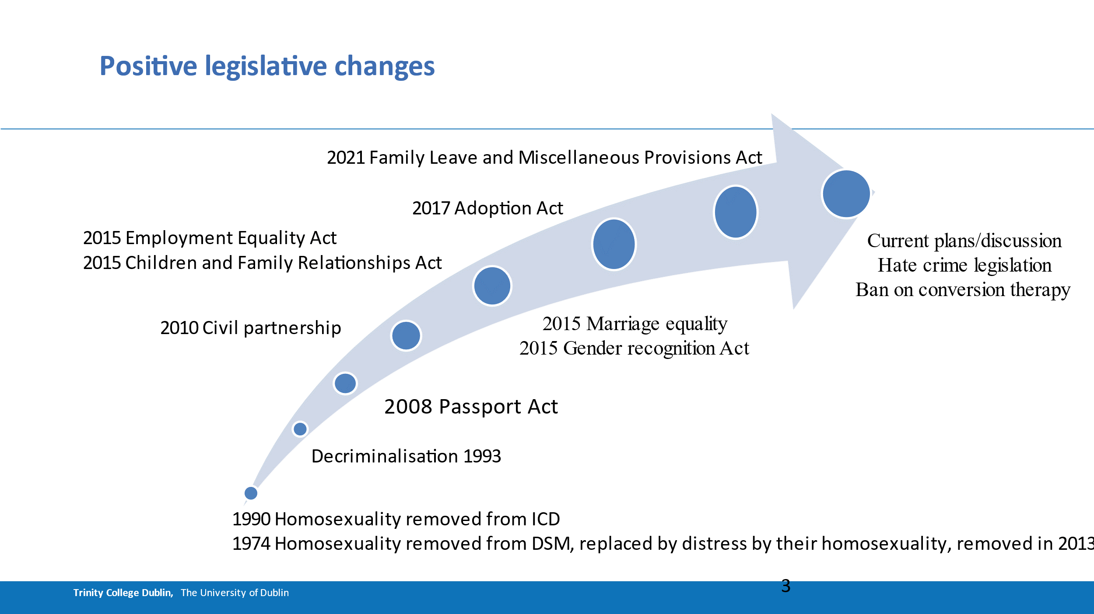

Slide 5
Strengths Literature: Positive Psychology and LGBTQI+ lives
Strengths: “..qualities or conditions (internal or external, often culturally bound, and developmental in nature) that helps individuals adaptively cope with life or that which makes life more fulfilling for oneself and others.” (Aspinwall & Staudinger, 2003)
Move away from a deficit model /positioning sexual minority identities as purely risk laden
Strengths focus - not discounting reality of stigma, discrimination, violence experience by [GSM] (Rostosky, 2018).
Instead, strengths focus, recognises the development of positive identity occurring within context of oppression/marginalisation, so learning about these strengths/resources, can be used to inform the development of [GSM] resilience (Rostosky et al., 2018).
Developing a positive LGB identity or holding affirming thoughts about oneself as an LGB-identified person have been found to be associated with psychological well-being (Riggle et al., 2014; Riggle & Rostosky, 2012).
Notes:
Focusing on distress/dysfunction, a reflection of the heterosexist and cissexist social and temporal context in which the literature was written (e.g. from era of homosexuality as a diagnosis) informed by heterosexist assumptions about functioning and psychological well-being (Vaughan, 2014).

Slide 6
Being LGBTQI+ in Ireland
Module 1
Lived experiences of LGBTQI+ people in Ireland
Module 2
Public Attitudes and perceptions of LGBTQI+ people and issues affecting the LGBTQI+ community in Ireland.
Follow up study to the first national study of the mental health and well-being of LGBTQI+ people in Ireland (Higgins et al., 2016).

Slide 7
Methodology: Being LGBTQI+ in Ireland study. Module 1
Online anonymous survey: October 2022
Identifying as LGBTQI+
14 years of age or older
Living in the Republic of Ireland
Recruitment via communication channels of LGBTQI+ organisations incl..Traveller, Migrant & Asylum Seeker, Eating disorder, Substance use.
Consent via tick box at beginning of survey
Survey: 170 Questions in total
Qualitative Questions: 29
Data analysis
Quantitative: Descriptive and inferential statistics
Qualitative: Thematic content analysis
Notes:
Young people; Parental consent not sought as could be prohibitive for those not out. 3x strategies to offset absence of parental consent. 1) Anonymous online survey, 2) Self-selection – i.e. no pressure, coercion, 3) partnering with LGBT organisations signalling a pathway for young people to seek assistance. Sample of 383 required for a confidence level of 95%, and confidence interval of 3%.

Slide 8
Aim of Current Presentation
  Present preliminary findings from one open/qualitative question:
    What do you like most about Being LGBTQI+?
  To identify key themes emerging
  To consider the potential implications for LGBTQI+ people and services.
** Participants age and self-identified gender and sexual orientation are used to code quotes.

Slide 9
Demographics: Sexual Orientation

Slide 10
Findings: Q. What do you like most about Being LGBTQI+?
Number of participants | n=2,555
Response rate | 89.3%

Slide 11
Findings: What do you like most about Being LGBTQI+?
Categories | Personal Aspects (Intra-personal) | Social Aspects (Inter-personal) | LGBTQI+ History, Culture, Politics,
Sub-themes | Personal Growth (n=410) Freedom (n=377) Being true to Myself/Being Myself (n=216) Statement of Fact (n=89) Being different/Unique (n=77) My LGBTQI+ Life/Lifestyle (n=17) Having language/label to describe myself (n=10) | Community (n=851) Other LGBTQI+ people (n=268) Attraction, Dating, Relationships (n=221) Friendships (n=160) Love (n=51) Support (n=46) Sex or Intimacy (n=34) Others Acceptance / Recognition (n=29) Being Open or Out (n=23) | LGBTQI+ History, culture, Politics (n=260)

Slide 12
Personal Aspects: Personal Growth (n=410)
1. Exploring/becoming OR having become or accepted - myself (n=234)
2. Being LGBTQI+ has given me a different perspective (n=176)
“I think it has helped me (after years of working on self-acceptance) to be more brave in being myself and caring less what other people think.” (37, Cis Female, Gay)
“I love how I can explore myself and my identity and change my labels as I grow and develop.” (24, Non-binary, Queer)
“..and gives me a unique perspective of life which allows me to be more accepting and compassionate towards all marginalised people.” (19, Non-binary, Bisexual)
“Once I accepted myself as a gay woman everything started to make sense.” (41, Cis Female, Lesbian)
“An understanding of how the world really marginalises people.” (48, Non-binary, Pansexual)

Slide 13
Personal Aspects: Freedom (n=377)
Feeling free from limitations of ‘conformity’, ‘heteronormativity’ or ‘social norms’..
Freedom to be… ‘can be’… ‘being able to’..
“I feel as if I can be myself.” (14, Cis Female, Questioning)
“The freedom of not being bound by heteronormative notions of how life should be lived.” (28, Cis Male, Gay)
“I like that there are no guidelines, no traditions already set out. It means we get to create the reality of being LGBTQ and there’s no blueprint, it’s whatever you want it to be!” (23, Cis Female, Lesbian)
“..and freeing feeling of being able to express myself.” (16, Trans Man, Queer)
Notes:
Idea that LGBTQI+ people are measuring their lives against heteronormativity..

Slide 14
Personal Aspects: Being True to Myself /Being Myself (n=216)
“It’s pretty nice to actually be myself after spending near a third of a life sleepwalking.. .. The company of other women might be the best thing..” (36, Trans Woman, Queer)
“Being happy out and living my life as who I am.”
(51, Cis Female, Lesbian)
“Being myself. I feel much more myself as a man and being bi than I ever did having to hide those parts of myself.” (22, Trans Man, Bisexual)
“Being me, being who I know I am.” (32, Cis Male, Gay)

Slide 15

Social Aspects: Community (n=851)
Some specifically referred to particular communities e.g. based on identity and/or sexual orientation, or space specific, e.g…
The LGB community; Bisexual; Ace; school based; online…
“The sense of community that I have created around me in my chosen family.” (33, Cis Male, Gay)
Some words used to describe community:
Supportive; welcoming; accepting; inclusive; close knit; open; like-minded; relatable; kind; understanding; respectful; connected; safe; friendly; strong; unique; vibrant; humorous/fun; non-judgemental; brave; resilient; loving; perspective challenging; diverse….
among others..

Slide 16
Social Aspects
Other LGBTQI+ People (n=268)
Some group distinctions e.g. other lesbians; queer people, gay people, age groups, women, men, etc..
Attraction, Dating, Relationships (n=221)
“Meeting people from different class and ethnic and national backgrounds that I might not if I were straight.” (42, Cis Male, Gay)
My Partner (n=109) e.g. wife; boyfriend, marriage..
Attraction/Dating/Relationship (Options) (n=86)
The Nature of relationships (n=27) e.g. communicative; accepting; solid; unique; equal..
“And I get to date girls and guys. Pretty fun.” (15, Cis Female, Bisexual)
‘..being able to connect over shared experiences.” (16, Non-binary, Lesbian)
“The options I have when looking to date.” (16, Cis Female, Omnisexual)
“Solidarity with other LGBTQ+ People.”
(50, Cis Female, Lesbian)

Slide 17
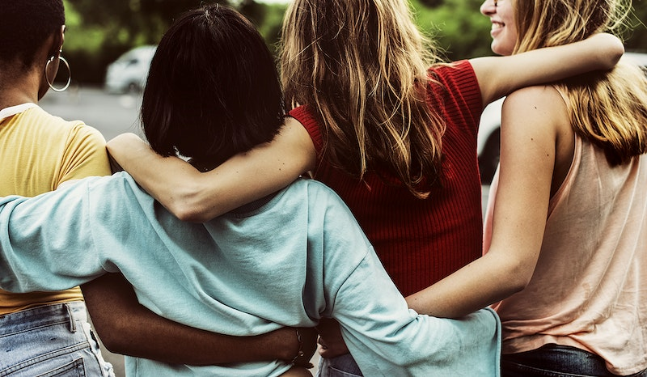
Social Aspects: Friendships (n=160)
“The amazing friends that I have made since coming out. I've found a whole unit of people who think like me and share the same experiences as me. We all validate each other and hype each other up and it makes me feel so great.” (24, Non-binary, Queer)
“I have a great set of friends that come from more diverse backgrounds than I likely would have had if I were straight.” (51, Cis Male, Gay)
“I like my queer friends and the community that I can feel open about who I am even if I am struggling with it at home.”
(23, Non-binary, Bisexual)
Notes:
Words to describe Friendships: Supportive; solid; bonded; honest; diverse in terms of background and social class; accepting; close-knit; fun; interesting; loving; and alternative friends.

Slide 18
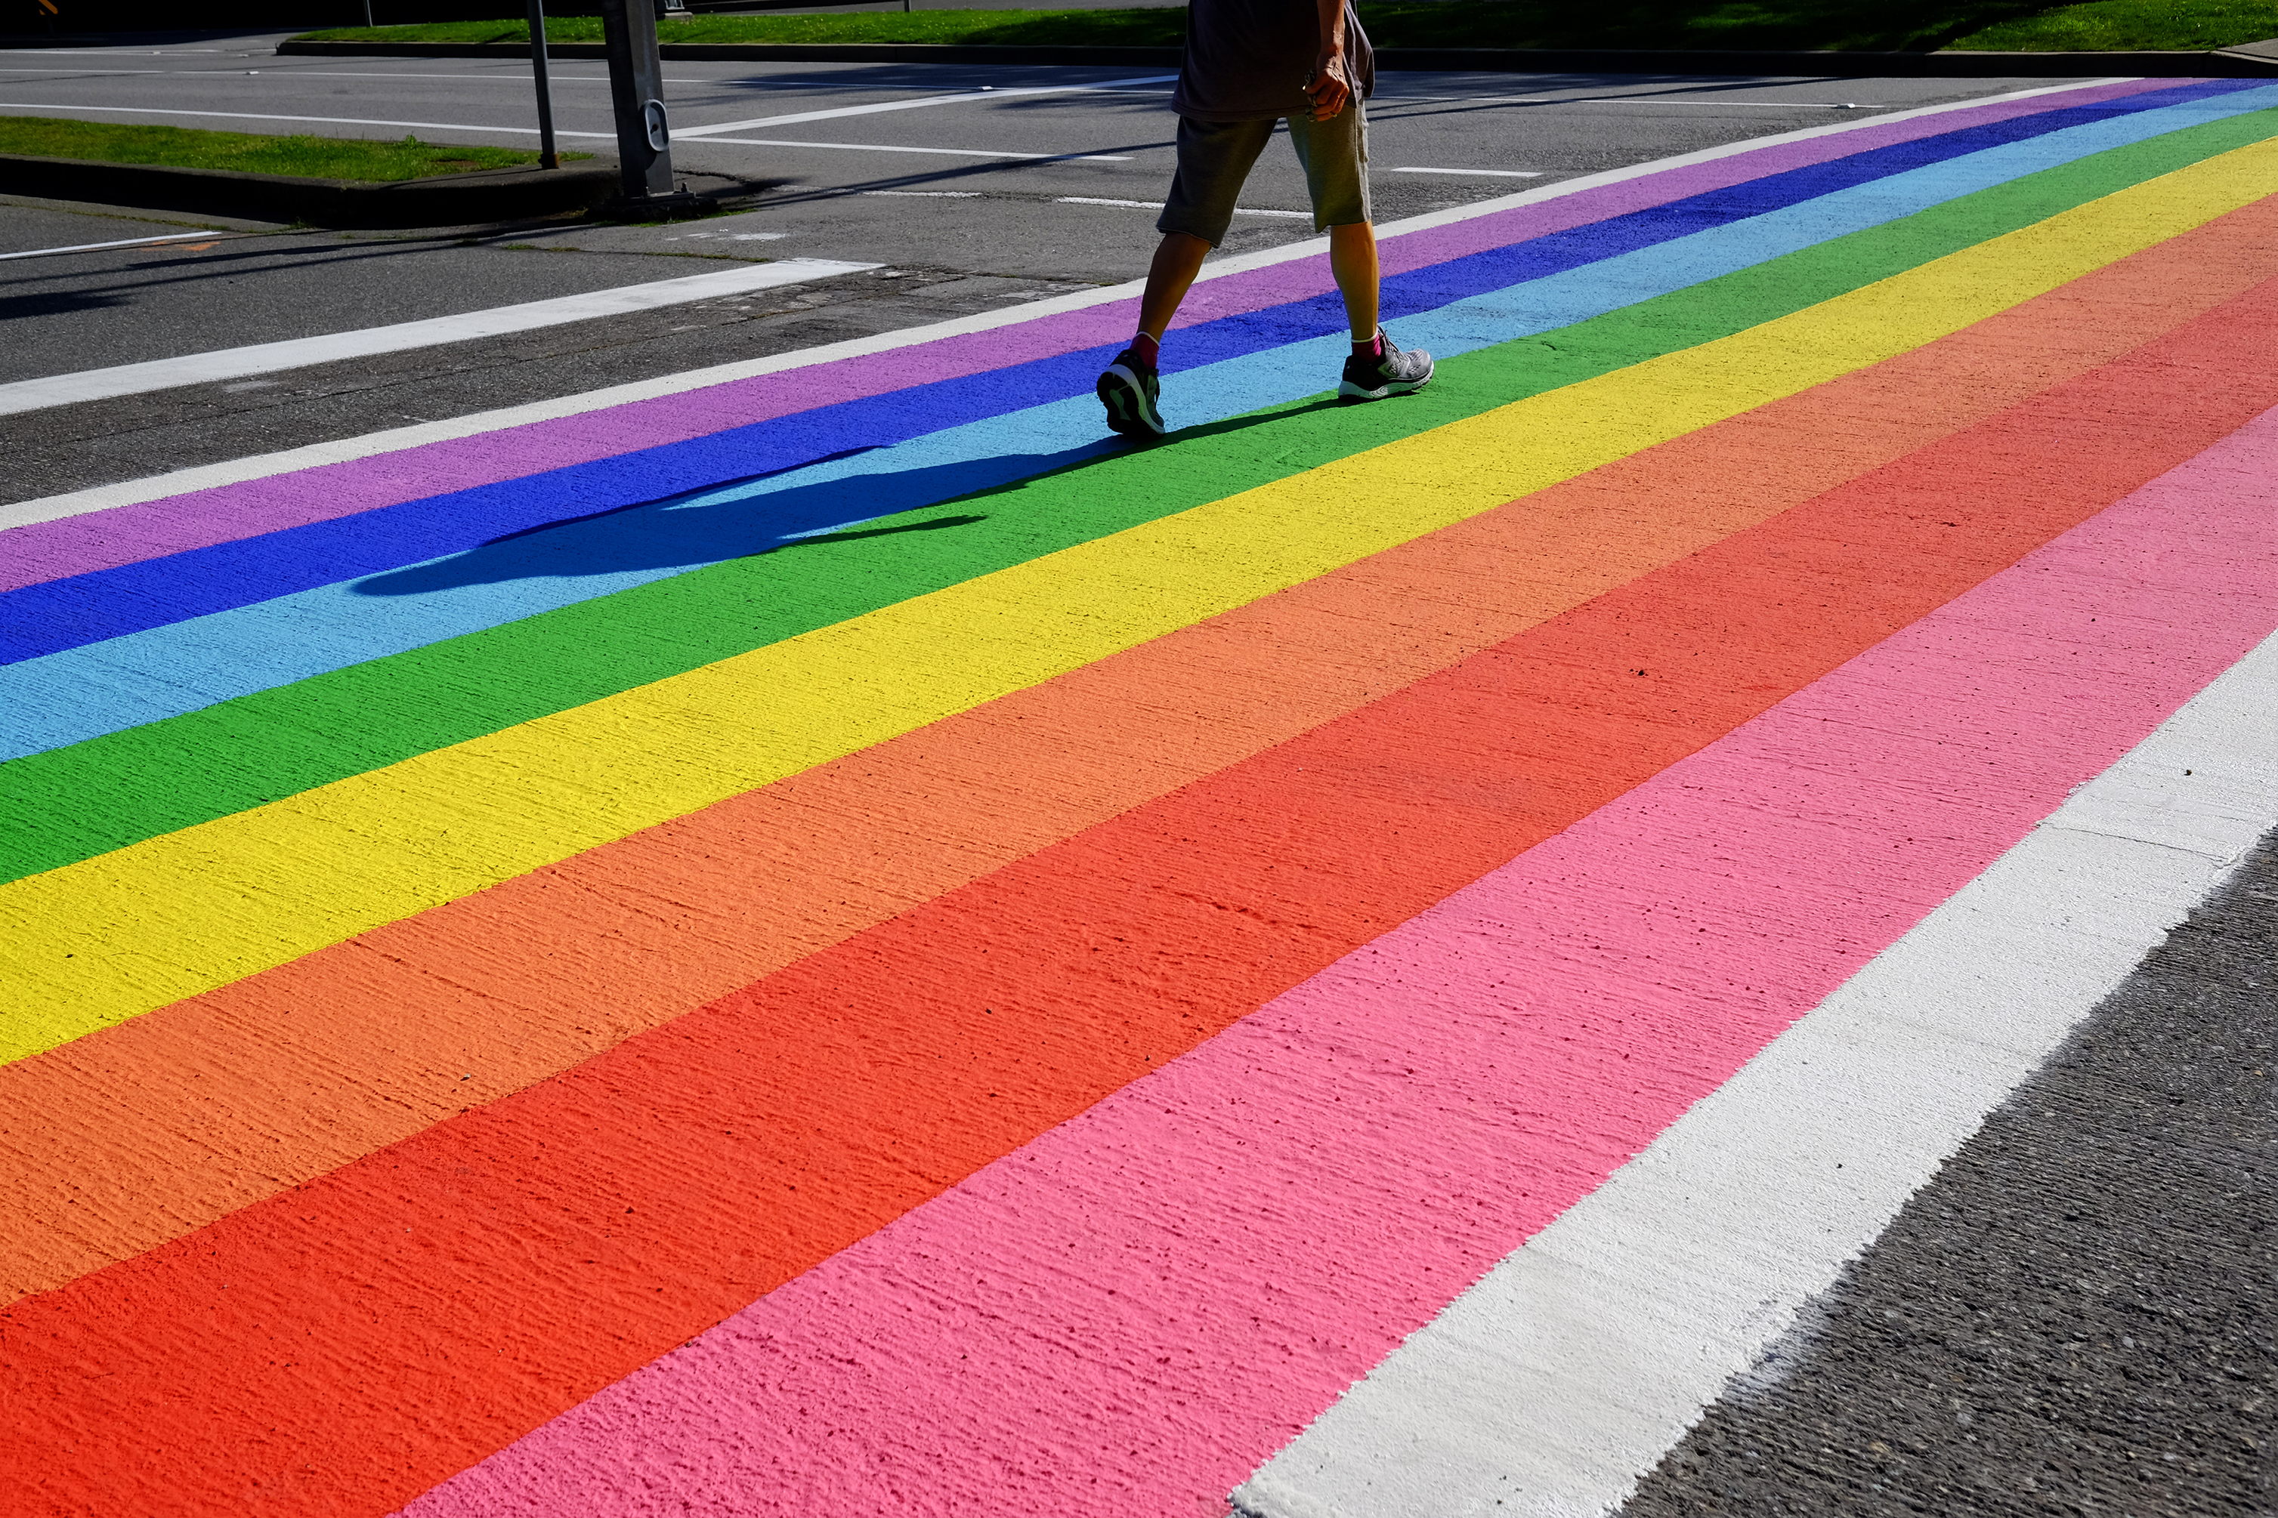
LGBTQI+ History, Culture, Politics (n=260)
LGBTQI+ Art, Books, Media
LGBTQI+ social life, events/spaces, symbols
Fighting spirit and activism
“I would also say I like the courage we have to live as ourselves.” (27, Questioning, Gay)
“LGBTQI+ events where I get to interact with other LGBTQI+ people, and witness LGBTQI+ joy!”
(22, Non-binary, Prefer not to label SO)
“Being part of a minority with a shared history of struggle but who have come a long way.” (30, Cis Female, Queer)
“And the fun of it all!” (25, Cis Male, Gay)
“Looking gorgeous and having fun as resistance to marginalisation and oppression.” (41, Cis Female, Lesbian)
Notes:
Words to describe Friendships: Supportive; solid; bonded; honest; diverse in terms of background and social class; accepting; close-knit; fun; interesting; loving; and alternative friends.

Slide 19
Concluding comments
Majority of studies on strengths have been conducted in North America.
Focus mostly on smaller identity groups within the LGBTQI+ communities /smaller sample sizes.
Current study:
Irish ROI context
Large sample
Proportionality related insights
Personal & Social Factors
Community (n=851)
History, Culture, Politics
History, Culture, Politics (n=260)
Personal Growth (n=410)
Freedom (n=377)
Attraction, Dating, Relationships (n=221)
Other LGBTQI+ People (n=268)
Friendships (n=160)
Being True to Myself / Being Myself (n=216)
Notes:
USA – methodology…. 2. proportion and young peopee.. Services to help LGBTQI+ people and communities.

Slide 20
Concluding comments - 2
Strengths:
Can inform practitioner education (and societal education) and reflective practice about the lived experiences of, and positive factors in, LGBTQI+ people’s lives.
Knowledge base for exploration and development of strengths-based mental health and well-being interventions for LGBTQI+ populations:
  supporting the development of resilient LGBTQI+ people, resilient communities, and in working together with other marginalised groups, resilient systems based on fair and healthy societies

Slide 21
Concluding comments - 3
LGBTQI+ strengths based literature offers a more balanced and representative understanding of LGBTQI+ lives – by moving beyond a deficit approach.
Offering a positive context for the younger generation coming up
Making visible that being LGBTQI+ can be a life of joy, community, solidarity, friendship, family and growth.

Slide 22
References
Aspinwall, L. G., & Staudinger, U. M. (Eds.) (2003). A psychology of human strengths: Fundamental questions and future directions for a positive psychology. Washington, DC: APA Books.
Galupo, M.P, Taylor, S.M., (2019) Cole Jnr, D., “I am double the Bi”: Positive Aspects of Being Both Bisexual and Biracial. Journal of Bisexuality, 19(2) 152-168.
Harper, G.W., Brodsky, A., & Bruce, D. (2012) What’s Good about Being Gay? Perspectives from Youth. Journal of LGBT Youth, 9(1), 22-41.
Higgins, A., Doyle, L., Downes, C., Murphy, R., Sharek, D., DeVries, J., Begley, T., McCann, E., Sheering, F., Smyth, S. (2016) LGBTIreland. The LGBTIreland Report: national study of the mental health and well-being of lesbian, gay, bisexual, transgender and intersex people in Ireland. GLEN and BelonG To, Dublin.
Poteat, T.C., Logie, C.H., & van der Merwe, L.A. (2021) Advancing LGBTQI+ Health Research The Lancet, Vol 397.
Riggle, E.D.B., Whitman, J.S., Olson, A, & Scales Rostosky, S.S. (2008) The Positive Aspects of Being a Lesbian or Gay Man. Professional Psychology: Research and Practice, 39(2) 210-217.
Riggle, E.D.B., Mohr, J.J., Rostosky, S.S., Fingerhut, A W., Balsam, K.F., (2014) A Multifactor Lesbian, Gay, and Bisexual Positive Identity measure (LGB-PIM). Psychology of Sexual Orientation and Gender Diversity, 9(4) 398-411.
Rostosky, S. S, Cardom, R.D., Hammer, J.H., & Riggle, E.D.B. (2018) LGB Positive Identity and Psychological Well-Being. American Psychological Association, 5(4) 482-489.
Rostosky, S.S., Riggle, E.D.B., Pascale-Hague, D., & McCants, A.E. (2010), The positive aspects of a bisexual identification. Psychology & Sexuality, 1(2), 131-144.
Vaughan, M.D, Rodriguez, E.M. (2014) LGBT Strengths: Incorporating Positive Psychology Into Theory, Research, Training, and Practice. Psychology of Sexual Orientation and Gender Diversity 1(4), 325 – 334.

Slide 23
Thank You!
Any Questions?
Contact details: kosulli7@tcd.ie
ahiggins@tcd.ie

