Slide 1
Next-Generation Fibre to the Home Deployment
A HEAnet Case Study
Dr. Marco Ruffini, Prof. David Payne
CTVR, University of Dublin, Trinity College

Slide 2
Collaboration
CTVR academics:
  Optical Network and Internet Architecture group: Dr. Marco Ruffini, Prof. David B. Payne, Prof. Linda Doyle, Trinity College Dublin
  Cork Computation Constraints Centre (4C): Prof. Barry O’sullivan, Dr. Deepak Mehta, Dr. Luis Quesada, University College Cork
University of Swansea academics:
  Prof. Nick Doran, Dr. Farsheed Farjady
Industry collaboration:
  HEAnet
  Eircom
  British Telecom

Slide 3
The bandwidth increase problem
Bandwidth forecast based on extrapolation of traffic trends are unreliable ➔ 2001 Telecom bubble
Forecast based on prediction of usage and applications are more reliable
  The 100%/year bandwidth increase was due to increase in Internet population and bandwidth of applications
  As population increase saturates we see lower growth rate
Internet overall traffic (data from L. Roberts)
NASDAQ composite index (NYSE data)
Traffic PB/Month
“Internet traffic is doubling every three months.” Business Week, Oct. 9, 2000
PB/Month
Data from Cisco Forecast 2010
Growth rate
37%
1960 1970 1980 1990 2000 2010
48%
23%
33%
29%
107%
112%
21%

Slide 4
How much bandwidth can we use?
  The final amount of information we can process and thus exchange is not infinite, but limited by our perceptions…
  … but we still have a potential growth of at least:
    2 orders of magnitude sustained rate -> 10Mbps
    3 orders of magnitude peak rate -> 10Gbps
  In any case it’s way more than xDSL can deliver
  Action points:
    Replace xDSL, with fibre to the home (FTTH)
    Modify or replace metro/core to support sustainable access bandwidth increase (i.e., cost and power consumption)
Relative growth
Unsustainable
Revenues
Revenues
Bandwidth
Margins
Incremental Costs
Incremental Costs
1 2 3 4 5 6
1 2 3 4 5 6
1 2 3 4 5 6
years

Slide 5
Future Networks: Evolvable & sustainable - Fluid
Remains economically viable
  as demand and services evolve
  and supports a range of business and ownership models
Low power consumption
  “Green” network solutions
Can scale to meet service growth requirements
  particularly those enabled by Fibre to the premises (FTTP)
  access bandwidth scales indefinitely up to limits of fibre technology.
Can adopt new technologies
  while co-existing with previous generations
  re-use installed physical infrastructure
Efficiently use network resources
  e.g. spectrum, bandwidth, infrastructure (cables & fibre), equipment and components, man-power, processing power, space, storage etc.
Major reduction in electronic equipment per unit of user bandwidth.
  Reduced number of nodes, interface ports, OEO conversions, and line cards.
  Cost per unit bandwidth needs to fall almost inline with bandwidth growth!

Slide 6






Cost effective and Energy efficient architecture
Self-architecting wireless
Flat optical core
LR-PON
Connects access and core

Slide 7

Legacy fibre access networks
Fibre access networks that allow Fibre to the home (FTTH) are generally called Passive Optical Networks (PON).
The PON divides the fiber bandwidth between a number of users (to reduce the cost per user)
~10-20km
Local Exchange
backhaul/metro
network
GPON
2.5Gb/s
Cabinet
1.25/2.5Gb/s
~32 way split
FTTP
Customers

Slide 8
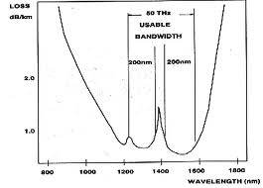
Next-generation fibre access
Build the fibre network around the fibre, rather than around legacy copper-centric architectures
The optical fibre has two great features:
  Large bandwidth
  Low loss
How can we best exploit such properties in the access?
  Reduce cost by sharing bandwidth more
  Reduce cost by eliminating the (electronic) metro network, connect access to the core
50THz bandwidth > 10Tbps data rate
Fibre Loss
wavelength

Slide 9

Long-Reach PON
~10-20km
~90-80km
~100km
Ex Local exchange
500 to 1000 way total split/LR-PON
The network is protected through dual-homing

Slide 10
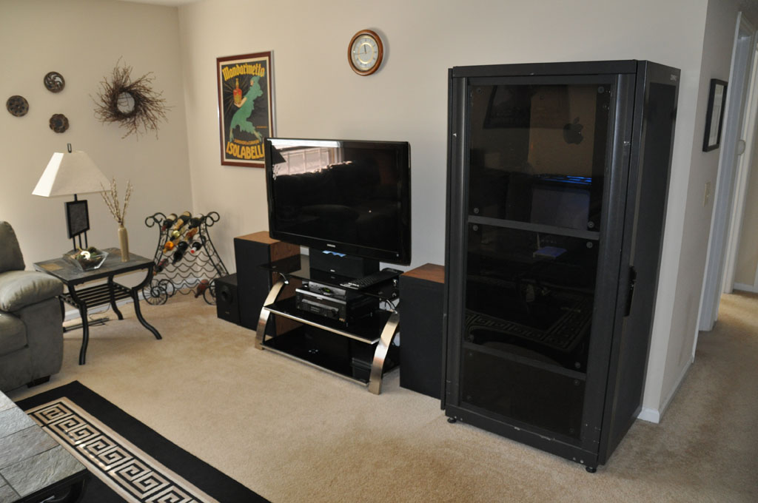




LR-PON in a nutshell
For the user:
  10-20Mbps avg sustained rate, up to 10Gbps peak rate (and upgradeable over x50) –x5,000 today
  No preferential point of connection…
  You can set up a content distribution system in your living room
  Or you can be tele-present anywhere any time, e.g., lecturing, High Quality conferencing,…
For the provider: savings and more revenue
  Reduce the number of central nodes, remove all electronics in the metro
  Provide strong dual-homed network protection, with 80% reduction in IP protection capacity
  Reduce traffic in your core network by switching it in the access when possible
  Provide flexible bandwidth services on demand

Slide 11
Cost and power savings

Slide 12
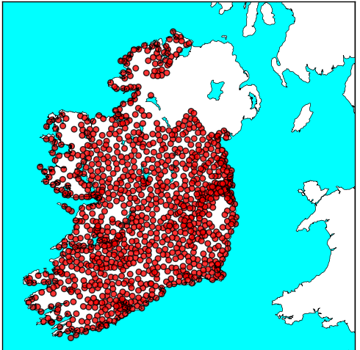
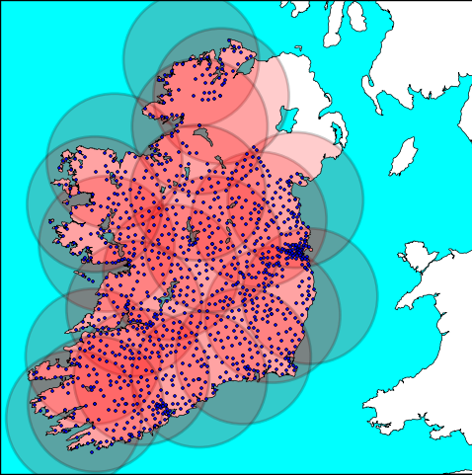
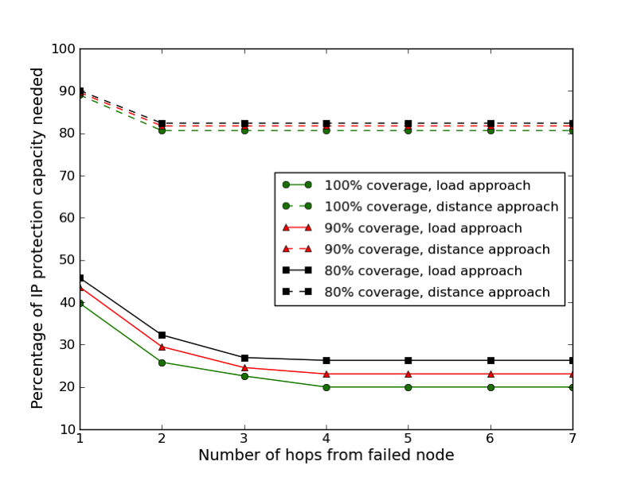
Nation-wide deployment case study
Ireland with all 1100 exchange buildings and DSL covrage
Ireland with 20 LR-PON core nodes
Reduce IP protection capacity by 80%
UK with 5600 exchange buildings and DSL covrage
UK with 75 LR-PON core nodes

Slide 13
HEAnet case study
Why a HEAnet case study?
To investigate the LR-PON architecture under diverse requirements and service scenario
Because fast and “unlimited Internet access” should be a primary concern in all education (not only third level)!
FTTS ➔ Fibre to the schools!

Slide 14
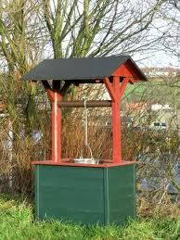

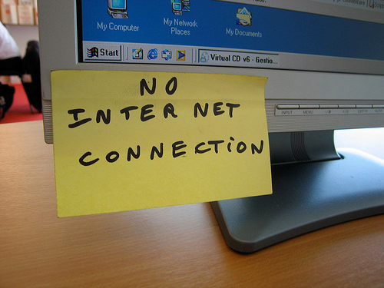
No Internet in Schools ☹…
No one would send kids to a school that hasn’t got a modern infrastructure for electricity and drinking water
In education, Internet connectivity is as important as water!

Slide 15



…vs Internet in schools ☺
Learning is based on sharing and exchanging information… from all over the planet
LR-PON can provide 10Gbps peak rate (or more) to every education facility

Slide 16
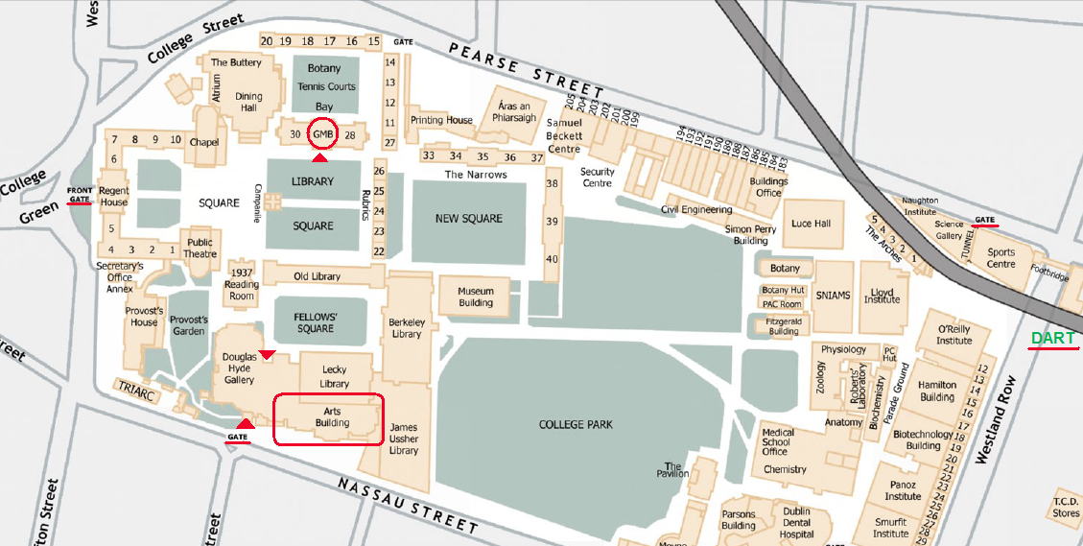
LR-PON for campus networks
The concept of LR-PON could also be used to bring fibre to the desktop economically
Serve 1,000 users with each passive network

Slide 17
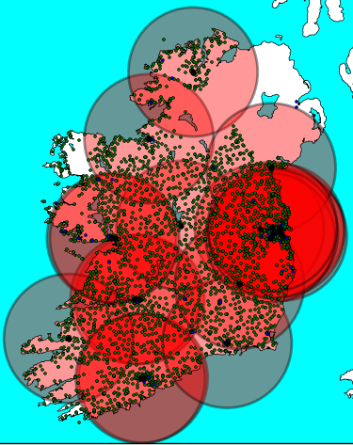
HEAnet investigation
Investigate whether a LR-PON solution could be successfully applied to a network like HEAnet
Try out deployment scenarios over different ownership models and tailor cost modeling
  HEAnet leasing fiber independently (build their own network infrastructure)
  HEAnet client of a nation-wide LR-PON based fibre network
Shape the scenario around current network infrastructure (dark fibre installation, cable ducts, access points,…)

Slide 18
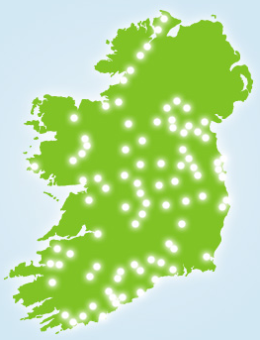
HEAnet case-study
Plenty of fibre available around the country

Slide 19
Conclusions
Next generation optical access will change the way we do business and operate
  It will provide us with more bandwidth and services
Once deployed in education institutes it will change the way we learn
But will require major network upgrades
  It is important to make the right design choices at the onset, to build a network that is evolvable and sustainable
In line with government policy for development of broadband in Ireland
“Next Generation Broadband, Gateway to a Knowledge Ireland”

