Slide 1
Epilepsy in children and adolescents with 22q11.2 Deletion Syndrome
Christopher Eaton, Rhys Thomas, Khalid Hamandi, Michael kerr, David Linden, Michael owen, Hayley moss, Hayley Moulding, Adam Cunningham, Ullrich Bartsch, Gareth Payne & marianne van den bree
7TH October 2017
Notes:
Introduction:
Name
Final year PhD student at Cardiff University
Today I’ll be talking about my project which looks at (read above)

Slide 2

ECHO study
Experiences of CHildren with cOpy number variants
150+!
Notes:
I work on the Experience of Childen with copy number variants (ECHO study) at Cardiff University. In ECHO, so far we’ve explored the physical, cognitive, social and psychiatric development of children with 22q11.2 Deletion Syndrome. I’m particular interested in seizures and epilepsy in young people with this syndrome. More specifically, I’m trying to better understand:
How common are seizures and epilepsy in 22q11.2DS?
What types of seizures do they experience?
What are the causes of their seizures?
What is the impact of seizures on their brain activity, their cognitive abilities and their mental health?

Slide 3
ECHO study
Experiences of CHildren with cOpy number variants
My project: Epilepsy and seizures in young people with 22q11.2DS
How common are seizures and epilepsy in 22q11.2DS?
What types of seizures do people with 22q11.2DS experience?
What are the causes of seizures in 22q11.2DS?
What is the impact of seizures on the brain activity and mental health of people with 22q11.2DS?
150+!
Notes:
I work on the Experience of Childen with copy number variants (ECHO study) at Cardiff University. In ECHO we’re interested in exploring the physical, cognitive, social and psychiatric development of children with 22q11.2 Deletion Syndrome. So far we’ve visited more than 150 children and adolescents with 22q. I’m particular interested in seizures and epilepsy in young people with this syndrome. More specifically, I’m trying to better understand:
How common are seizures and epilepsy in 22q11.2DS?
What types of seizures do they experience?
What are the causes of their seizures?
What is the impact of seizures on their brain activity, their cognitive abilities and their mental health?

Slide 4
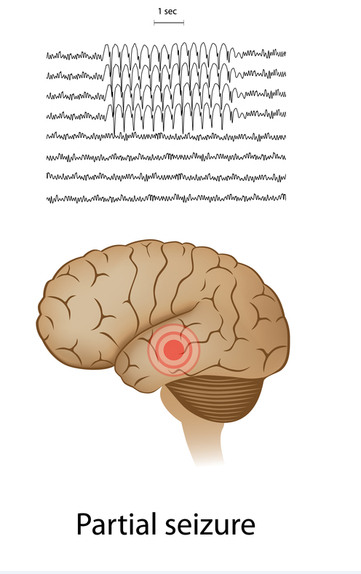
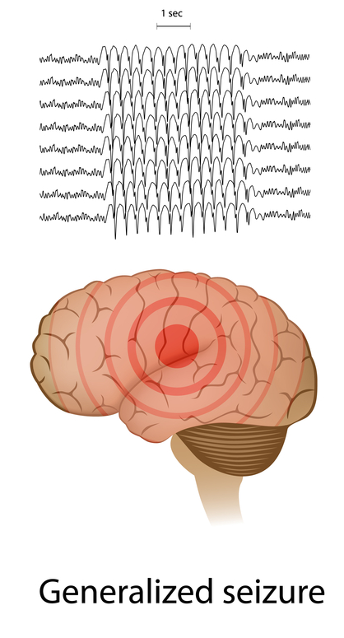
Seizures
A sudden burst of intense electrical activity:
In part of the brain:
Across all of the brain:
Notes:
Firstly, I’d like to briefly touch upon what seizures are is and the relationship between seizures and epilepsy
In a seizure, there is a sudden burst of intense electrical activity which can occur in part of the the brain or across the whole brain and this temporarily mixes-up the electrical and chemical messages the cells of the brain use to communicate with one another
The type of behaviours that you see in a seizure depend upon what area of the brain the abnormal electrical activity affects and what that area of the brain is usually responsible for doing.

Slide 5
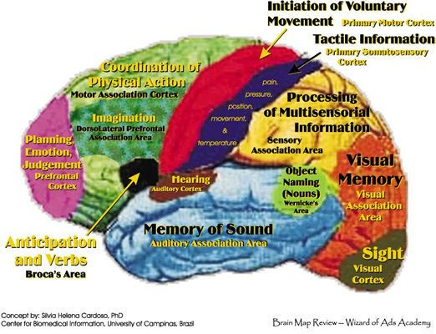
Seizures
A sudden burst of intense electrical activity:
The behaviours seen during a seizure depend on:
Which area of the brain is affected
What that area is normally responsible for:
In part of the brain:
Across all of the brain:
Notes:
Firstly, I’d like to briefly touch upon what a seizure is and the relationship between seizures and epilepsy
In a seizure, there is a sudden burst of intense electrical activity which can occur in part of the the brain or across the whole brain and which temporarily mixes-up the electrical and chemicals messages the cells of the brain use to communicate with one another
The type of behaviours that you see in a seizure depend upon what areas of the brain the abnormal electrical activity affects and what that area of the brain is usually responsible for doing.

Slide 6
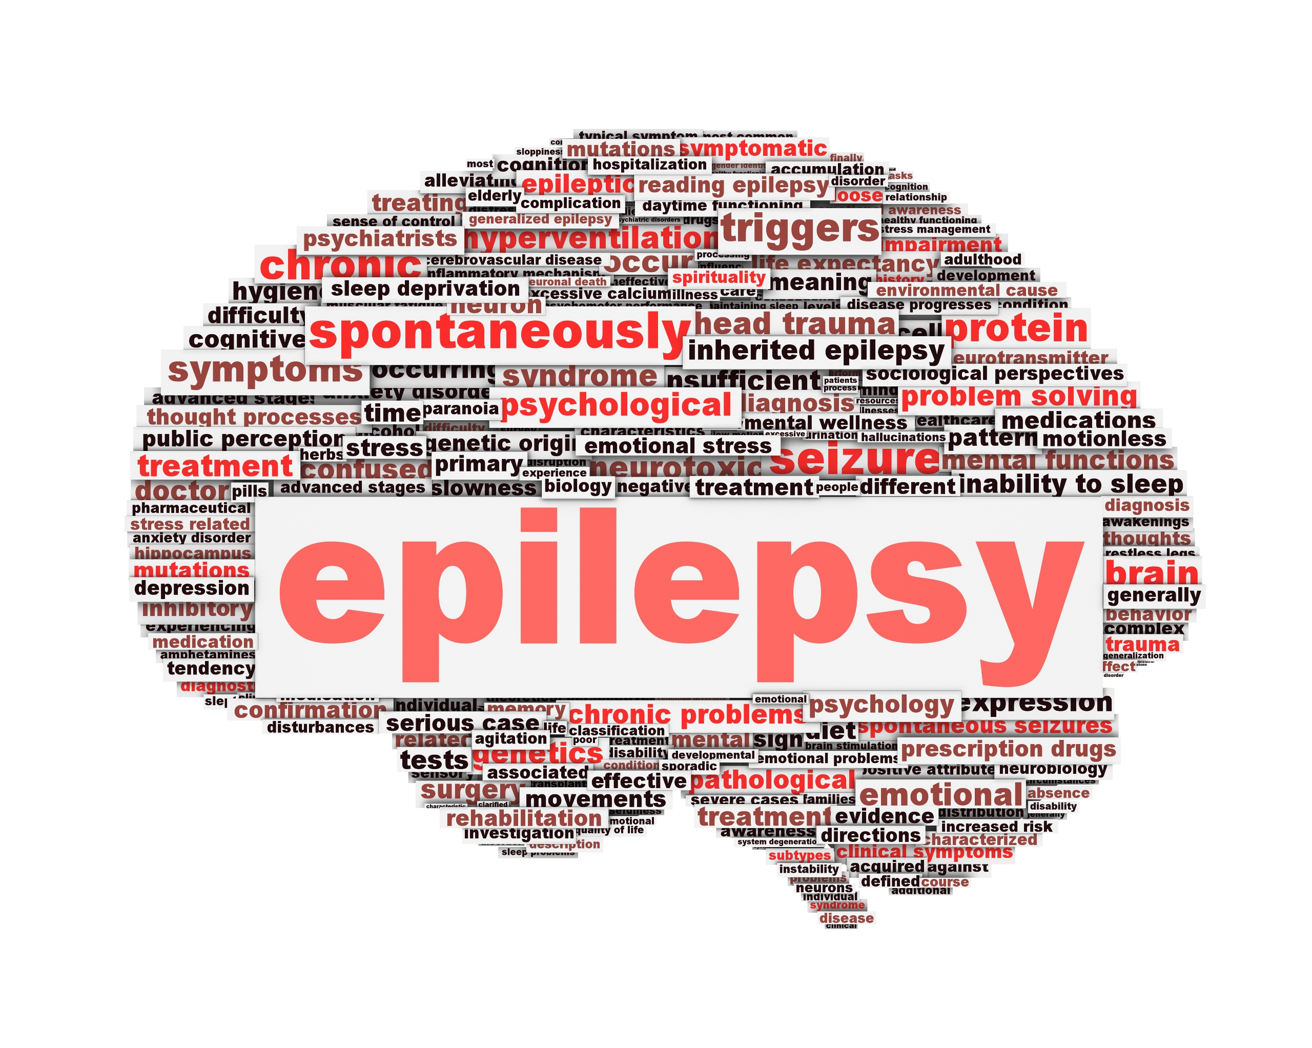
Epilepsy
Any of us can have a seizure, given the correct circumstances
  e.g. severely low blood sugar or calcium levels
Notes:
What then distinguishes a person that has had a seizure from a person who is given a diagnosis of epilepsy?
A key point to note is that anyone can have a one-off seizure, given the right circumstances, for example, if a person’s calcium or blood sugar levels become severely and dangerously low.
A person with epilepsy is different in that they have a long-term tendency to have recurrent seizures. This tendency to have seizures is caused by a difference in their brain. Sometimes this difference can be clearly identified by doctors, but other times it may be more subtle and may not be found.

Slide 7
Epilepsy
Any of us can have a seizure, given the correct circumstances
  e.g. severely low blood sugar or calcium levels
Epilepsy: a long-term tendency to have recurrent seizures
  Due to some underlying difference in the brain. This difference is sometimes clearly identifiable, in other cases it is unknown
Notes:
What then distinguishes a person that has had a seizure from a person who is given a diagnosis of epilepsy?
A key point to note is that anyone can have a one-off seizure, given the right circumstances, for example, if a person’s calcium or blood sugar levels become dangerously low.
A person with epilepsy is different in that they have a long-term tendency to have recurrent seizures which is caused by a difference in their brain. Sometimes this difference can be clearly identified by doctors (e.g. a tumour) but other times it may be more subtle and may not be found.

Slide 8
Epilepsy in 22q11.2 DS: previous studies
Hypocalcaemia: up to 75% of cases
Hypocalcaemia-induced seizures 10-15%
Notes:
What do we already know about seizures and epilepsy in 22q?
Hypocalcaemia (low levels of calcium in the bloodstream) occurs in up to 75% of people with 22q11.2DS. As I mentioned on the previous slide, having severely low levels of calcium can result in a seizure, and indeed between 10-15% of people with 22q have seizures caused by hypocalcaemia.
However, there is evidence to suggest that some people with 22q11.2DS have seizures that are not caused by hypocalcaemia or any other obvious external circumstances. Instead they have spontaneous, ‘unprovoked seizures’, which suggests they have an underlying difference in their brain leading to a tendency to have seizures. Researchers have looked at unprovoked seizures in 22q11.2DS and have diagnosed between 4-15% of people with 22q11.2DS with epilepsy, which is higher than the 1% rate of epilepsy that we see in the general population. So (read message above)
Researchers have also taken the opposite approach and have looked at how common 22q is in people with epilepsy. It was found that the 22q deletion was more common in people with epilepsy (3 in 1’000) than it was in people without epilepsy (0 in 5’000). So (read message above)

Slide 9
Epilepsy in 22q11.2 DS: previous studies
Hypocalcaemia: up to 75% of cases
Hypocalcaemia-induced seizures 10-15%
Epilepsy in 22q11.2DS: 4-15%
Epilepsy in the general population: 1%
Message: Epilepsy is more common in people with 22q11.2DS than in people without 22q11.2DS
Notes:
What do we already know about seizures and epilepsy in 22q?
Hypocalcaemia (low levels of calcium in the bloodstream) occurs in up to 75% of people with 22q11.2DS. As I mentioned on the previous slide, having severely low levels of calcium can result in a seizure, and indeed between 10-15% of people with 22q have seizures caused by hypocalcaemia.
However, there is evidence to suggest that some people with 22q11.2DS have seizures that are not caused by hypocalcaemia or any other obvious external circumstances. Instead they have spontaneous, ‘unprovoked seizures’, which suggests that they have some underlying difference in their brain causing these seizures. Researchers have investigated this further and have diagnosed between 4-15% of people with 22q11.2DS with epilepsy, which is higher than the 1% rate of epilepsy that we see in the general population.
Researchers have also taken the opposite approach and have looked at how common 22q is in people with epilepsy. It was found that the 22q deletion was more common in people with epilepsy (3 in 1’000) than it was in people without epilepsy (0 in 5’000). So (read message above)

Slide 10


Epilepsy in 22q11.2 DS: previous studies
Hypocalcaemia: up to 75% of cases
Hypocalcaemia-induced seizures 10-15%
Epilepsy in 22q11.2DS: 4-15%
22q11.2DS in people with epilepsy:
Epilepsy in the general population: 1%
22q11.2DS in people without epilepsy:
Message: Epilepsy is more common in people with 22q11.2DS than in people without 22q11.2DS
Message: 22q11.2DS is more common in people with epilepsy than in people without epilepsy
Notes:
What do we already know about seizures and epilepsy in 22q?
Hypocalcaemia (low levels of calcium in the bloodstream) occurs in up to 75% of people with 22q11.2DS. As I mentioned on the previous slide, having severely low levels of calcium can result in a seizure, and indeed between 10-15% of people with 22q have seizures caused by hypocalcaemia.
However, there is evidence to suggest that some people with 22q11.2DS have seizures that are not caused by hypocalcaemia or any other obvious external circumstances. Instead they have spontaneous, ‘unprovoked seizures’. Researchers have looked at unprovoked seizures in 22q11.2DS and have diagnosed between 4-15% of people with 22q11.2DS with epilepsy, which is higher than the 1% rate of epilepsy that we see in the general population.
Researchers have also taken the opposite approach and have found that the 22q deletion was more common in people with epilepsy (3 in 1’000) than it was in people without epilepsy (0 in 5’000).

Slide 11
Epilepsy in 22q11.2DS: previous studies
Increased risk of
Seizures shortly after birth
(hypocalcaemia-induced)
Learning difficulties
Notes:
Finally, some research has also been done looking at the impact of seizures on development in 22q11.2DS. A recent study provided evidence to suggest that people with 22q11.2DS who have hypocalcaemia-induced seizures shortly after birth may be at increased risk of developing more severe learning difficulties. Another study suggested that children with 22q11.2 who have epilepsy may have an increased risk of developmental delay (where a child does not reach developmental milestones (e.g. walking) at the expected age.

Slide 12
Epilepsy in 22q11.2DS: previous studies
Increased risk of
Seizures shortly after birth
(hypocalcaemia-induced)
Learning difficulties
Increased risk of
Epilepsy
Developmental delay
Notes:
Finally, some research has also been conducted looking at the impact of seizures on development in 22q11.2DS. A recent study provided evidence to suggest that people with 22q11.2DS who have hypocalcaemia-induced seizures shortly after birth may be at increased risk of developing more severe learning difficulties. Another study suggested that children with 22q11.2 who have epilepsy may have an increased risk of developmental delay (where a child does not reach developmental milestones (e.g. walking) at the expected age.

Slide 13

Epilepsy in 22q11.2DS: Limitations of previous research
Epilepsy in 22q11.2DS
4-15% - based off of review of medical records
What about young people with 22q11.2DS and epilepsy whose seizures have not yet been picked up by a doctor?
Notes:
We’ve seen then that previous research has shown that people with 22q11.2DS are at an increased risk of developing epilepsy and that having seizures or epilepsy may increase the risk of learning difficulties. This research is important, but it has its weaknesses. The first weakness is that the research suggesting that between 4-15% of people with 22q have epilepsy was based on reviews of their medical records. This method will identify people with 22q who have seen a doctor about their epilepsy, but it could miss young people with 22q who are having very brief, subtle seizures that haven’t yet been spotted. So perhaps previous work has under-estimated how common epilepsy is in 22q11.2DS.
Secondly, research examining the impact of epilepsy on development in 22q is just beginning and there are many areas not yet explored. For example, what is the impact of seizures on psychiatric health, sleep quality and motor function in 22q11.2 Deletion Syndrome?

Slide 14
Epilepsy in 22q11.2DS: Limitations of previous research
Epilepsy in 22q11.2DS
4-15% - based off of review of medical records
What about young people with 22q11.2DS and epilepsy whose seizures have not yet been picked up by a doctor?
Impact of epilepsy in 22q11.2DS
Seizure and epilepsy increase the risk of learning difficulties and developmental delay
What about the impact of seizures on mental health, sleep, motor functioning?
Notes:
We’ve seen then that previous research has shown that people with 22q11.2DS are at an increased risk of developing epilepsy and that having seizures or epilepsy may increase the risk of learning difficulties. This research is important, but it has its weaknesses. Firstly, the research suggesting that between 4-15% of people with 22q have epilepsy was based on reviews of their medical records. This approach will identify people with 22q who have seen a doctor about their epilepsy, but it could miss young people with 22q who are having very brief, subtle seizures that haven’t yet been spotted. So perhaps previous research has under-estimated how common epilepsy is in 22q11.2DS.
Secondly, research examining the impact of epilepsy on development in 22q is just beginning and there are many areas not yet explored. For example, what is the impact of seizures on mental health, sleep quality and motor ability in 22q11.2 Deletion Syndrome?

Slide 15
Aims of study
Systematically assess a group of young people with 22q11.2DS for evidence of seizures and epilepsy
Notes:
Our study then aims to meet families who have a child with 22q11.2DS and systematically assess whether that young person child has had seizures or epilepsy.
I also want to examine the impact of these seizures on a variety of different areas of development in 22q11.2DS, so that we have a good understanding of the spectrum of consequences that seizures can have

Slide 16
Aims of study
Systematically assess a group of young people with 22q11.2DS for evidence of seizures and epilepsy
Examine the impact that seizures have on development (e.g. IQ, mental health, motor functioning)
Notes:
My study then aims to meet families who have a child with 22q11.2DS and systematically assess whether their child has had seizures or epilepsy.
I also want to examine the impact of these seizures on a variety of different areas of development in 22q11.2DS, so that we have a good understanding of the spectrum of consequences that seizures can have

Slide 17
What have we done so far?
95 young people with 22q11.2DS (mean age=12 years) and 49 unaffected siblings (mean age=13 years)
Notes:
What have we done so far to address these aims?. We recruited 95 young people with 22q11.2DS and 49 of their unaffected siblings into our study- it is important we also assess their siblings so we can see how different young people with 22q are from people without the deletion.
We gave parents a questionnaire which screened for lifetime history of seizure-related events; so by this I mean whether child has had an epilepsy diagnosis, seizures and seizure symptoms. Seizure symptoms are behaviours that can occur with seizures, such as uncontrollable jerking movements of the body or frequent daydreaming or vacant episodes.
We also visited young people with 22q in their home and assessed their IQ, conducted psychiatric interviews with the parent and child and gave parents a questionnaire asking about their child’s motor ability (e.g. whether they can throw or catch a ball properly).

Slide 18
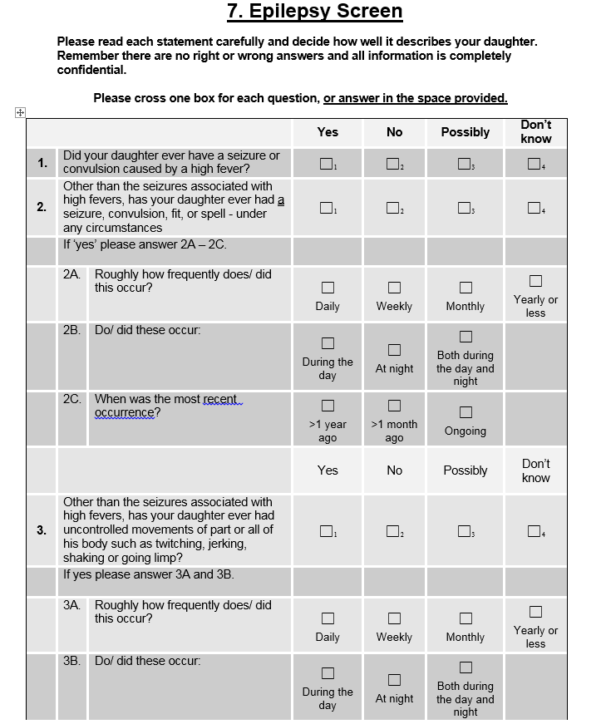

What have we done so far?
95 young people with 22q11.2DS (mean age=12 years) and 49 unaffected siblings (mean age=13 years)
Lifetime history of seizure-related events (epilepsy diagnosis, seizures and seizure symptoms)
Full-scale IQ
Psychiatric disorders
and sleep disturbance
Motor function
Notes:
What have we done so far to address these aims?. We recruited 95 young people with 22q11.2DS into our study. We also recruited 49 unaffected siblings into our study- it is important we also assess their siblings to get a sense of how different young people with 22q are from people without the deletion.
We gave parents a questionnaire which asked about whether their child had seizure-related events; so by this I mean whether they had had an epilepsy diagnosis, seizures and seizure symptoms. Seizure symptoms are behaviours which may occur with seizures, such as uncontrollable jerking or twitching movements of the body or frequent daydreaming or vacant episodes.
We also visited young people with 22q in their home and assessed their IQ, conducted psychiatric interviews with the parent and child and gave parents a questionnaire asking about their child’s motor ability (e.g. whether they can throw or catch a ball properly).

Slide 19
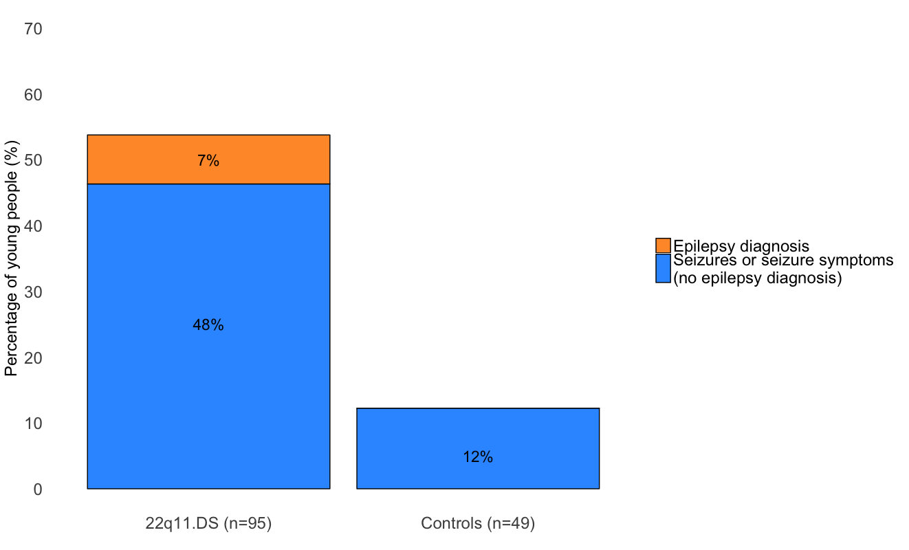
Findings (1)
Results from the Epilepsy Screen Questionnaire
Notes:
Here are the results of the epilepsy questionnaire. On the left we have a bar corresponding to children with 22q11.2DS and on the right we have a bar corresponding to their siblings. The vertical axis tells us the percentage of children who had a seizure-related event and the different colours tell us what kind of event they’ve had. The first point to take away from this graph is that the overall percentage of seizure-related events in children with 22q is much greater than in their siblings, in fact, children with 22q were 8 times more likely to have experienced a seizure-related event than their unaffected siblings.
Now if we focus on the bar for young people with 22q we can see in the yellow section that 7% had an epilepsy diagnosis at some point in their lives. However, we can see that the blue section is much larger. This blue section tells us that 48% of young people with 22q experienced a seizure or seizure symptom but had not been given an epilepsy diagnosis. Bear in mind that this is questionnaire data so we need to conduct more detailed investigations to determine whether these events are epileptic seizures. In particular, the seizure symptom questions are very broad questions that could be picking up on seizures, but instead could be picking up on other aspects of 22q, for example, frequent daydreaming (which the epilepsy questionnaire asks about) is a behaviour associated with learning disability or ADHD. However, at the very least, our findings suggest that there might be more seizure-related events in 22q than previously thought.

Slide 20
Findings (1)
Results from the Epilepsy Screen Questionnaire
Key points:
Young people with 22q11.2DS are 8 times more likely to have experienced a seizure-related event than their unaffected siblings
Notes:
Here are the results of the epilepsy screening questionnaire. On the left we have a bar corresponding to children with 22q11.2DS and on the right we have a bar corresponding to their siblings. The vertical axis tells us the percentage of children who had a seizure-related event and the different colours tell us what kind of event they’ve had. The first point to take away from this graph is that the overall percentage of seizure-related events in children with 22q is much greater than in their siblings, in fact, children with 22q were 8 times more likely to have experienced a seizure-related event than their unaffected siblings.
Now if we focus on the bar for young people with 22q we can see in the yellow section that 7% had an epilepsy diagnosis at some point in their lives. However, we can see that the blue section is much larger. This blue section tells us that 48% of young people with 22q experienced a seizure or seizure symptom but had not been given an epilepsy diagnosis. Bear in mind that this is questionnaire data so we need to conduct more detailed investigations to determine whether these events are epileptic seizures. In particular, the seizure symptom questions are very broad questions that could be picking up on seizures, but instead could be picking up on other aspects of 22q, for example, frequent daydreaming (which the epilepsy questionnaire asks about) is a behaviour associated with learning disability or ADHD. However, at the very least, our findings suggest that there might be more seizure-related events in 22q than previously thought.

Slide 21
Findings (1)
Results from the Epilepsy Screen Questionnaire
Key points:
Young people with 22q11.2DS are 8 times more likely to have experienced a seizure-related event than their unaffected siblings
Whilst 7% of young people with 22q11.2DS have an epilepsy diagnosis, a much greater proportion have had seizures or seizure symptoms in the absence of an epilepsy diagnosis
Notes:
Here are the results of the epilepsy screening questionnaire. On the left we have a bar corresponding to children with 22q11.2DS and on the right we have a bar corresponding to their siblings. On the vertical axis we have the percentage of children who had a particular feature from the Epilepsy Screening Questionnaire, and the different colours tells us which feature they had. The first point to take away from this graph is that the overall percentage of seizure-related events in children with 22q is much greater than in their siblings, in fact, children with 22q were 8 times more likely to have experienced a seizure-related event than their unaffected siblings.
Now if we focus on the bar for young people with 22q we can see in the yellow section that 7% had an epilepsy diagnosis. However, a much larger 48% of young people with 22q experienced a seizure or seizure symptom but had not been given an epilepsy diagnosis. Our findings suggest that there might be more seizure-related events in 22q than previously thought although bear in mind that this is questionnaire data so we need to conduct more detailed investigations to determine whether these events are epileptic seizures. In particular, the seizure symptom questions are very broad questions that could be picking up on seizures, but instead could possibly be picking up on the behaviours associated with learning disability and ADHD and autism that we see in 22q.

Slide 22
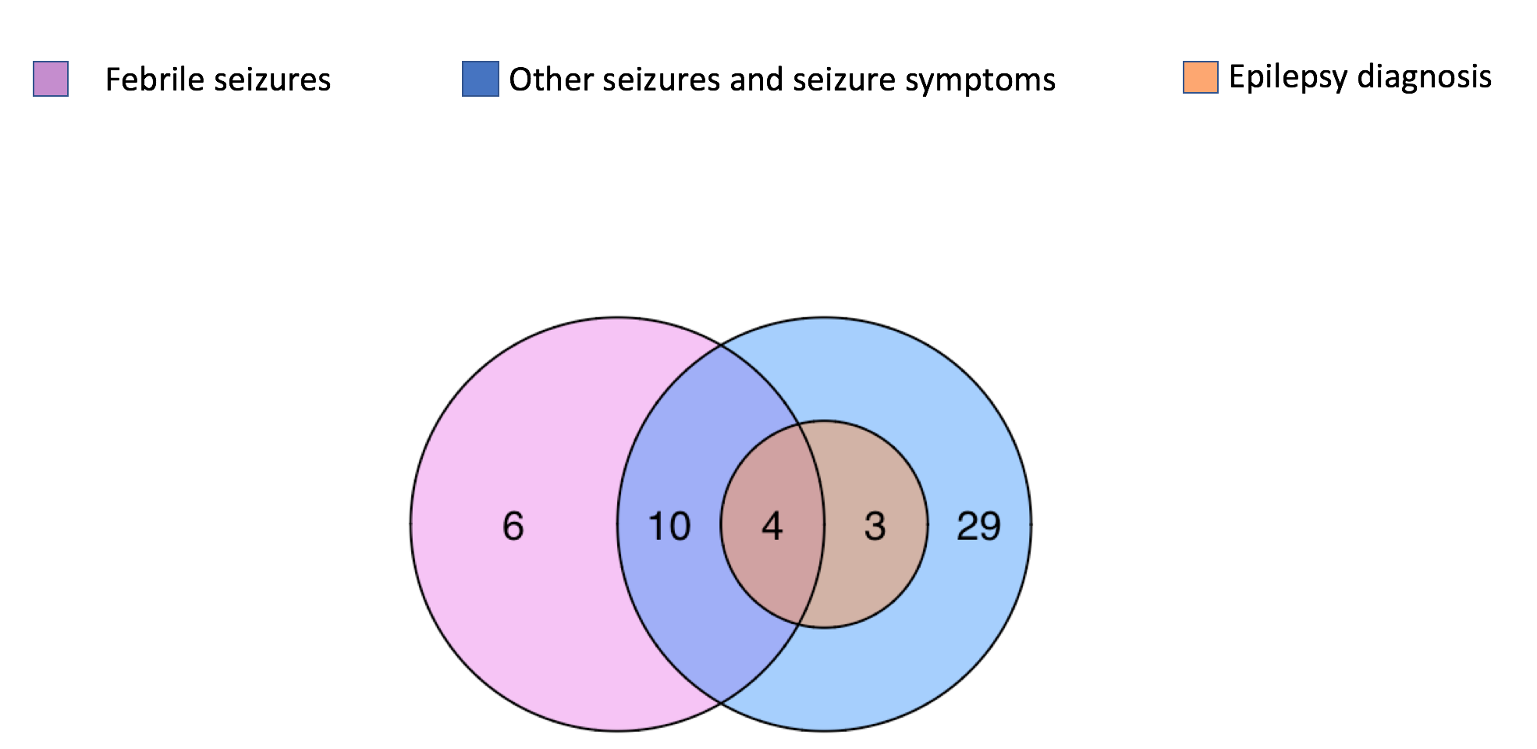
Findings (2)
Breaking down the responses of the Epilepsy Screen Questionnaire in 22q11.2DS
Notes:
On this slide we can see a Venn diagram that gives a more detailed breakdown of which seizure-related events parents told us their children with 22q had experienced.
The key points to take away here are that some young people with 22q have had an epilepsy diagnosis, some have had other seizures and seizure symptoms without an epilepsy diagnosis and some have had fever-related seizures, called febrile convulsuions. Some young people with 22q have had some or all of these events.
In particular, I want to highlight that we found that 21% of young people with 22q had experienced febrile convulsions, which is higher than in the general population, where the rate is about 4-8%

Slide 23
Findings (2)
Breaking down the responses of the Epilepsy Screen Questionnaire in 22q11.2DS
Key points:
Young people with 22q11.2DS can experience febrile seizures, other seizures, seizure symptoms and epilepsy
Notes:
On this slide we can see a Venn diagram that gives a more detailed breakdown of which seizure-related events parents told us their children with 22q had experienced.
The key points to take away here are that some young people with 22q have had an epilepsy diagnosis, some have had other seizures and seizure symptoms without an epilepsy diagnosis and some have had fever-related seizures, called febrile convulsuions. Some young people with 22q have had some or all of these events.
In particular, I want to highlight that we found that 21% of young people with 22q had experienced febrile convulsions, which is higher than in the general population, where the rate is about 4-8%

Slide 24
Findings (2)
Breaking down the responses of the Epilepsy Screen Questionnaire in 22q11.2DS
Key points:
Young people with 22q11.2DS can experience febrile seizures, other seizures, seizure symptoms and epilepsy
A notable proportion of our sample had experienced febrile seizures (21%)
Notes:
On this slide we can see a Venn diagram that gives a more detailed breakdown of which seizure-related events parents told us their children with 22q had experienced.
The key points to take away here are that some young people with 22q have had an epilepsy diagnosis, some have had other seizures and seizure symptoms without an epilepsy diagnosis and some have had fever-related seizures, called febrile convulsuions. Some young people with 22q have had some or all of these events.
In particular, I want to highlight that we found that 21% of young people with 22q had experienced febrile convulsions, which is higher than in the general population, where the rate is about 4-8%

Slide 25
Findings (3)
Behaviours suggestive of Autism Spectrum Disorder
3 times more likely to have
22q11.2DS with seizure-related events
4 times more likely to have
Behaviours suggestive of Developmental Coordination Disorder
Notes:
Finally, we found that young people with 22q11.2DS who had experienced at least one seizure related event were 3 times more likely to also show behaviours suggestive of Autism Spectrum Disorder and 4 times more likely to show behaviours suggestive of Developmental Coordination Disorder ( which is a disorder characterised by problems with controlling movement, such as handwriting, playing sports etc). It seems then that seizure-related events may be linked to some psychiatric and motor problems in 22q11.2DS

Slide 26
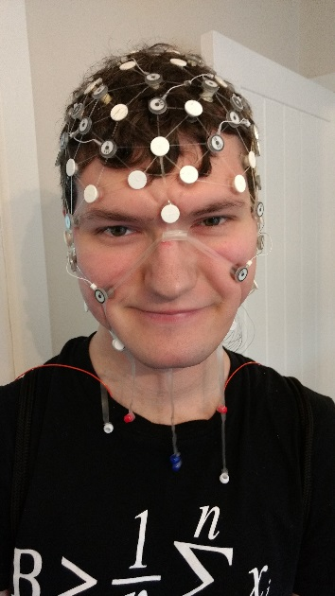
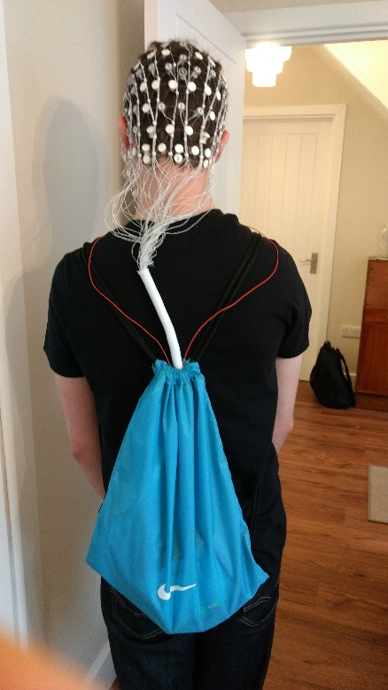

Current follow-up study
Measuring brain activity over 24 hours in the family home
Seizure interview with parent and child
Two-month seizure diary
Video-recordings of seizure-related events
Review of seizure-related medical records
Participant | Number
22q11.2DS | 32
Unaffected sibling | 16
EatonCB@cardiff.ac.uk
echo@cardiff.ac.uk
@ceaton1993
Notes:
As mentioned previously, it is important to that we follow-up these seizure-related events parents have told us about with a detailed investigation so that we can determine whether they are epileptic seizures.
What we’re doing then is travelling all of the UK and conducting a systematic epilepsy assessment with young people who have 22q and with their siblings. This involves (read list above, for EEG explain how this allows us detect patterns of brain activity which suggests a person may have or might be at risk of having epilepsy). So far, we’ve seen 32 young people with 22q11.2DS and 16 unaffected siblings. If you’d like to know more about the study or get involved, then you can email me here or echo study address, or follow me on twitter.

Slide 27
Potential impact
Raise awareness of the rate of seizures and epilepsy in 22q11.2DS
Raise awareness of the impact that seizures and epilepsy can have on development in 22q11.2DS
Notes:
I hope that my work can give us raise awareness of the rate of seizures and epilepsy in 22q11.2DS and provide us with a good understanding of the impact they have on development in 22q11.2DS. In doing so, it could be the case that doctors then monitor children with 22q11.2DS for seizures and epilepsy earlier on in these children’s lives. This could mean that seizures are treated earlier on in life and thus may have less of an impact on a child’s development

Slide 28
Potential impact
Raise awareness of the rate of seizures and epilepsy in 22q11.2DS
Raise awareness of the impact that seizures and epilepsy can have on development in 22q11.2DS
Epilepsy spotted earlier?
Epilepsy treated earlier?
Epilepsy has less of an impact on development?
Notes:
My work could have numerous outcomes. I hope that my work can give us raise awareness of the rate of seizures and epilepsy in 22q11.2DS and provide us with a good understanding of the impact they have on development in 22q11.2DS. In doing so, it could be the case that doctors then monitor children with 22q11.2DS for seizures and epilepsy earlier on in these children’s lives. This could mean that seizures are treated earlier on in life and thus may have less of an impact on a child’s development

Slide 29


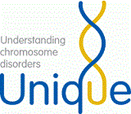




Acknowledgements
Professor Marianne van den Bree
Professor David Linden
Professor Sir Michael Owen
Dr Rhys Thomas
Dr Khalid Hamandi
Professor Jeremy Hall
Professor Liam Gray
Professor Mike Kerr
Dr Sarah Knott
Clinical Neurophysiology department at University Hospital of Wales
  Dr Gareth Payne
Dr Ullrich Bartsch (University of Bristol)
Professor Matt Jones
(University of Bristol)
The ECHO/IMAGINE team
ECHO study families
Notes:
Here are my acknowledgements, in particular I’d like to thank 22q11 Ireland for hosting this event, the charities MaxAppeal and 22q crew and most importantly, all of the families that have taken part in our research- without you this none of this would be possible! Thanks for listening.

