Slide 1



Fiona McNicholas
MD FRCPsych Dip Clin Psychother
Consultant at OLCHC & Lucena Clinic, Rathgar, Chair UCD
& Lorna Kerin
…………
8th Oct, 2017
‘One Stop Shop!’
Psycho-Educational Program for Parents PEEP
Building MH Resilience in Children, Young People with 22Q11DS and their Parents/Carers

Slide 2


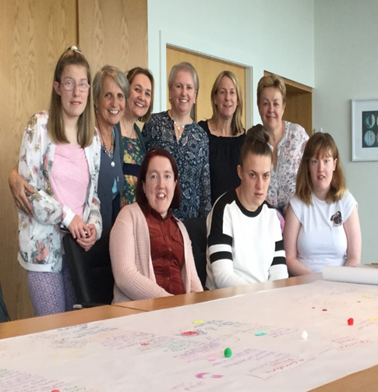
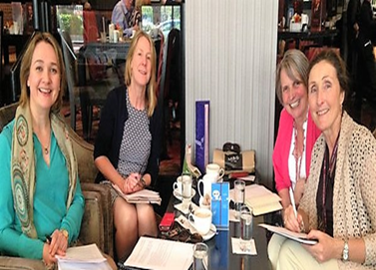


Disclosure Slide
Multi-Collaborative Effort

Slide 3

A Message For Every Day Of The Week
Mon: MH Matters
Tues: Three is a crowd
Weds: We Count
Thurs: Transitions
Fri: Family Focuss
Sat: Screening
Sun: STOP.

Slide 4
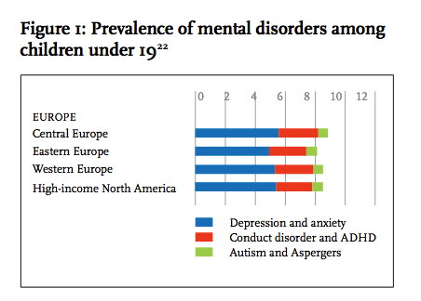
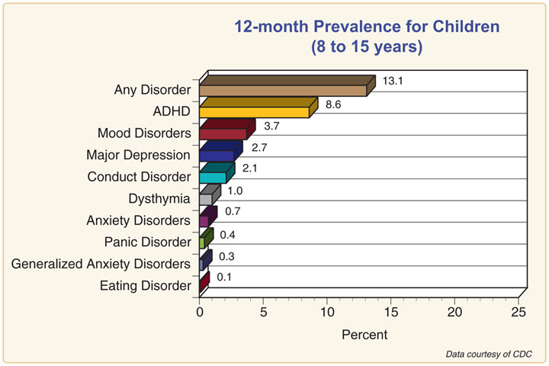

MH Matters

Slide 5
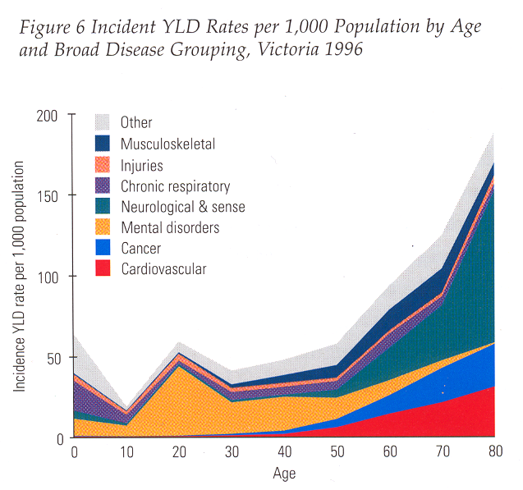
‘
Mental Disorders ‘The chronic disease of the young’ (Insel & Fenton 2005)
Persistent
A disproportionate impact on the most productive decades of life
  On education, health, family, society
Associated with significant morbidity & mortality

Slide 6
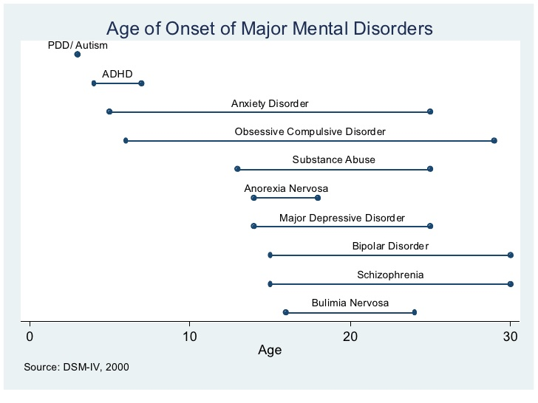
Start Early..
Dunedin Longitudinal Study, NZ (Silva 1996)
74% of total sample had a dx by age 18, 50% by age 15
USA National Study on N=9000 adults (Kessler et 2005)
50% by age 14, with median for anxiety and ADHD age 11
WHO MH Survey 17 countries N=85,000 (Kessler et 2007)
50% by mid teens and 75% by mid 20s.
WE NEED TO INTERVENE EARLY
THEY CONTINUE…

Slide 7
Three is a crowd!
The link with MH, physical illness and 22Q11DS
Rates of MH increased in presence of Physical illness.
  2X general
  5X if CNS involved
  22Q11DS a particular vulnerability
Comorbid IQ another risk
ADHD (35-55%)
Depression, OCD & anxiety disorders
Psychosis:
  Sub-threshold psychotic symptoms (28%)
  Schizophrenia (24%)
  Risk For SZ: (Murphy & Owen 2001)
    1.Being the child of two parents with schizophrenia
    2.Monozygotic co-twin of an affected individual
    3.22q11.2
Autism Spectrum Disorder (14-50%)

Slide 8
HOW…
Non specific-reaction to chronic illness
  Consequence of a series of negative life events, from investigation of symptoms, to diagnosis, treatment
  Enforced Lifestyle changes
Disease process affecting brain pathology
  Eg epilepsy, secondary lesions, brain injury
Treatment of physical illness
  Side effect medications
    eg steroids/ roacutane
  PTSD associated with medical/surgical procedures
    Feeding problems post intubation
22Q11DS
  Some psycho-pathology linked with genetic deletion

Slide 9
Varied and Multiple Impacts.
Impact on child:
  Age at diagnosis, eg epilepsy, IDDM
  Functional impairment (days off school, pain, physical limitations, level of dependence, QOL etc)
  Physical appearance
  Hope for recovery
Impact on family:
  Parental Responsibility for treatment
  Parents reaction to illness
  Relationships past and present
  Financial
  Blame and guilt if heritable
  Concern re future risks
Pre-existing biological, interpersonal or societal risk factors--- increased risk of negative psycho-social outcome. SOME MODIFIABLE

Slide 10
So, so far..
MH Matters: Need to intervene early.
22Q a risk group

Slide 11


We Count
Service-User Collaboration and Participation
Giving young people a Voice
YEEP Projects (LK/AL/FC/LC/Others)
Working with Parents Families through 22Q11 Association (AL/FC/LK)
PEEP

Slide 12
MH Matters: Need to intervene early.
22Q a risk group
No Say with out us. Develop services that meet their needs

Slide 13
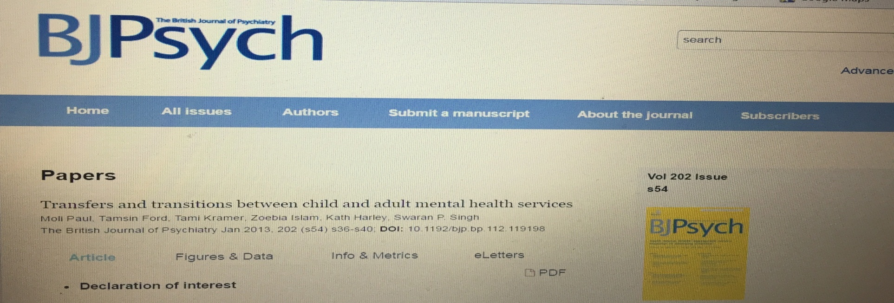

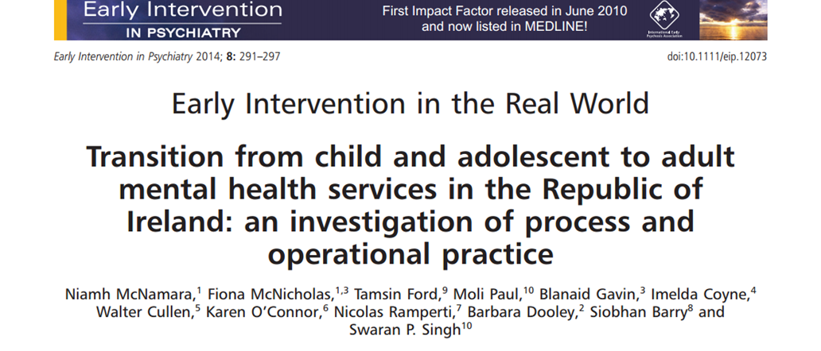
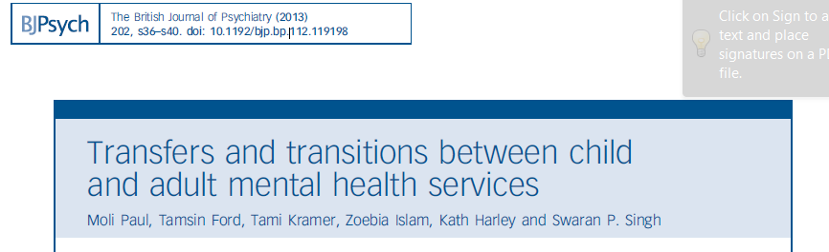

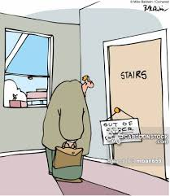
TRANSITIONS
Poorly understood

Slide 14

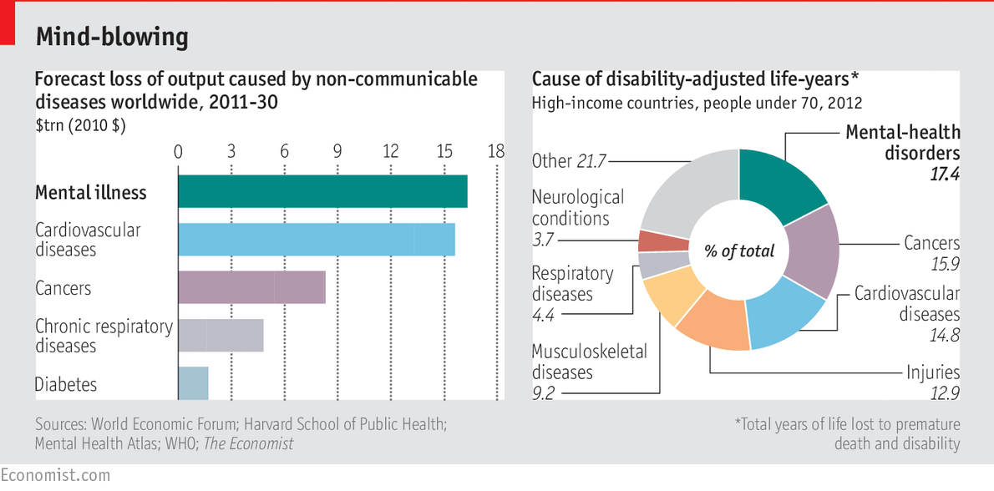

  The World Economic Forum
  (Bloom et al 2011)
  MH Leading cause of lifelong disability
Costs estimated to double within next 2 decades
  MI/CVS disease Principal threat GDP over next 2 decades

Slide 15
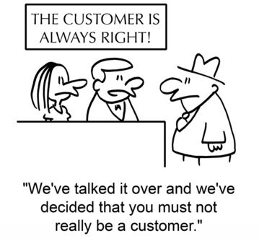

YEEP Inform us.
Many Transitions
Stressful
Changing Identities YP Parent
Need to plan
Qualatitive Study on Transitions
MH GAPS:
CAMHS AMHS
ID services

Slide 16
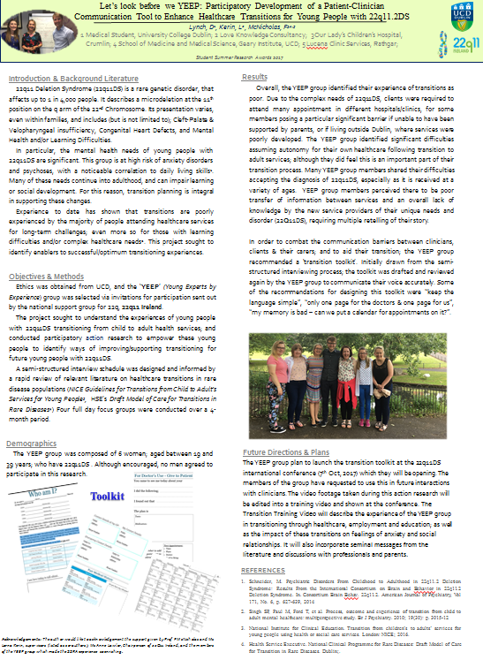
Awareness of Need to Transition YEEP-T
Ongoing need for Medical & MH services
Risk of falling through service gap
Transition tool developed
Need to extend 1 stop shop to adult medical and MH services

Slide 17
Mon, Tues, Weds, Thurs…
(Mon) MH Matters: Need to intervene early.
(Tues) 22Q a risk group
(Weds) No Say with out us. Develop services that meet their needs
(Thurs) Strengthen the weakest links: transitions

Slide 18
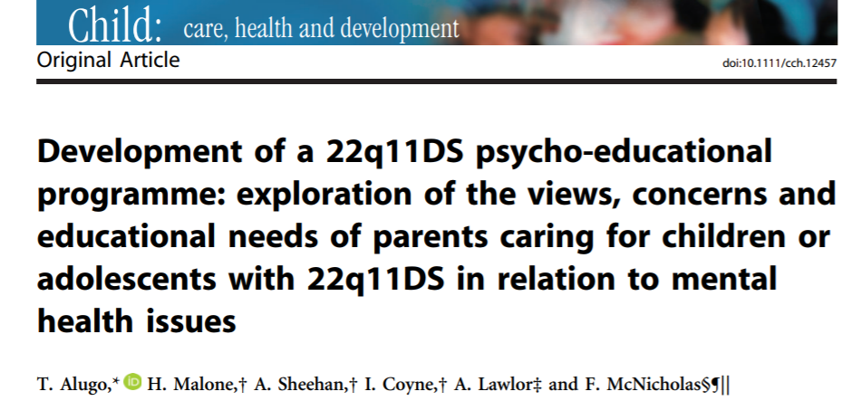

Family Psycho-Education MH Programme PEEP
Importance of Knowledge, fore warned is froe armed
FG to ascertain what parents want.
Fears of MI one of major concerns
SR literature: no programme exists

Slide 19
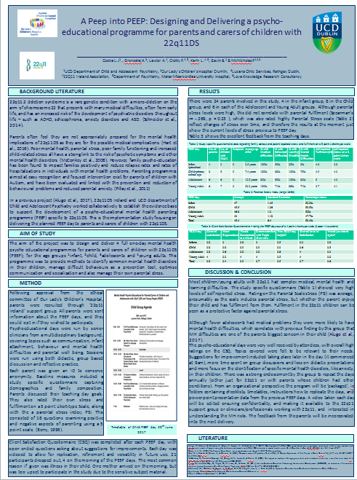
Delivery of PEEP
4 full one-day MH
Pre-school, child, adolescent and Young Adult
Topics:
  Common mental health disorders
  Parenting & Managing difficult behaviours
  Optimise communication and socialisation
  Manage their own parental stress
  Know where to go for help
Evaluation:
  N=24 attended
  Videoed for future use
  Well received
  Practical suggestions

Slide 20
MH Matters: Need to intervene early.
22Q a risk group
No Say with out us. Develop services that meet their needs
Strengthen the weakest links: transitions
Psycho education & parental well being key

Slide 21


Screening MH
Screening key developmental ages
Referrals from paediatricians/ genetics
Post assessment clinical cases referred to CAMHS
No clinical concern, advice, resources, plus return if necessary.

Slide 22



STOP (1 Stop or Joined Shopping)
Avoid the need for families to discover and navigate through all services
HRB Proposal for NPH MDT services (to include dedicated MH so that CL team can offer more continuous as opposed to consultation only service, as appropriate)
Learning from the Experts:
  Mtg with CHOP, London, Leuven, Connecticut
A lot Done, More to do!

Slide 23
End my section

Slide 24
For the younger age
Attachment and Bonding with your infant/child. Dr Aoife Twohig.
Coping with grief/ unexpected / disability. ?TBC
Developmental Milestones and how a parent can optimize this. Prof Eleanor Molloy.
‘How to communicate, and Optimizing communication’ ?SALT
Principles of parenting- with a focus on feeding, sleeping and developmental milestones optimization. ?TBC
Minding your (the parents) own MH. ?TBC.
In the primary school age,
A – Z of MH problems in this age group:
  ADHD, anx, OCD, behavior, ASD. Prof Fiona McNicholas
Managing Emotions & behaviors ?TBC or Prof Fiona McNicholas
Principles of parenting- moving towards temper tantrums, general behavior, ADHD type. ?TBC
Minding your (the parents) own MH. ?TBC.
? other area needed

Slide 25
Adolescent group
A – Z of MH problems in this age group:
depression, anx, eating disorders, psychosis, substances. FMcN
Understanding Emotions & Stress, and the adolescent Brain ?TBC or FMcN
Managing Emotions & DBT type skills. TBC?
Principles of parenting- moving towards more authoritative and democratic.. ?TBC
Minding your (the parents) own MH. ?TBC.
Transitioning to young adult group (? Just parents or parallel group with parents and YP)
A – Z of MH problems in this age group: Depression, anx, eating disorders, psychosis, substances. Prof Fiona McNicholas
Managing the change in identity linked with going from parent/carer to less involvement, letting go. ?TBC or Prof Fiona McNicholas
Managing Emotions & DBT type skills. TBC?
Minding your (the parents) own MH., Moving on, re-establishing relationship with spouse/ partner/ other SO. ?TBC.
?any other.

