Slide 1


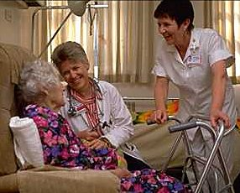

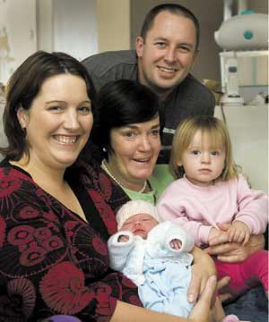
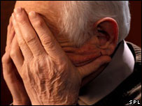
Determining the added value that a mixed method design gave within a large national evaluation study of specialist and advanced practice (SCAPE)
The value of mixed methods

Slide 2

Aim of presentation
To explore the added value of mixed method research (MMR), looking at why mix at all, the value of mixing, and using example from the SCAPE study to examine the added value that MMR gave.

Slide 3
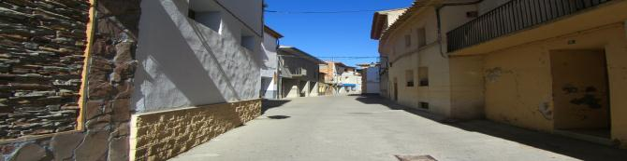
What is Mixed Methods
Tashakkori & Creswell (2009, pg 4) define mixed method research as:
“…. research in which the investigator collects and analyses data and integrates findings, and draws inferences using both qualitative and quantitative approaches or methods in a single study or programme of inquiry”

Slide 4
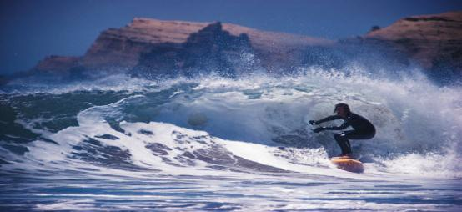
MMR must
Many MM studies are simply qualitative and
quantative studies and not MM at all
Mix qualitative and quantitative
Analyse the results together
Present results with the mix

Slide 5
Development of Mixed Methods
Creswell & Plano Clark (2011) identifies five stages in the evolution of mixed methods
The formative
The paradigm debate
The procedural development
The advocacy and expansion
The reflective period

Slide 6
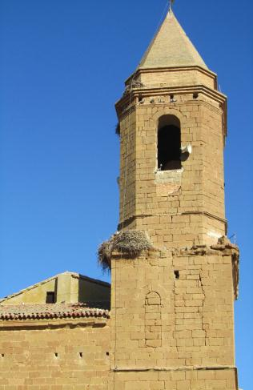
Designs
convergent parallel,
explanatory,
exploratory,
embedded.
Transformative
multi-phase

Slide 7

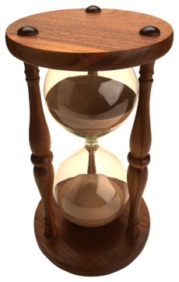
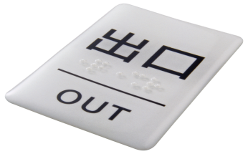
MM not easy
Need expert team
Take more time
Costly
Can be difficult to publish

Slide 8
Need to think
Purpose of using MMR
Creswell & Plano Clark (2011) outline the importance of articulating a purpose and recommend the use of a purpose statement so that the rationale for using MMR is explicit to those reviewing MMR papers.
So the purpose of this multi-phased study was to ……

Slide 9
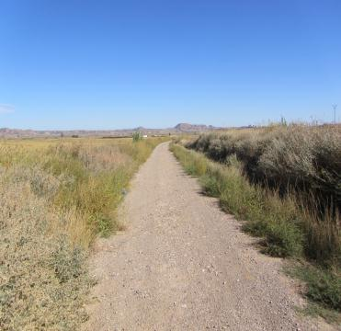
Why do it
The purpose of MMR for
Confirmation
Completeness
Initiation
Development
(Casey & Murphy, 2009, Doyle et al. 2009, Obwuegbuzie & Collins 2007, Streubert & Carpenter 1999, Shih et al. 1998, Begley 1996, Knafl & Breitmayer, 1991, Jick, 1979).

Slide 10
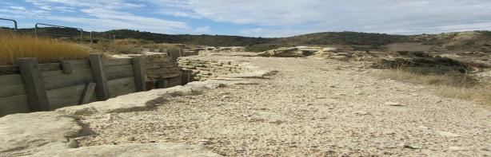
Controversies and Concerns
Should we do this
No side: Johnson et al. 2001, Kelly et al. 2000 Sim & Sharpe 1998, Heath 1998, Guba & Lincoln 1994, Blaikie 1991, Duffy 1985).
Yes side: Creswell 2007, Foss & Effefer 2002, Denzin 1978, Jick 1979),

Slide 11

Controversies and Concerns
Recent focus is on how to do mixed methods research:
Rigorously
articulating the added value of using MMR
(Maudsley 2011, Crewell & Plano Clark 2007).

Slide 12
VALUE ADDED
Building on the strengths and minimises weaknesses
Comprehensive and complete picture of phenonmena
Builds research capacity and Expertise
Convincing Results for funders and policy-makers

Slide 13


Value added in the SCAPE Study
School of Nursing and Midwifery,
National University of Ireland, Galway
School of Nursing and Midwifery,
Trinity College Dublin, University of Dublin
and

Slide 14
Aim
To produce a focused evaluation of the clinical services provided by clinical nurse and midwife specialists (CNS/CMS) and advanced nurse and midwife practitioners (ANP/AMP) in Ireland.

Slide 15

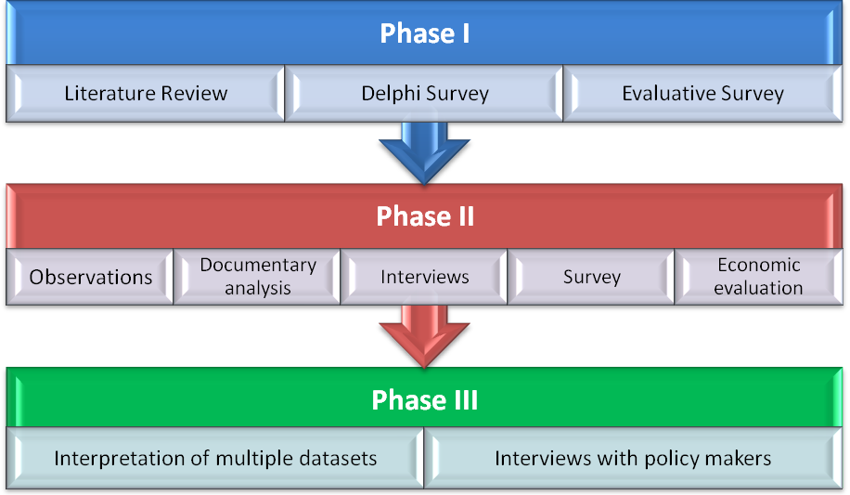
Methodology and Design

Slide 16
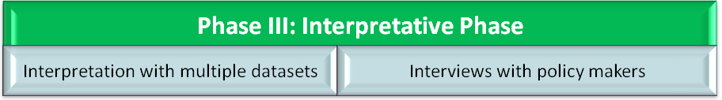

Slide 17
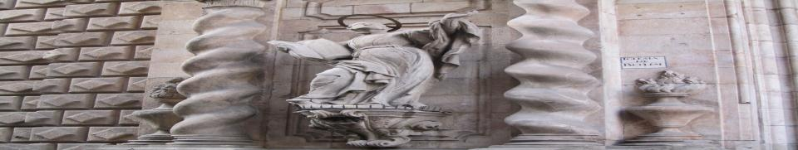
Building on the Strengths of single research designs and overcoming weaknesses
Phase 1:
Qualitative
Focus Groups used to inform DELPHI survey instrument
Quantitative
The DELPHI survey was then distributed to a representative sample of the population of CSs and APs, allowing results to be generalised
In phase 2, in-depth interviews with service users provided context and personal experience, while the concurrent survey of service users enabled us to generalise results to the service user population.
MMR enabled both in-depth identification and exploration of outcomes and the capacity to generalise results to the relevant population

Slide 18

P:
P: Comprehensive and complete picture of Phenomenon
The evidence in practice was gathered from field notes, non-participant observation of clinicians in practice, documentary evidence provided by clinicians, surveys and interviews with service users/family members/carers, managers and members of the multi-disciplinary team.
MMR enabled a complete picture to be constructed using qualitative and quantitative methods and this could only be done by comparing outcomes gathered in each approach.

Slide 19

E: Building research capacity and Expertise
Put together team and then structures enabled the SCAPE team, through sharing data, debate, discussion and joint analysis, to understand each other’s data sets in order to integrate them.
MMR helped expand research knowledge, collaboration.
Build the capacity to explore complex health issues in the future.

Slide 20

C: Convincing and powerful results for funders and policy-makers

Slide 21
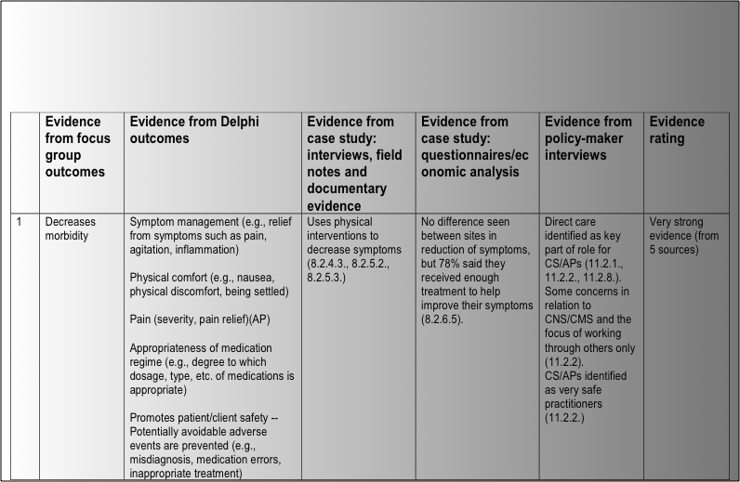

Slide 22

Does Value Added
MMR not easy
Need to plan
Expertise,
time and resources
Thinking about added value first useful because can ask is it worth it.

