Slide 1
The Sustainability of collecting EVERYTHING
Peter Dudley (Sub-Librarian, Reading Room Services & Space)
Christoph Schmidt-Supprian (Head of Content Management & Open Scholarship)

Slide 2


Slide 3

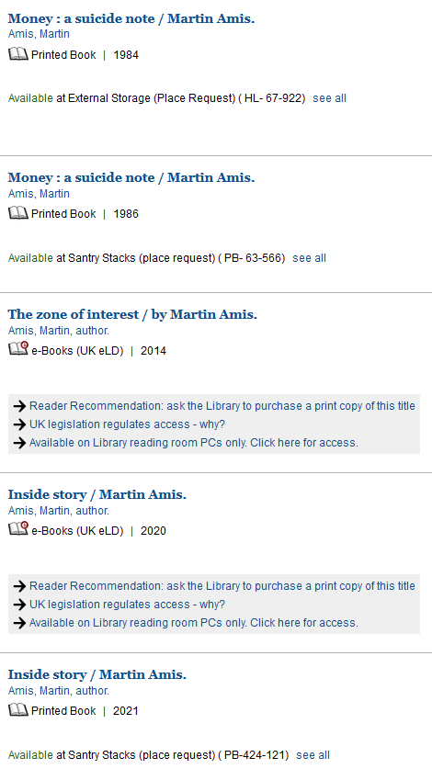


Slide 4
A brief history of UK legal deposit
The Industrial & Commercial Property (Protection) Act 1927 confirmed reciprocal legal deposit: Irish publishers continue to deposit with the 5 UK libraries, as well as with the National Library and with the Irish university libraries
Agreement extended to Cambridge University and Royal Library (later to become the British Library)
Act of Union + Copyright Act of 1801 made Trinity College Dublin a legal deposit library
1610
1710
1925
2013
1662
1801
1927
Agreement between Sir Thomas Bodley and the Stationers’ Company of London
Copyright Act 1710, the first copyright Act in the world. Gave 14 years of copyright protection
The current list of six UK legal deposit libraries has been in place since 1925 with the formation of the National Library of Scotland
The UK’s Legal Deposit Libraries (Non-Print Works) Regulations 2013, based on an enabling Act in 2003, started the transition from print to electronic deposit

Slide 5
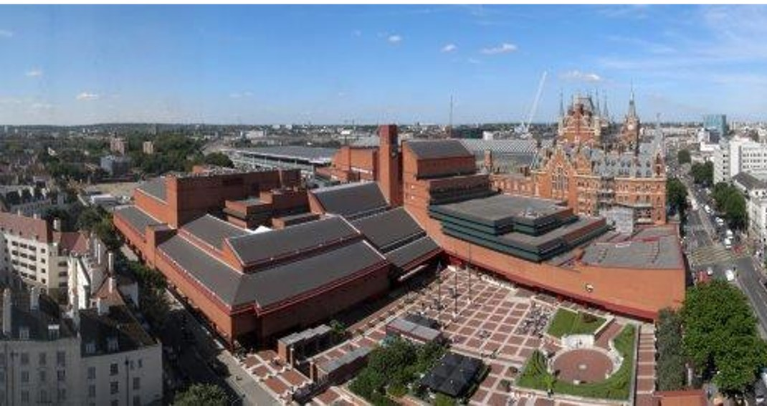
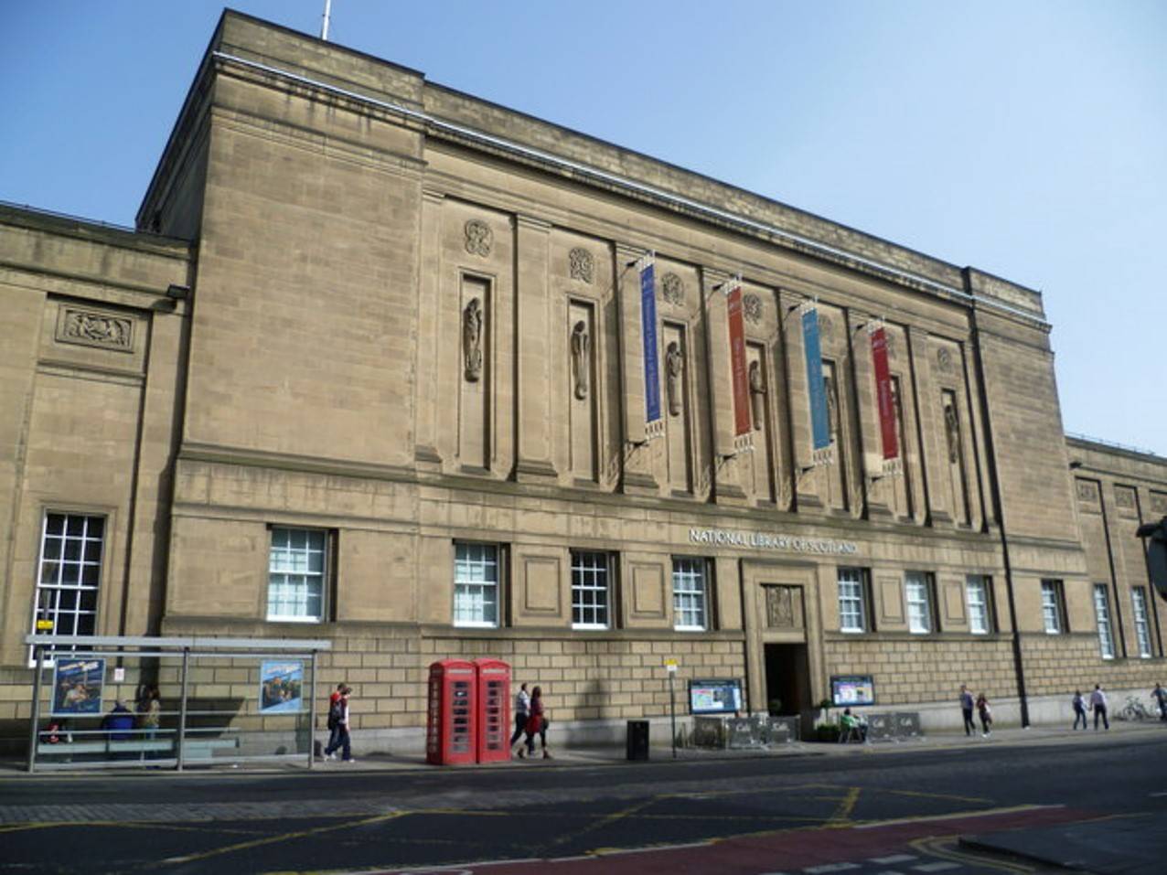




The Six UK & Ireland Legal Deposit Libraries
The British Library, with reading rooms in London and Yorkshire
The National Library of Scotland, in Edinburgh
The National Library of Wales, in Aberystwyth
Cambridge University Library
The Bodleian Libraries, University of Oxford
The Library of Trinity College Dublin

Slide 6
READER SERVICES
+ USER FORUM
JOINT COMMITTEE FOR LIBRARIES & PUBLISHERS
Department of Digital, Culture, Media & Sport (DCMS)
SUB-GROUPS: WEB ARCHIVE, EMERGING FORMATS ETC.
CHIEF LIBRARIANS + IMPLEMENTATION GROUP
COLLECTION DEVELOPMENT & ACQUISITION GROUP (CDAS)
INFRASTRUCTURE,
TECHNICAL + METADATA GROUPS
UK LEGAL DEPOSIT GOVERNANCE STRUCTURE

Slide 7

What is collected by legal deposit?
Legal Deposit is extremely broad in its application and aims to be comprehensive and inclusive. It applies to publishers of all sizes, from individual self-publishers and small presses, through to the largest multinational publishers.

Slide 8
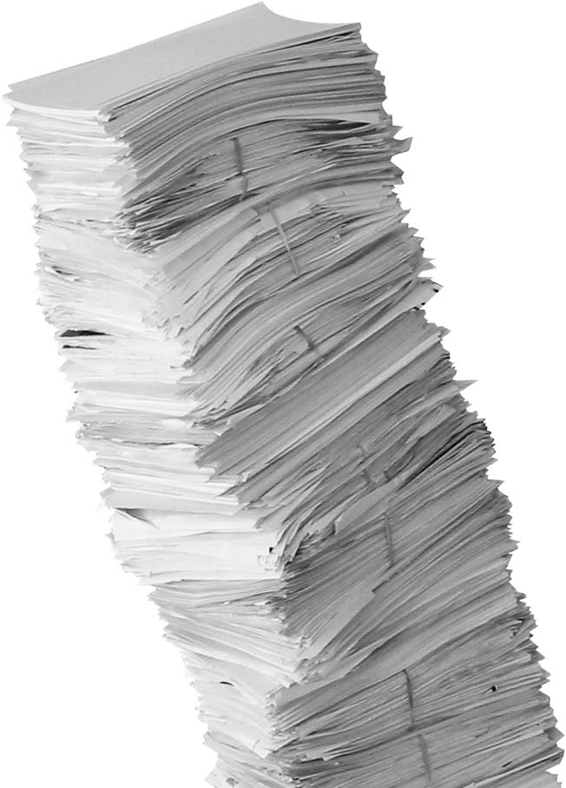
FOR PRINT PUBLICATIONS:
LEGAL DEPOSIT APPLIES TO:
Books, pamphlets, magazines, newspapers, journals
Sheet music
Maps, plans, charts, tables
DEPOSIT METHOD:
Publishers send one copy to the British Library
The other LDLs claim their copy via an Agency
Irish publishers also send to the eight Irish deposit libraries

Slide 9
Growth of Print Collections in Trinity
 | 2013/ 2014 | 2014/ 2015 | 2015/ 2016 | 2016/ 2017 | 2017/ 2018 | 2018/ 2019 | 2019/ 2020 | 2020/ 2021 | 2021/ 2022
Print Books | 96,112 | 93,747 | 73,889 | 62,371 | 57,908 | 57,841 | 33,299 | 25,018 | 55,069
Print Journals (current titles) | 15,547 | 14,038 | 11,243 | 9,657 | 7,254 | 6,813 | 5,633 | 5,500 | 5,155
Print Journal Issues | 67,756 | 55,480 | 39,697 | 34,486 | 30,132 | 29,591 | 18,369 | 30,431 | 20,852
TCD holds approx. 7 million volumes, of which 6 million (approx. 85%) were received under legal deposit

Slide 10

FOR DIGITAL PUBLICATIONS:
  Ebooks and ejournals
  Government publications and parliamentary papers
  Websites
  Born digital maps
  Music notation
  Innovative and complex digital publications (‘emerging formats’)

Slide 11

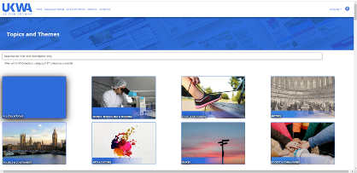

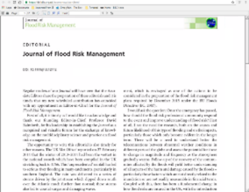

1.3 PB
Archived Web growing at 90TB per year
800K
eBooks
56K
Born digital music scores
3.3 TB
digital map datasets
>10 Million
eJournal articles
For context, YouTube
storage was 300 PB in 2022

Slide 12

The sustainability of legal deposit comes down to competing demands

Slide 13
CONSOLIDATE
(Maximise sustainability)
EXPAND
(Maximise value)
AMNESIA MEMORY
LIMIT ACCESS EXPAND ACCESS
FOCUS ON TRADITIONAL MEDIA EXPAND TO NEW MEDIA
TOLERATE PRESERVATION RISKS MINIMISE PRESERVATION RISKS
ENERGY, HARDWARE, TRANSPORT, STORAGE, STAFFING

Slide 14
memory vs amnesia

Slide 15

In 2007, the “Shaw Report” concluded that poor record keeping across institutions made investigations into institutional child abuse much more difficult.
Luckily, the National Library of Scotland was able to supply Civil Service Yearbooks to help establish who had responsibility for certain departments historically.

Slide 16
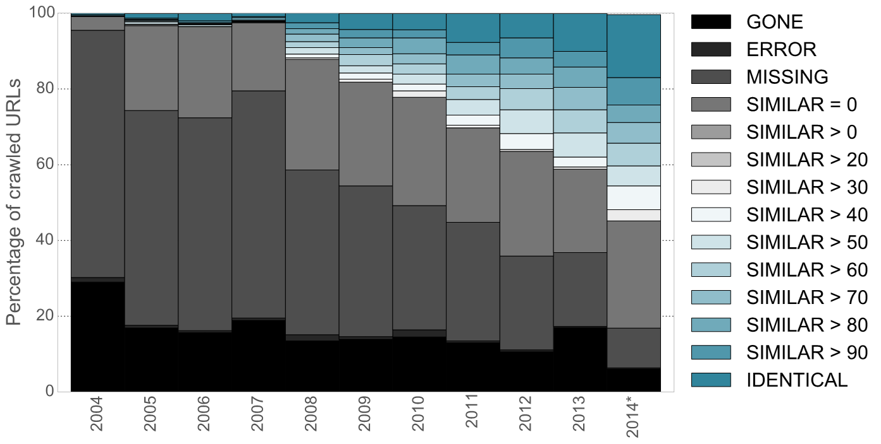
Transience: Evolution of the UK Web (2004-2014)
A.Jackson (2015), BL - Ten years of the UK web archive: what have we saved?

Slide 17
Traditional
vs new media

Slide 18







Slide 19
Preservation
risk averse vs risk tolerant

Slide 20
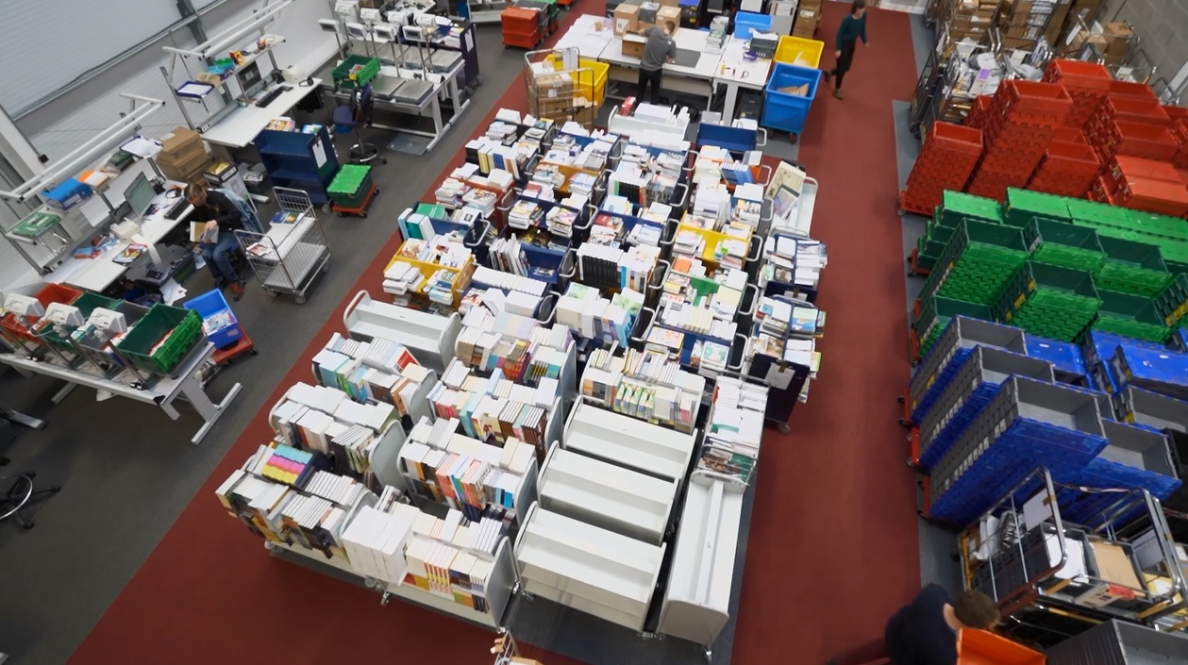
Agency for the Legal Deposit Libraries

Slide 21
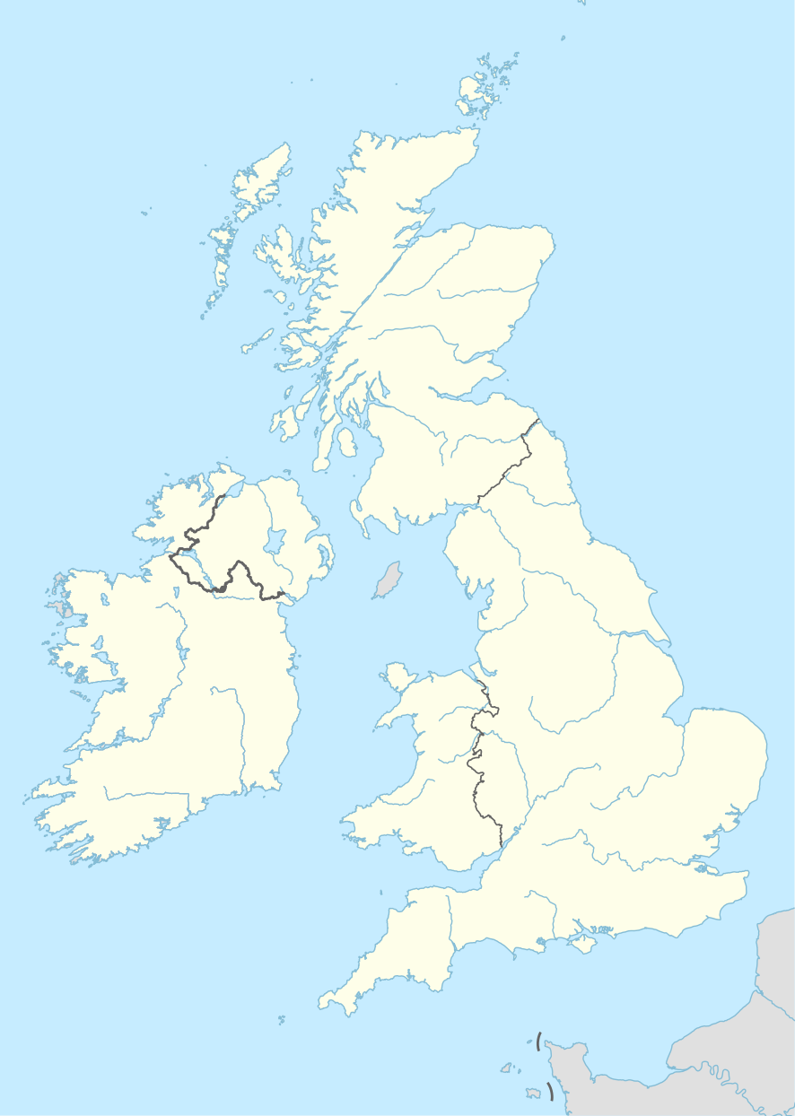

Digital Legal Deposit Infrastructure (Preservation)
4 NODES
British Library (London)
British Library (Boston Spa, Yorkshire)
National Library of Scotland (Edinburgh)
National Library of Wales (Aberystwyth)
PURPOSE OF NODES
Not discoverable on public internet
Secure storage
Preservation (4 copies, plus 4 back-ups)
Secure user access

Slide 22
Access
limit vs expand

Slide 23

Digital Legal Deposit Infrastructure
(Access)
9 ACCESS SITES (Reading Rooms)
British Library (London)
British Library (Boston Spa, Yorkshire)
National Library of Scotland (Edinburgh)
National Library of Scotland (Glasgow)
National Library of Wales (Aberystwyth)
National Library of Wales (Cardiff)
Bodleian Libraries (Oxford)
Cambridge University Library (Cambridge)
Library of Trinity College Dublin (Dublin)
IMPACT
Access servers, e.g. 4 in Dublin
Library terminals (no user-owned devices)
Readers must travel

Slide 24
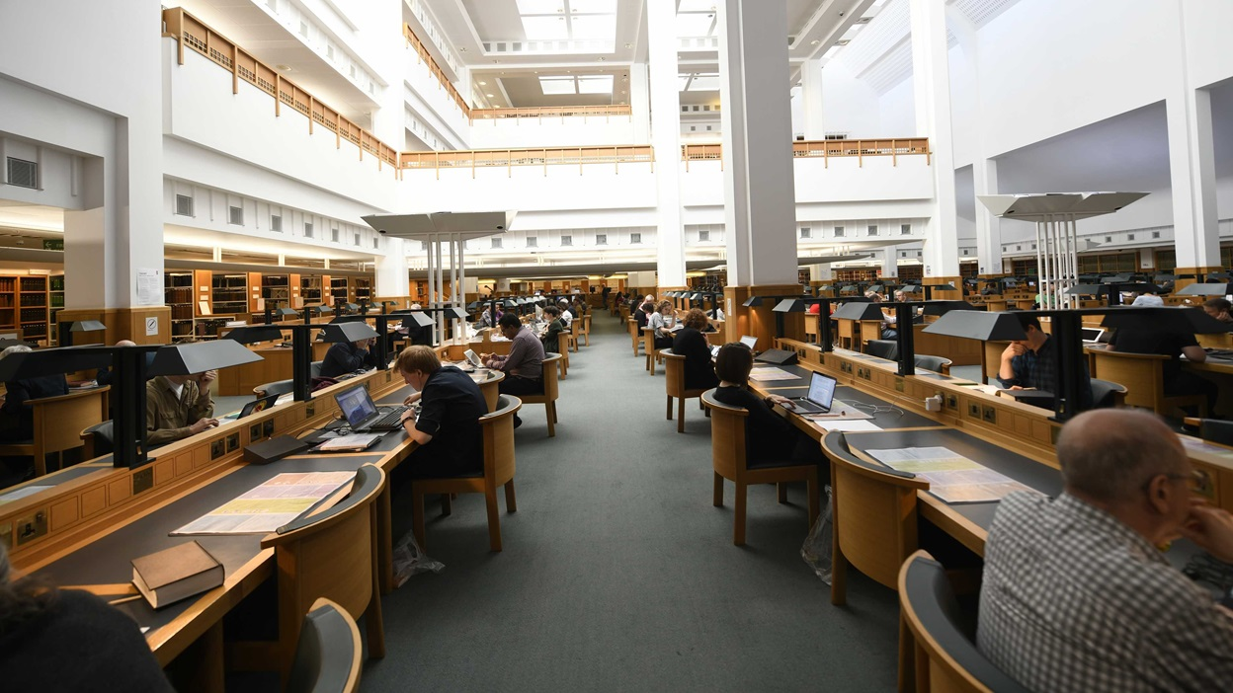
Reading… and borrowing…

