Slide 1
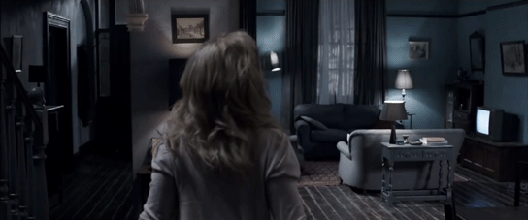
The Babadook, maternal Gothic and the ‘woman’s horror film’
Paula Quigley
Trinity College Dublin
Gothic Feminism: The Representation of the Gothic Heroine in Cinema Conference
University of Kent, 26-27 May 2016

Slide 2
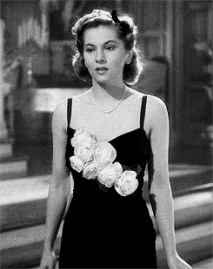
‘women’s horror films’
(Mark Jancovich)
‘concealed women’s films’
(David Greven)
‘maternal horror’
(Sarah Arnold)

Slide 3
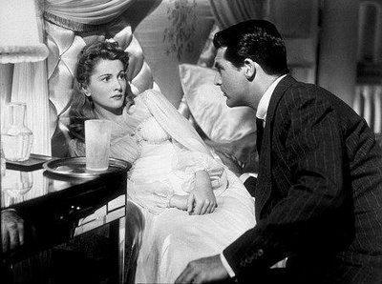
‘Gothic (or paranoid) woman’s films’
‘most involve a woman who feels threatened or tortured by a seemingly sadistic male authority figure, who is usually her husband’
(Mark Jancovich, 2013: 21)

Slide 4
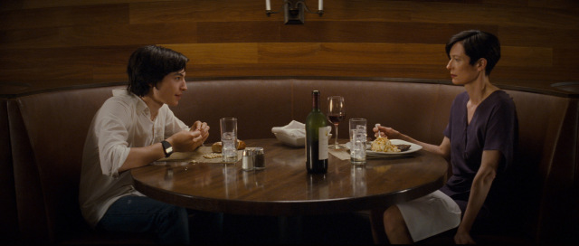
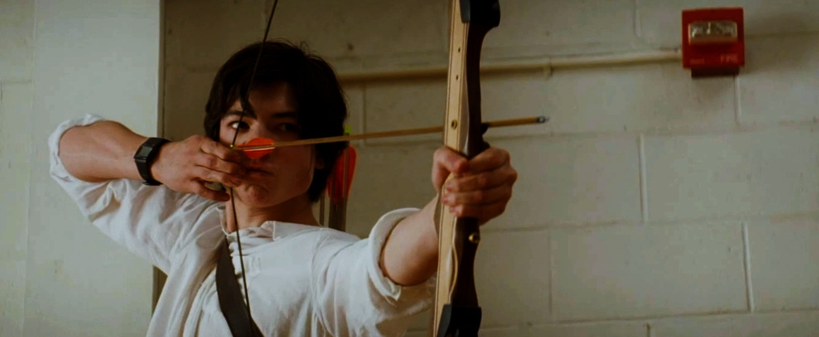
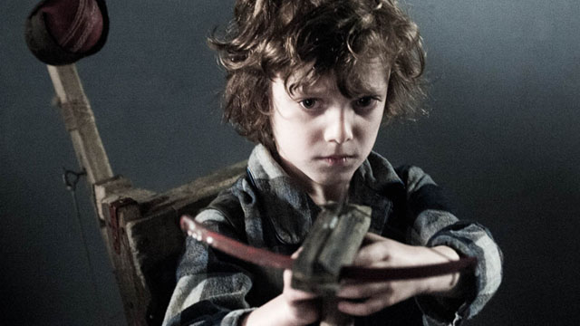
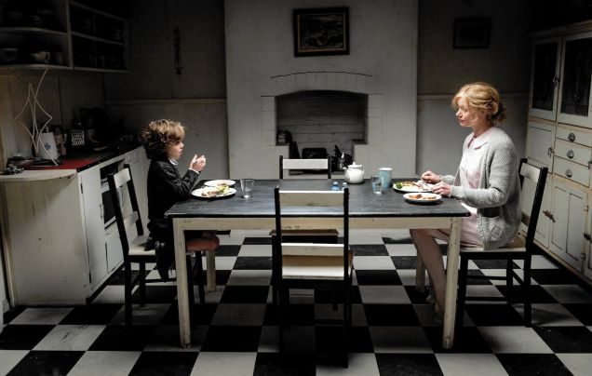
‘ … threatened or tortured by a seemingly sadistic male authority figure …’

Slide 5
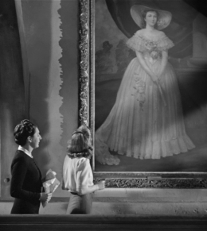
The ‘dead-undead mother’
‘the ongoing battle with a mirror image that is both self and other’
(Claire Kahane, 1985: 327).

Slide 6
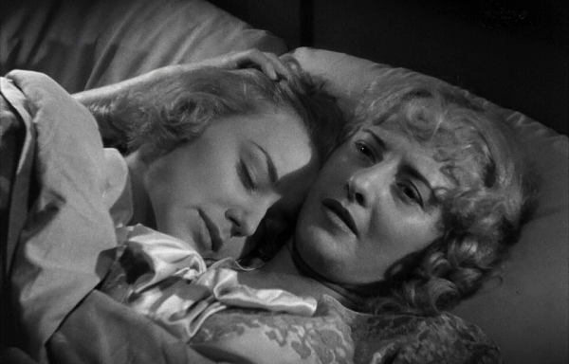
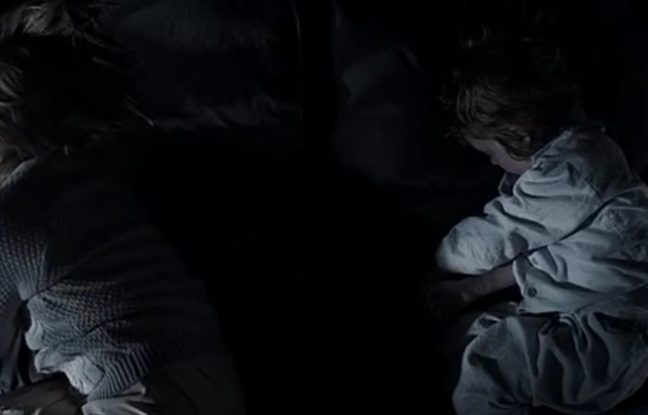
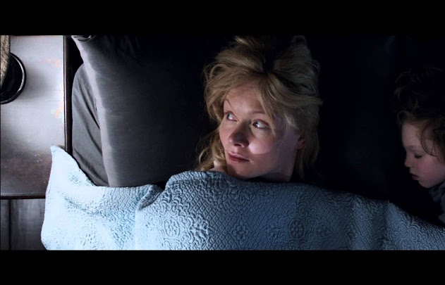
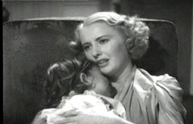

Slide 7
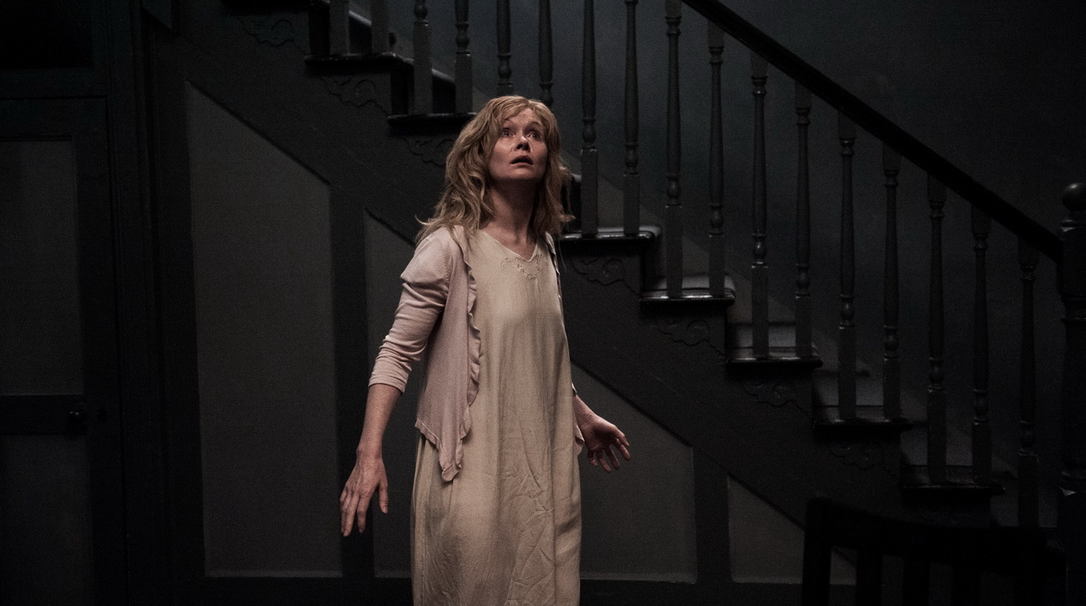
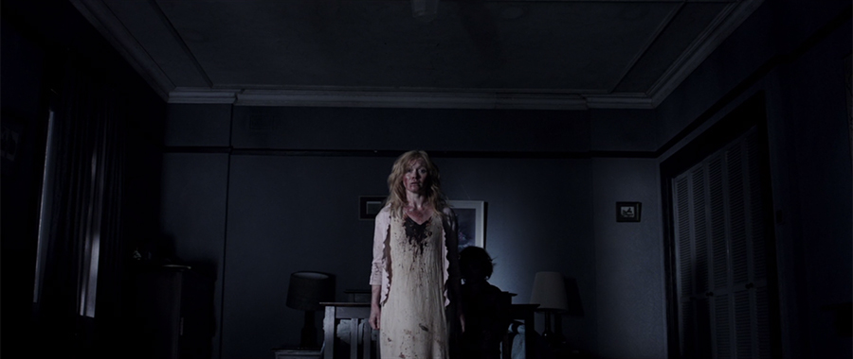
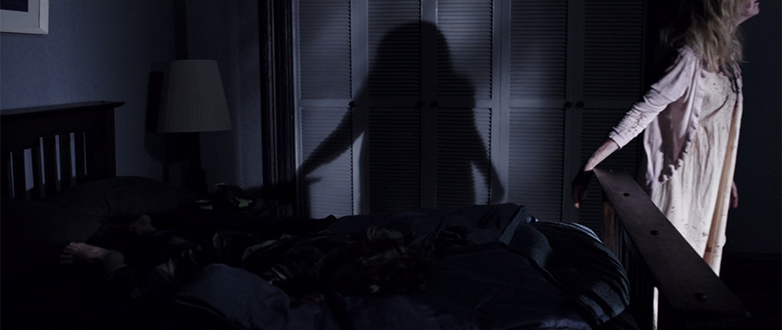
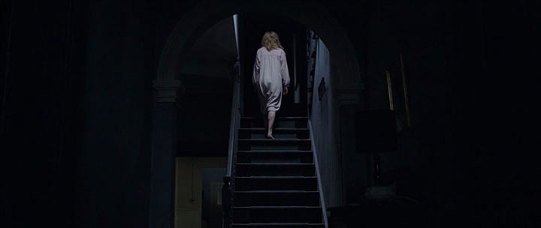
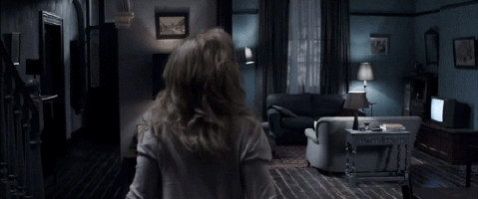
The (Gothic) house

Slide 8
‘Apart from We Need To Talk About Kevin, I can’t easily think of other examples [that address maternal ambivalence] and it’s the great unspoken thing. We’re all, as women, educated and conditioned to think that motherhood is an easy thing that just happens. But it’s not always the case.’
(Jennifer Kent)

Slide 9
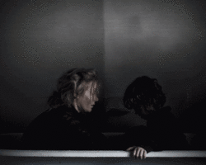
‘Even when she goes to some really dark places, I still tried to keep it within her point of view as much as possible, so that people would not sit back with their arms folded and judge her, but they’d actually travel through that experience with her.’
(Jennifer Kent)

Slide 10
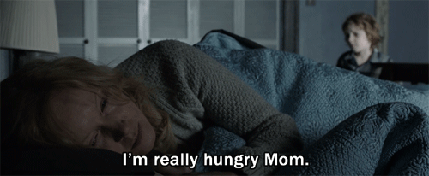
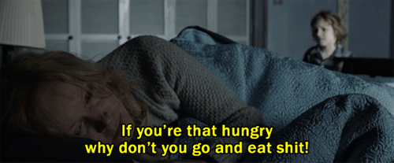

Slide 11
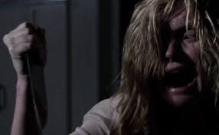
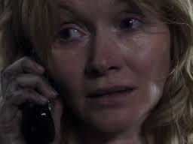
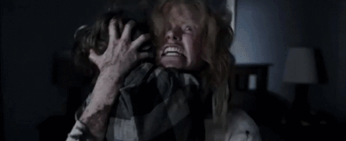

Slide 12
‘The Good Mother is rarely […] a powerful agent within the patriarchal family and the maternal horror film struggles to find an alternative position from which she can speak’
(Sarah Arnold, 2013: 37).

Slide 13


